Slide 1
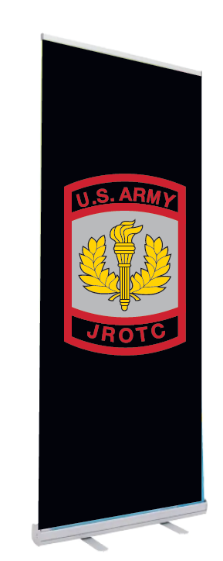
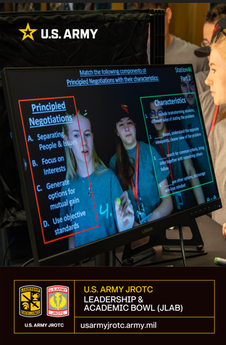
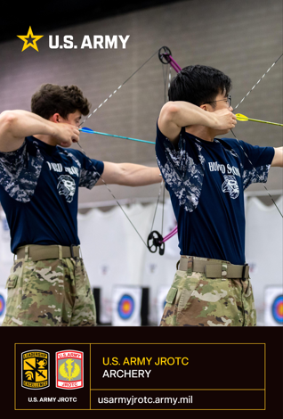
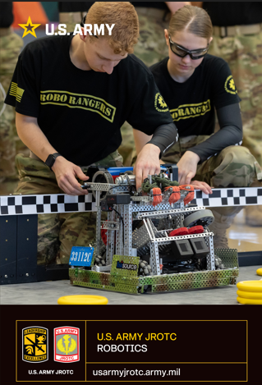
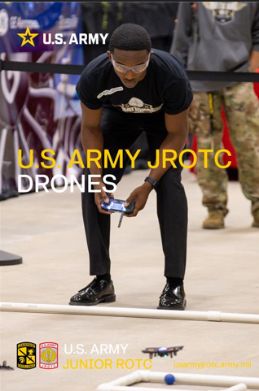
Army JROTC School Outreach Package
Pull-Up Banners
Each JROTC Program can choose 2 images:
  Cyber
  Archery
  Robotics
  JLAB
  Raider

Slide 2
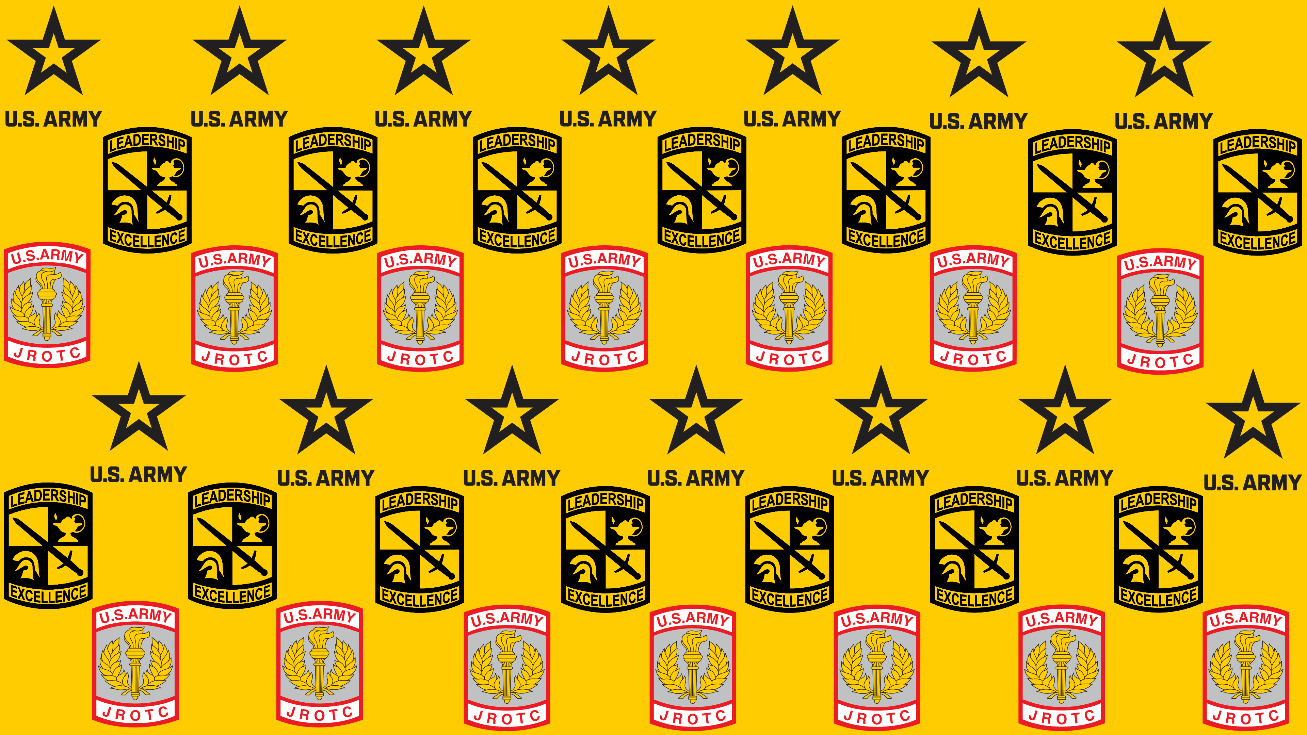

Army JROTC School Outreach Package
Backdrop
Each JROTC Program will get one 5 x 7 ft with standard JROTC image
Table Skirt
Each JROTC Program will get one 6ft table skirt with standard JROTC image

