Slide 1
USAREC OVERVIEW/ARMY BENEFITS
JROTC
16 April 2025

Slide 2
Purpose
The purpose of this brief is to provide a general understanding of Army benefits, along with basic knowledge of operations within USAREC.

Slide 3









Recruiting Stakeholders
US Army Recruiting Command Supports
Supports US Army Recruiting Command
US Army Recruiting Command
The Surgeon General
Human Resources Command
US Army Special Operations Command
Military Entrance Processing Command
Direct Support
Office of the Chief of Army Reserve
Corps of Engineers
Army Enterprise Marketing Office
US Army Recruiting
Division
US Army Cadet Command
Key Stakeholders
Secretary of the Army
Chief of Staff of the Army
Sergeant Major of the Army
Assistant Secretary of the Army for Manpower & Reserve Affairs
Army G1 (Personnel)
Directorate of Manpower and Personnel Management
Army Chief of Chaplains

Slide 4
Recruiting Boundaries
5 Enlisted Recruiting Brigades
1 Medical Recruiting Brigade
1 Marketing & Engagement Brigade
OCONUS
Alaska | Japan
Hawaii | American Samoa
Puerto Rico | South Korea
Virgin Islands | Guam
Germany
1ST MRB BN
9A1
9A2
9A3
9A4
MDW
Boston
NCY
Pittsburgh
9E
Marketing & Engagement Bde
9A
2ND MRB BN
9B1
9B2
9B3
Atlanta
Nashville
Orlando
7A Mission Support Bn (Ft Knox, KY)
7A3 Outreach Company (Ft Knox, KY)
7B Parachute Team (Ft Bragg, NC)
7C Marksmanship Unit (Ft Benning, GA)
9C
9D
3RD MRB BN
9C1
9C2
9C3
Minneapolis
Chicago
Columbus
9B
5TH MRB BN
9D1
9D2
9D3
San Antonio
Kansas City
Houston
1st Bde
2nd Bde
3rd Bde
5th Bde
6th Bde
Medical Bde
1A
1B
1D
1E
1G
1K
1N
1O
Albany
Baltimore
New England
Harrisburg
New York City
Mid-Atlantic
Syracuse
Richmond
3A
3D
3E
3G
3H
3J
3N
3T
Atlanta
Columbia
Jacksonville
Miami
Montgomery
Raleigh
Tampa
Baton Rouge
5A
5C
5D
5H
5I
5J
5K
5N
Chicago
Cleveland
Columbus
Indianapolis
Great Lakes
Milwaukee
Minneapolis
Nashville
4C
4D
4E
4G
4J
4K
4P
Dallas
Denver
Houston
Kansas City
Oklahoma City
San Antonio
Phoenix
6F
6H
6I
6J
6K
6L
6N
Los Angeles
Portland
NorCal
Salt Lake City
Southern Cal
Seattle
CentCal
9A
9B
9C
9D
9E
9O
1ST MR Bn (Ft Meade, MD)
2nd MR Bn (Redstone, AL)
3rd MR Bn (Ft Knox, KY)
5th MR Bn (Ft Sam Houston, TX)
6th MR Bn (Las Vegas, NV)
SORB MR Bn (Ft Bragg, NC)

Slide 5



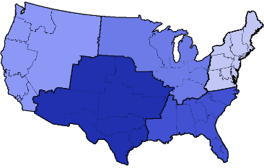







How USAREC Works
Make Appt w/ Prospect
Army Interview
ASVAB
Test
Army Reserve Referrals
ASVAB
Test Pass
Military Entrance
Processing Command
Physical
Packet
Build / 2807 & SF86 / background check / medical pre-screen
Conduct
Mental
Basic Combat Training / One Station Unit Training
Advanced Individual Training (AIT)
Return to TPU
Basic Combat Training / One Station Unit Training
Advanced Individual Training (AIT)
Ship to First Unit of Assignment
First Unit Of Assignment
Losses
+/- 1.2K

Slide 6
Benefits
Thrift Savings Plan (TSP)
The Thrift Savings Plan (TSP) is a Federal Government-sponsored retirement savings and investment plan. It offers the same type of savings and tax benefits that many private corporations offer their employees under "401(k)" plans.
• Potential sign-on bonus
• Earn a salary while learning a skill
• Medical and dental coverage
• Earn college credits for their MOS
• Retire young with a pension
• 30 days- paid vacation per year
Blended Retirement System (BRS) Members of the Uniformed Services If you are a member of the uniformed services who began serving on or after January 1, 2018, your service automatically enrolled you in the TSP (or will) once you had served 60 days . 3% of your basic pay is deducted from your paycheck each pay period and deposited in the traditional balance of your TSP account, unless you have made an election to change or stop your contributions. You can make an election by following the instructions in Starting, Changing, and Stopping Your Contributions.

Slide 7
Blended Retirement System
The BRS combines elements of the legacy retirement system with benefits similar to those offered in many private-sector 401(k) plans.
Eligibility:
If you enter the Uniformed Services on or after Jan. 1, 2018, you are automatically enrolled in the BRS. This is your retirement plan.
Defined Benefit:
Benefit vesting- 20 years of service (YOS).
Benefit multiplier-2.0%.
Benefit working age annuity- Active duty: Choice of full annuity or lump sum option (50% or 25%) at retirement; National Guard/Reserve: Lump sum based on annuity at age 60 (or earlier with creditable active service).
Benefit retirement age- Active duty: At 20 or more YOS; National Guard/ Reserve: After 20 or more qualifying YOS and age 60 (or earlier with creditable active service).
Benefit cost-of-living adjustment (COLA)- Full COLA.
Benefit disability retired pay- Disability rating (minimum 30%) capped at 75% or 2.0% multiplier.

Slide 8
BRS Contribution
Defined contribution:
DoD contribution rate- 1% automatic, plus up to 4% matching (Max=5%).
DoD contribution rate YOS-1% automatic: Begins at 60 days of service through 26 YOS Matching: Starts after two YOS and continues through 26 YOS.
Enrollment- Automatic for members entering service on or after Jan. 1, 2018; automatic re-enrollment every January if member zeros out contributions.
Contribution member contribution rate-3% automatic; full DoD match requires 5% contribution; default to Traditional TSP account, Lifecycle (L) Fund.
Contribution vesting - Always vested in Service member contributions, DoD matching and any earnings. Vested in Service Automatic (1%) Contribution and any earning after two years in service.
Contribution forfeit of DoD contributions- If you leave service before two years, you forfeit the Service Automatic (1%) Contribution and any of their earnings.

Slide 9
BRS Continuation Pay/Lump Sum
Continuation Pay:
Continuation pay Continuation pay multiplier (months of basic pay)- Active duty (including AGR and FTS): Between 2.5 and 13 times monthly basic pay. National Guard/Reserve: Between 0.5 and 6 times monthly basic pay (as if on active duty).
Continuation pay commitment- Any member who elects to receive continuation pay will incur an additional service obligation of not less than three years, as determined by the member’s Service.
Continuation pay eligibility-Eligible for continuation pay when complete between eight, but no more than 12 YOS, calculated from Pay Entry Base Date (PEBD)
Lump sum:
Lump sum options- May choose a lump sum of either 25% or 50% of the discounted present value of future retirement payments, in exchange for reduced monthly retired pay, until full Social Security retirement age, which for most is age 67.
Lump sum election- Active duty: Lump sum election must be made no less than 90 days before retirement. National Guard/Reserve: No less than 90 days before receipt of retired pay.
Lump sum eligibility-Active duty: At retirement after 20 or more YOS. National Guard/Reserve: Upon becoming eligible to begin receiving retired pay at age 60 (or earlier with creditable active service).
*Members who opt into BRS receive Service Matching Contributions immediately regardless of YOS.
**The multiplier. This is the percentage of your basic pay that you receive for each year of service. Defined benefit under the BRS: 2.0% x years served x the average of your highest 36 months of basic pay.

Slide 10
College Loan Repayment Program (LRP)
Regular Army: Active Duty
The Loan Repayment Program (LRP) is a special incentive that the Army offers to highly qualified applicants entering the Army. Under the LRP, the Army will repay part of a Soldier's qualifying student loans. Only specified Military Occupational Specialties (MOSs) qualify for the LRP.
Eligibility
Enlisting Active-duty Soldiers are eligible for the Loan Repayment Program if they meet the following conditions:
Soldier must agree to a term of service of three years or more
Soldier must decline enrollment in the Montgomery GI Bill in writing, using DD Form 2366
Soldier must have Loan Repayment Program guaranteed in writing in the enlistment contract
Soldier must be a non-prior service accession
Soldier must have a high school diploma and a score of 50 or higher on the Armed Forces Qualification Test (AFQT)
Soldier must enlist in one of the critical MOSs that qualifies for the program (Local Army recruiters have the current list, which changes quarterly)
Loans must be made, insured, or guaranteed prior to entry on active duty

Slide 11
College Loan Repayment Program (LRP)
Regular Army: Active Duty
Benefit Highlights
The Army will repay 33 1/3% of the outstanding principal balance, less taxes of the Soldier's student loans annually or $1,500, whichever is greater, after each year of service (up to $65,000, less taxes) up to three years total. Loan must not be in default before entering active duty, and during the repayment process.
Loans that qualify for repayment:
Any loan made, insured, or guaranteed under the Federal Family Education Loan Program, part B of title IV of the Higher Education Act of 1965 (20 U.S.C. 1071 et seq.)
Any loan made under the William D. Ford Federal Direct Loan Program, part D of title IV of the Higher Education Act of 1965 (20 U.S.C. 1087a et seq.)
Any loan made under Federal Perkins Loans part E of title IV of the Higher Education Act of 1965 (20 U.S.C. 1087aa et seq.); or
Any loan incurred for educational purposes made by a lender that is -
an agency or instrumentality of a State
a financial or credit institution (including an insurance company) that is subject to examination and supervision by an agency of the United States or any State
from a pension fund or a non-profit private entity (subject to case-by-case review)
This includes:
Parent Loans for Undergraduate Students (PLUS) (only loans incurred for use of individual contracting for the LRP)
Supplemental Loans for Students (SLS)
Stafford Loans
Perkins Loans
William D. Ford Loans
Consolidated Loans (Only loans incurred for the Soldier’s education will be paid)
Notes:
Loans that do not qualify
Private Loans
State Funded Loans
Institution Loans
Equity Loans
Consolidated Loans for someone else (wife, sister, brother, etc.)
Parent Loans incurred for someone other than the LRP participant
USAA Loans

Slide 12
College Loan Repayment Program (LRP)
Army Reserve: Active Duty
The Loan Repayment Program (LRP) is a special incentive that the Army offers to highly qualified applicants entering the Army. Under the LRP, the Army will repay part of a Soldier's qualifying student loans. Only specified Military Occupational Specialties (MOSs) qualify for the LRP.
Eligibility
Non-prior service, initial-term Army Reserve Soldiers on active duty are eligible for the Loan Repayment Program if they meet the following conditions:
Soldier must enlist for a minimum of six years
Soldier must decline enrollment in the Montgomery GI Bill in writing, using DD Form 2366
Soldier must have Loan Repayment Program guaranteed in writing in the enlistment contract
Soldier must be a non-prior service accession
Soldier must have a high school diploma and a score of 50 or higher on the Armed Forces Qualification Test (AFQT)
Soldier must enlist in one of the critical MOSs that qualifies for the program (Local Army recruiters have the current list, which changes quarterly)
Loans must be made, insured, or guaranteed prior to entry on active duty
Notes:
Army Reserves “Drilling” PART TIME Same as above they only they don’t have to decline the GI BILL

Slide 13
College Loan Repayment Program (LRP)
Army Reserve: Active Duty
Benefit Highlights
The Army will repay 15% of the outstanding principal balance, less taxes of the Soldier's student loans annually or $1,500, whichever is greater, after each year of service (up to $20,000, less taxes).
Loans that qualify for repayment:
Any loan made, insured, or guaranteed under the Federal Family Education Loan Program, part B of title IV of the Higher Education Act of 1965 (20 U.S.C. 1071 et seq.)
Any loan made under the William D. Ford Federal Direct Loan Program, part D of title IV of the Higher Education Act of 1965 (20 U.S.C. 1087a et seq.)
Any loan made under Federal Perkins Loans part E of title IV of the Higher Education Act of 1965 (20 U.S.C. 1087aa et seq.); or
Any loan incurred for educational purposes made by a lender that is -
an agency or instrumentality of a State
a financial or credit institution (including an insurance company) that is subject to examination and supervision by an agency of the United States or any State
from a pension fund or a non-profit private entity (subject to case-by-case review)
This includes:
Parent Loans for Undergraduate Students (PLUS) (only loans incurred for use of individual contracting for the LRP)
Supplemental Loans for Students (SLS)
Stafford Loans
Perkins Loans
William D. Ford Loans
Consolidated Loans (Only loans incurred for the Soldier’s education will be paid)
Notes:
Loans that do not qualify
Private Loans
State Funded Loans
Institution Loans
Equity Loans
Consolidated Loans for someone else (wife, sister, brother, etc.)
Parent Loans incurred for someone other than the LRP participant
USAA Loans

Slide 14
Concurrent Admissions Program (ConAP)
The Concurrent Admissions Program (ConAP) is a partnership between the Army Recruiting Command and over 1,900 participating colleges to mutually advance the goals of lifelong learning and postsecondary education for Future Soldiers.
ConAP goals are to increase enlistment of college-capable active duty and Reserve Soldiers; increase the number of Army Soldiers, Veterans, and Reserve Soldiers enrolled in college; and increase the use of GI Bill education benefits.
Key program features:
Creates a plan for Future Soldiers to attend college after enlistment and use Army education benefits
Links Future Soldiers to a participating post-secondary institution of higher learning at time of enlistment
Assists colleges in identifying future Veterans interested in attending their institution
Provides colleges that have a current Department of Defense (DoD) Voluntary Education Partnership memorandum of Understanding (MOU) participation in ConAP. Participating colleges must be accredited and recognized by one of the accrediting organizations of the United States Department of Education or the Council for Higher Education Accreditation (CHEA).
Automates the process of establishing prospective relationships between Future Soldiers in the U.S. Army and Army Reserve and over 1,900 colleges nationwide through an Electronic ConAP College Referral and Intent to Enroll Form.

Slide 15
Tuition Assistance (TA)
The Tuition Assistance (TA) Program provides financial assistance for voluntary off-duty civilian education programs in support of a Soldier's professional and personal self-development goals. TA is a Public Law that is implemented by Department of Defense (DoD) Directive and DoD Instruction, and all Soldiers (officers, warrant officers, enlisted) on active duty, Army National Guard and Army Reserve Soldiers on active duty (pursuant to U.S. Code Title 10 or Title 32), and TPU Soldiers are authorized to participate in the TA program.
On December 11, 2024, the Army released ALARACT 099/2024 (Changes to Voluntary Education Policy) to announce the following policy updates to the TA Program:
Annual cap increased from $4,000 to $4,500
Semester hours increased from 16 to 18
Require Soldiers who are first time users of TA to take ArmyIgnitED training prior to requesting TA
Require Soldiers to use the decision support tool prior to requesting TA.

Slide 16

Mobile Exhibits
The U.S. Army Marketing & Engagement Brigade influences the American People to join the Army by enhancing and conducting recruiting operations through direct engagements and demonstrating elite Army skills and exhibits, provide unique support to the operational and generating force.

Slide 17

ASVAB Career Exploration Program (CEP)
The ASVAB CEP is a complete career planning program. Students are given the opportunity to take the ASVAB at no cost and no commitment to military service.
Who can participate in the ASVAB CEP?
High Schoolers 10-12 grade
First and second year college students
The ASVAB CEP provides the foundation for students and parents to discuss all career options and pathways. The ASVAB CEP puts the power in the student's hands to make informed decisions about their career. Students who take the ASVAB as part of the ASVAB CEP do not have to join a particular branch of service.
Within the ASVAB CEP
Students can expand a career catalog, where they can explore extensive details about 1,100+ careers, identify those most closely aligned to their interests and abilities, and discover all the paths available to that occupation.
Create a Portfolio, my portfolio is a customizable resume-like document designed to help students chart and share their post-secondary intentions, academic and professional experiences, interests, test scores, favorite occupations and more!
Students can discover all-inclusive details about military careers across all Services. Students can see Service-specific ASVAB line scores and job opportunities and easily contact any Services to discuss their options.

Slide 18
Hometown Recruiter Assistant Program (HRAP)
The Hometown Recruiter Assistance Program (HRAP) allows enlisted Soldiers who have recently completed Advanced Individual Training (AIT), One Station Unit Training (OSUT) or Army Civilian Acquired Skills Training (ACASP) to return to their hometowns to assist the local recruiters by sharing their Army training experiences with family, friends, high school classmates, Future Soldiers, veterans, and community leaders.
HRAP Soldiers report to the recruiting station and accompany recruiters throughout the community to assist in obtaining quality referrals for enlistment.
HRAP Soldiers return home on permissive TDY for up to 14 days. Soldiers who meet the below criteria may volunteer to participate in HRAP by submitting a DA Form 31 through the appropriate chain of command.
High School Diploma Graduates, have completed a GED, or completed 15 or more credit hours of college (ACASP basic training, AIT or OSUT graduates may participate on HRAP).
Meet Army height & weight standards.
Reside within 50 miles of the nearest recruiting station (must provide own transportation).
Volunteer to perform HRAP duty in permissive TDY status at no cost to the government.

Slide 19
Future Soldier Preparatory Course
FSPC/09M is RA and AR (STP only) NPS applicants who have scored 21-30 AFQT on the ASVAB (CATIV). The CATIV applicants will have the opportunity to attend an improvement course at Fort Jackson. At the completion of the course the Soldiers will be administered the Armed Forces Classification Test (AFCT(in-service ASVAB)). Soldiers are required to score a 31 AFQT or above on the AFCT.
Applicants enlisting in the FSPC/09M must meet the following criteria.
a. Have 3 valid ASVAB attempts listed in ERM (School ASVAB scores must be visible in the "Test Scores" tab in ERM) b. Applicant must have a valid high school letter with expected graduation date c. Score 21-30 AFQT on the ASVAB d. Enlist for 09M (Delayed Trainee)
Applicants enlisting in the FSPC/09M “Assessment of Recruit Motivation and Strength (ARMS)
2.1%-6% over body fat is authorized.
“ASVAB and ARMS” can be combined and Applicants can participate in both.

Slide 20
Option 1 (Direct Assignment to US Army Special Operations Aviation
1: Applicant selects U.S. Army Option 1 RA Non-Prior Service (NPS) Regular Army (RA) ONLY
2: Soldier successfully graduates BCT+AIT+Airborne ( depending which option)
3: Soldier Completes Special Operations Aviation Enlisted Combat Skills Course, “Green Platoon” (Fort Campbell, KY):
-27 Training Days
-Physical Fitness Assessments
-Land Navigation Training
-Combative Level 1 Training and Certification with Close Quarters Combat Training
- Combat Lifesavers Course and Certification
-Advanced Weapons Training (Students will shoot thousands of rounds with M4 and M18 pistol)
4: Soldier is assigned to one of three 160th SOAR locations:
-Hunter Army Airfield, GA
-JBLM, WA
-Fort Campbell, KY
Specific location will not be guaranteed up front. Soldiers will be assigned to a location during IADT based on their MOS and unit availability. Must meet airborne screening at MEPS prior to enlisting. Airborne ETP's will be considered. All MOS qualifications remain in effect.

Slide 21
Option 19
Request Option 19, US Army Station of Choice Enlistment Option is available for RA Non-Prior Service (NPS) Regular Army (RA) ONLY
Option 19 has limited training seat availability in select MOSs, which guarantees direct assignment to various locations. Locations available will be selected when pulling temporary or permanent reservations.
3. All applicants requesting enlistment under Option 19 are required to be screen for family member(s) who may require enrollment into the Exceptional Family Member Program (EFMP) .
**NOTE: To qualify for overseas assignments including Alaska and Hawaii; applicants must be 18 years old upon completion of Advance Individual Training (AIT)/ One Station Unit Training (OSUT).**

Slide 22
Option 19 Locations
Vicenza, Italy
Hawaii
Germany
Korea
Fort Novosel, Alabama
JB Elmendorf-Richardson, Alaska
Fort Wainwright, Alaska
Fort Huachuca, Arizona
Fort Irwin, California
Fort Carson, Colorado
Fort Drum, New York
Fort Stewart, Georgia
Fort Moore, Georgia
Fort Eisenhower, Georgia
Fort Riley, Kansas
Fort Leavenworth, Kansas
Fort Campbell, Kentucky
Fort Knox, Kentucky
Fort Johnson, Louisiana
Fort Meade, Maryland
Fort Detrick, Maryland
Fort Leonard Wood, Missouri
Fort Liberty, North Carolina
Fort Sill, Oklahoma
Fort Bliss, Texas
Fort Sam Houston, Texas
Fort Cavazos, Texas
Fort Belvoir, Virginia
Fort Eustis, Virginia
Fort Story, Virginia
Fort Gregg-Adams, Virginia
Joint Base Lewis-McCord, Washington
**NOTE: To qualify for overseas assignments including Alaska and Hawaii; applicants must be 18 years old upon completion of Advance Individual Training (AIT)/ One Station Unit Training (OSUT).**

Slide 23
Option 20
Option 20 is available for Non-Prior Service Regular Army Only.
Both permanent and temporary reservations are authorized to be pulled with the following options:
a. ALA4 will include assignment to Joint Base Elmendorf-Richardson and Airborne. Applicants will require a valid Airborne screening to enlist with this option. Associated airborne and guaranteed assignment to Alaska acknowledgement will be included in the enlistment annex.
b. ALA8 will include assignment to Fort Wainwright and non-Airborne. Acknowledgement of guaranteed assignment to Alaska will be included in the enlistment annex
c. Applicants enlisting for Option 20, either ALA4 or ALA8, must be 18 years old upon completion of Advance Individual Training (AIT)/ One Station Unit Training (OSUT).

Slide 24
Ranger Option 40
MOS 11X, 17C, 35F, 35G, 35N and 68W
4-year minimum term of service. Minimum weight of 110 lbs. Minimum reach, with both feet flat on the ground or floor of 80” to enlist with this option. If a medical waiver has been approved, an OPT 40 ETP must be approved. Airborne screening is NOT required.
ORDER OF TRAINING: BT, AIT, RASP, BAT
Secret. US citizen. Must be able to obtain/maintain a secret (not waiver-able). No moral waivers (drug or criminal history). No ETPS authorized for color vision. No ETP for GT score.

Slide 25
Ranger Option 61
MOS 13U, 17E, 25H, 35M and 94E
4-year minimum term of service. Minimum weight of 110 lbs. Minimum reach, with both feet flat on the ground or floor of 80” to enlist with this option. If a medical waiver has been approved, an OPT 40 ETP must be approved. Airborne screening is NOT required.
ORDER OF TRAINING: BT,AIT,RASP,BAT
Secret. US citizen. Must be able to obtain/maintain a secret (not waiver-able). No moral waivers (drug or criminal history). No ETPS authorized for color vision. No ETP for GT score.

Slide 26
Ranger Option 62
MOS 12W, 12Y, 15E, 15W, 25B, 25S, 25U, 27D, 36B, 42A, 46V, 74D, 88M, 89B,
91B, 91C, 91D, 91F, 91S, 92A, 92F, 92G, 92R, 92Y, AND 94F
4-year minimum term of service. Minimum weight of 110 lbs. Minimum reach, with both feet flat on the ground or floor of 80” to enlist with this option. If a medical waiver has been approved, an OPT 40 ETP must be approved. Airborne screening is NOT required.
ORDER OF TRAINING: BT, AIT, RASP, BAT
Secret. US citizen. Must be able to obtain/maintain a secret (not waiver-able). No moral waivers (drug or criminal history). No ETPS authorized for color vision. No ETP for GT score.

Slide 27
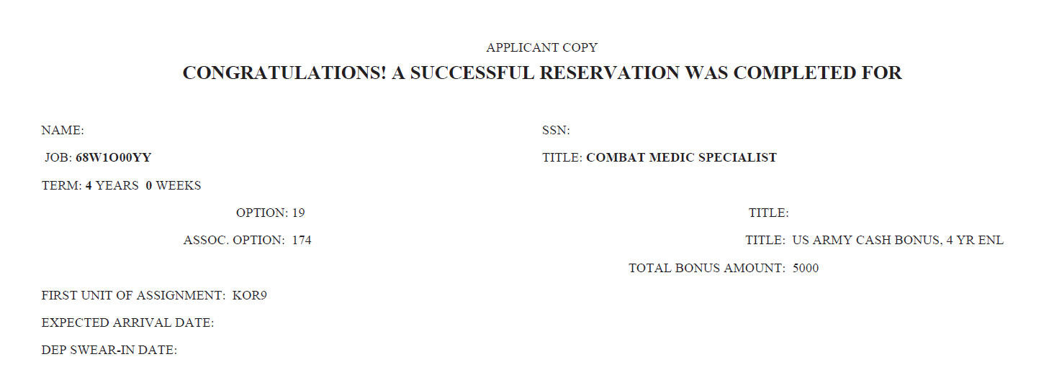
Option Enlistment Example

Slide 28
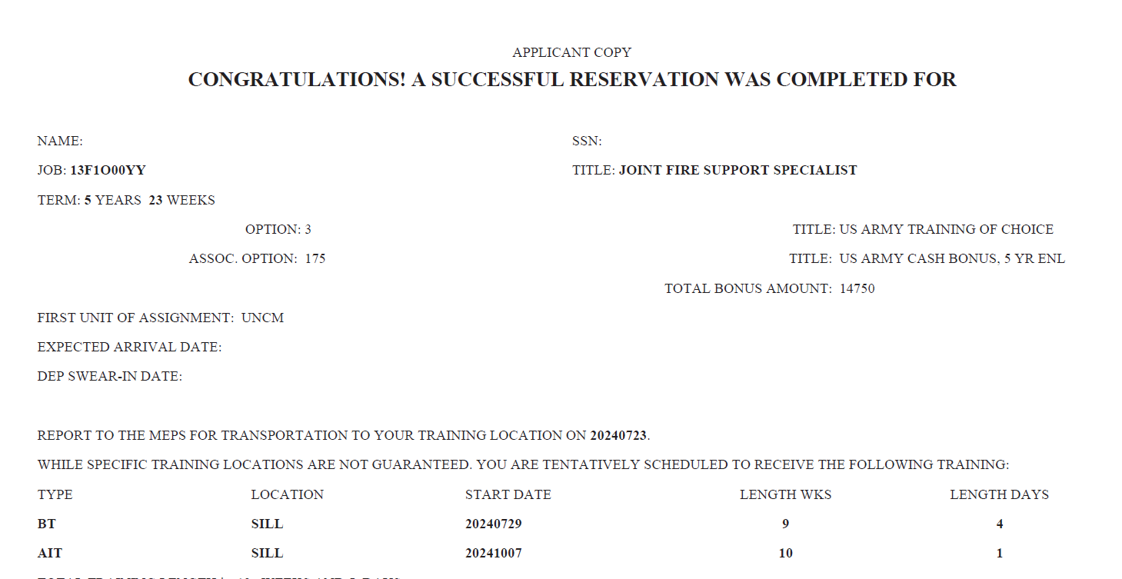
Regular Army Reservation Example

Slide 29
MOS Changes

Slide 30
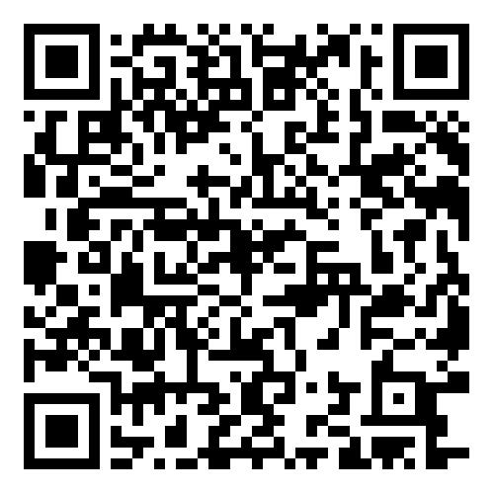
G3 Training Management Team
usarmy.knox.usarec.list.hq-g3-master-trainers@army.mil

