Slide 1
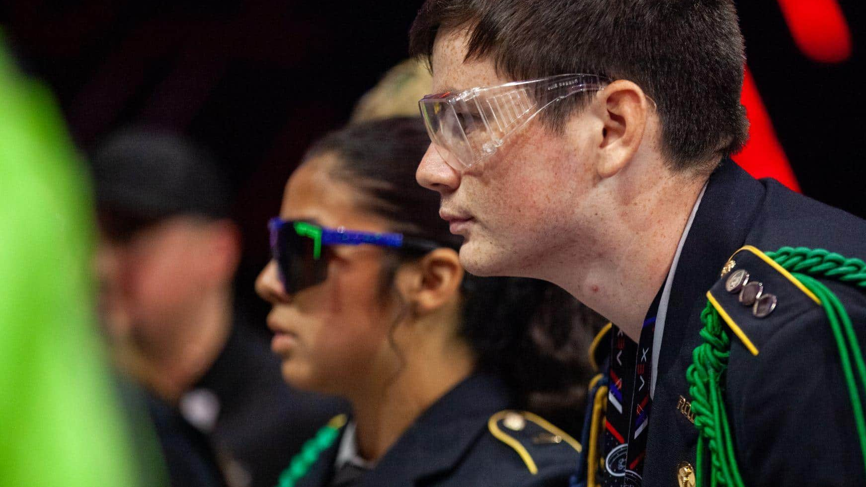




JROTC
ROBOTICS
Dylon Caudill
Director of Regional Operations
Robotics Education & Competition Foundation

Slide 2
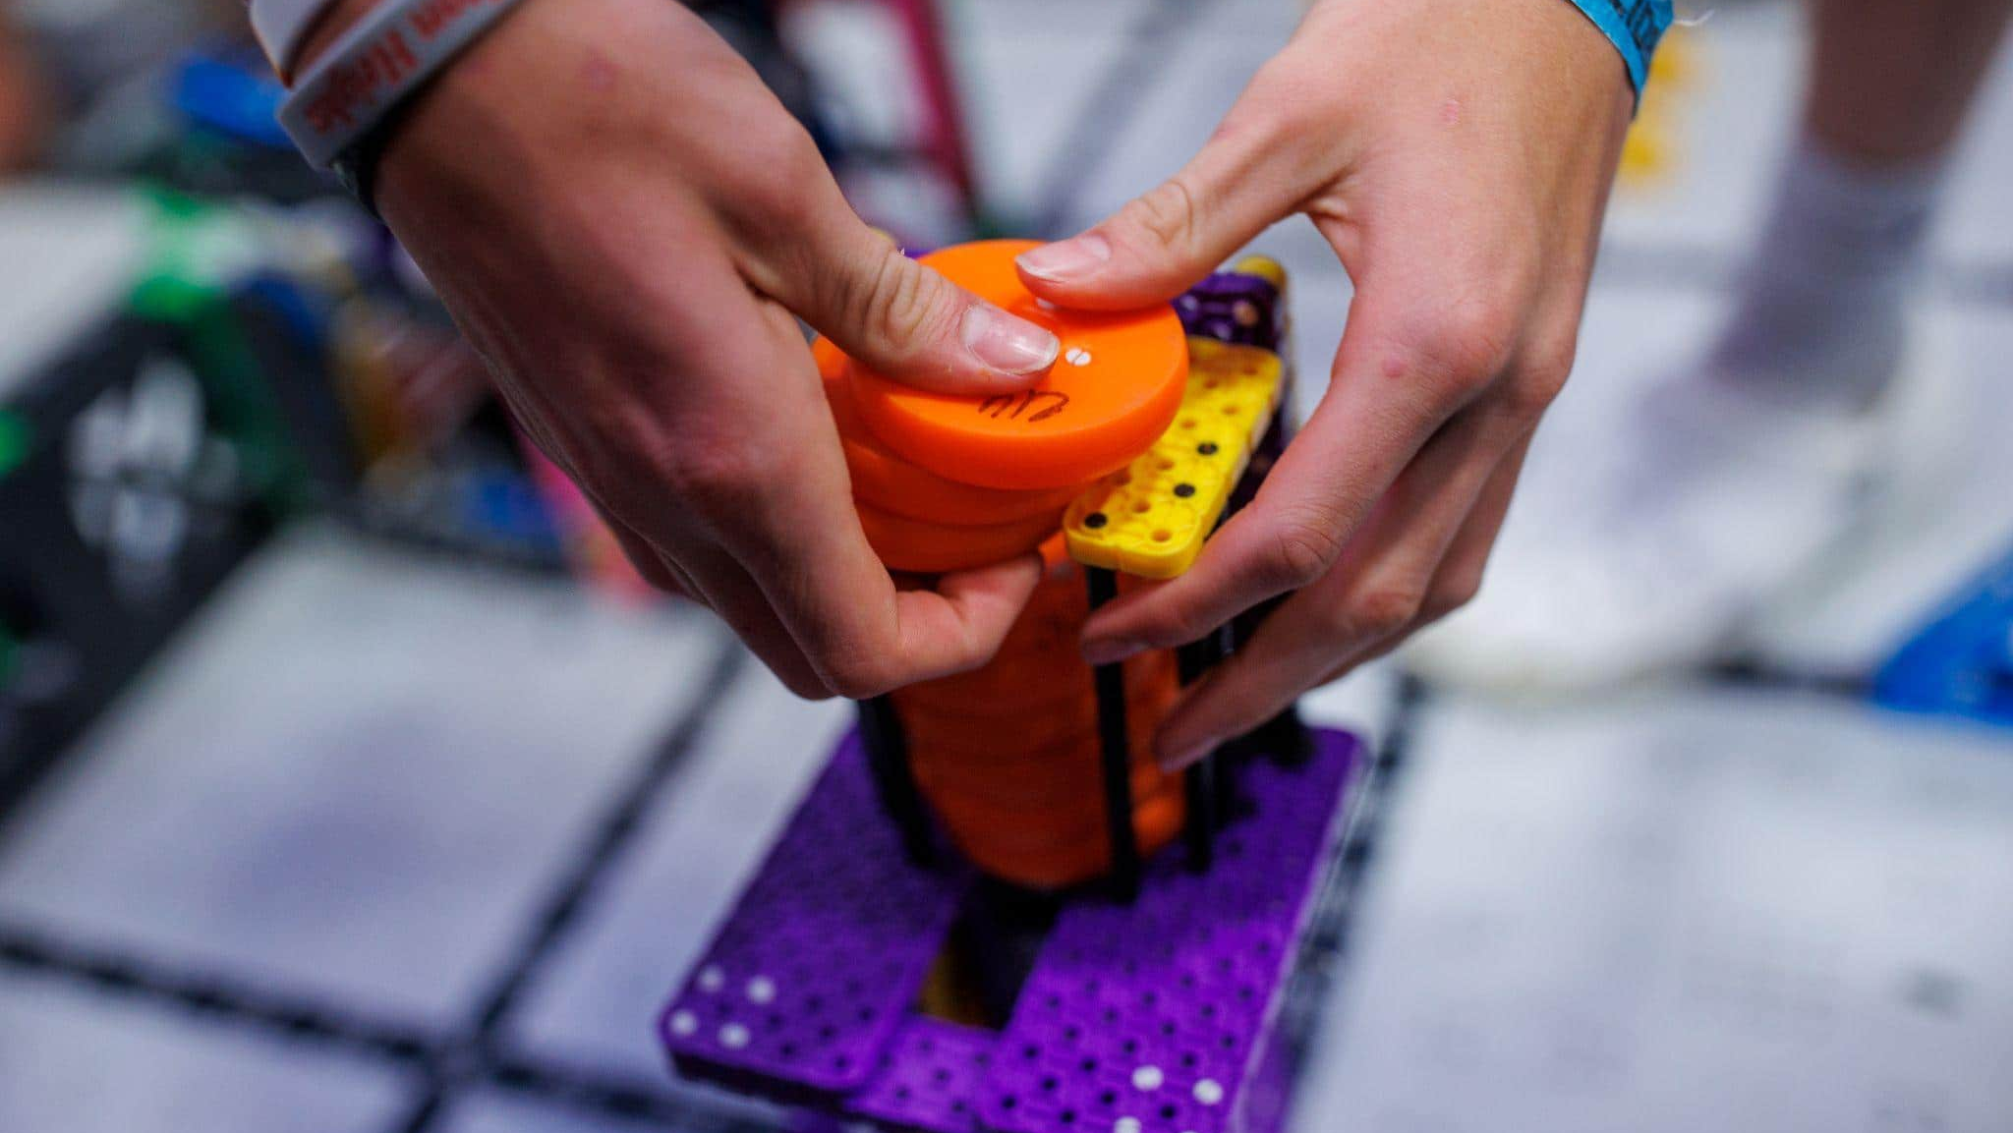


Mission
The Robotics Education & Competition (REC) Foundation’s global mission is to provide every educator with competition, education, and workforce readiness programs to increase student engagement in science, technology, engineering, math, and computer science.

Slide 3

Vision
We see a future where every student designs and innovates as part of a team, overcomes failure, perseveres, and emerges confident in their ability to meet global challenges.

Slide 4


Why
Robotics?
Engages students in accessible STEM activities
Develops communication and cooperation skills
Develops education and employment skills
Employers recognize robotics students
It’s the future
Because it’s fun!
Robotics Education & Competition Foundation
Inspiring students, one robot at a time.
JROTC Robotics Program Overview

Slide 5

Guiding Policy of REC Foundation Programs
Student-Centered Learning
Students are actively involved in learning opportunities to increase their knowledge and skills in the engineering design process, mechanical design, programming, and teamwork under the guidance of adult mentorship.
Student-Centered Application
Students have ownership on how their robot is designed, built, programmed, and utilized in match play with other teams and Robot Skills matches.
Core Principles
Student-Centered
Link to Student Centered Policy
Robotics Education & Competition Foundation
Educator Training
Notes:
Welcome
Today’s Agenda

Slide 6
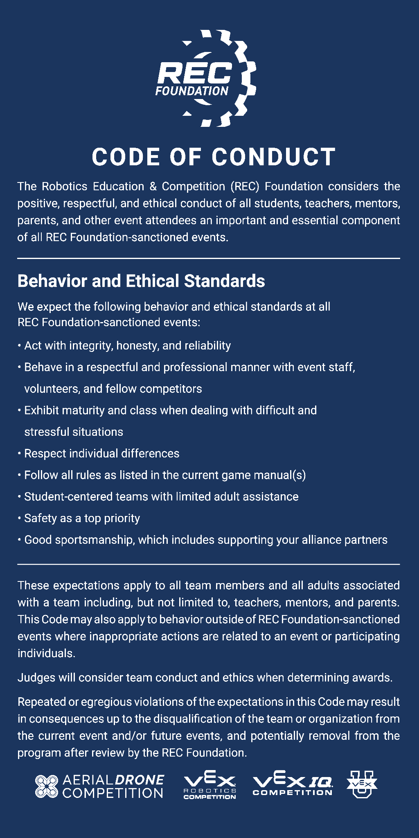
Core Principles
Student-Centered
The following behavior and ethical standards are expected at
all REC Foundation sanctioned events:
Act with integrity, honesty, and reliability
Behave in a respectful and professional manner with event staff, volunteers, and fellow competitors
Exhibit maturity and class when dealing with difficult and stressful situations
Respect individual differences
Follow all rules as listed in the current game manual(s)
Student-centered teams with limited adult assistance
Safety as a top priority
Good sportsmanship, which includes supporting your alliance partners
Link to Code of Conduct
Robotics Education & Competition Foundation
Educator Training
Notes:
Welcome
Today’s Agenda

Slide 7

THE COMPETITION

Slide 8
Typical Competition
Cycle
JUN
JUL
AUG
SEP
OCT
NOV
DEC
JAN
FEB
MAR
APR
MAY
Summer Camp
Team registration
Tryouts
Kick Off
Team formation
Learn the game
Competition season
Best practices
Compete early
Allow 2 weeks between events
Regional
Championships
World Championship
Optional
START / END
START / END
START / END
START / END
START / END
Robotics Education & Competition Foundation
Educator Training

Slide 9
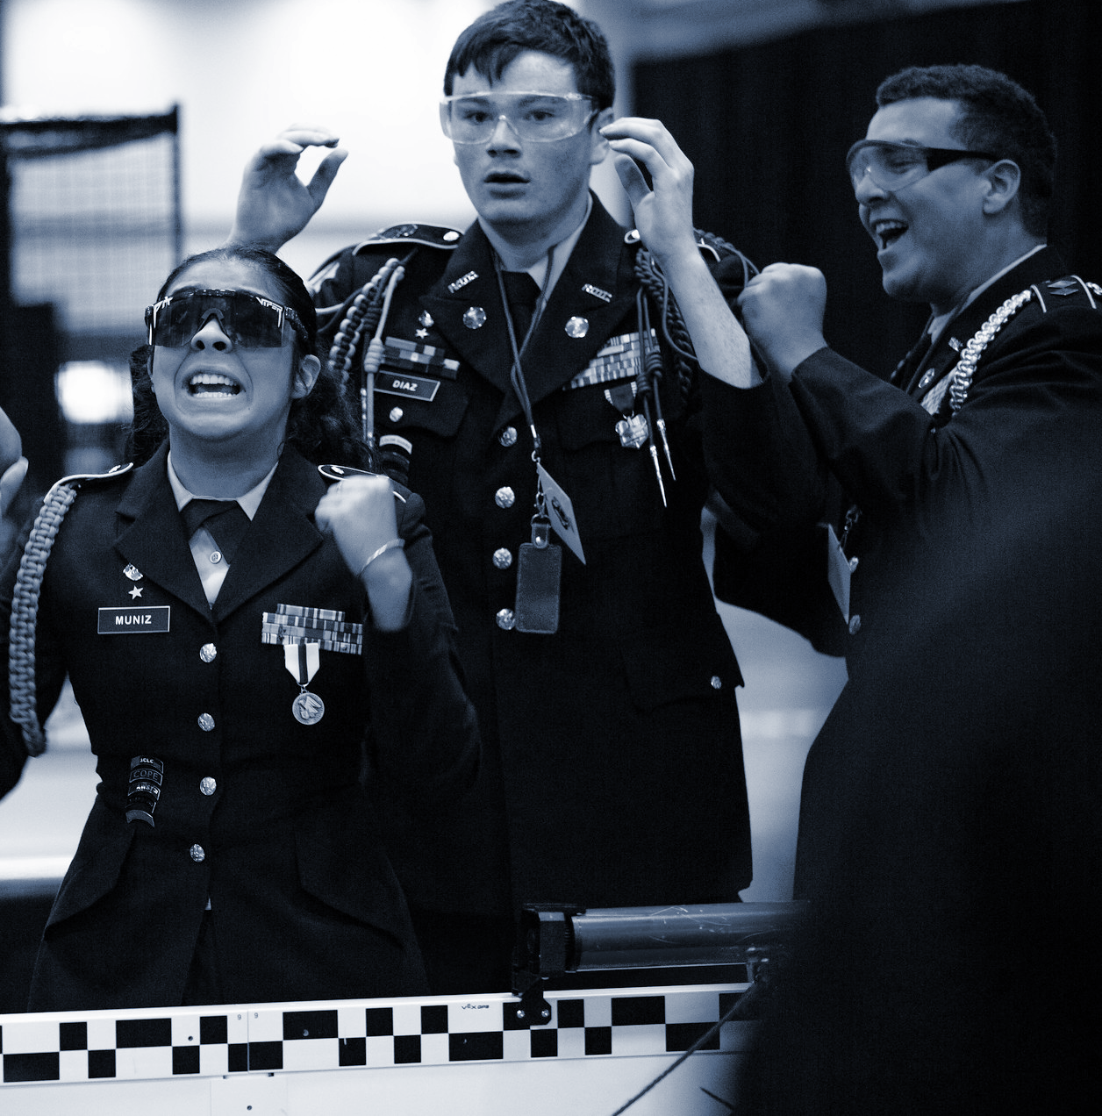
Competition
VEX Robotics Competition (VRC)
VEX Robotics Competition teams are tasked with designing and building a robot to play against other teams in a game-based engineering challenge.
Two Alliances – one “red” and one “blue” – composed of two Teams each, compete in matches consisting of a fifteen (15) second Autonomous Period, followed by a one minute and forty-five second (1:45) Driver Controlled Period.
The object of the game is to attain a higher score than the opposing Alliance.
Robotics Education & Competition Foundation
Inspiring students, one robot at a time.
JROTC Robotics Program Overview

Slide 10
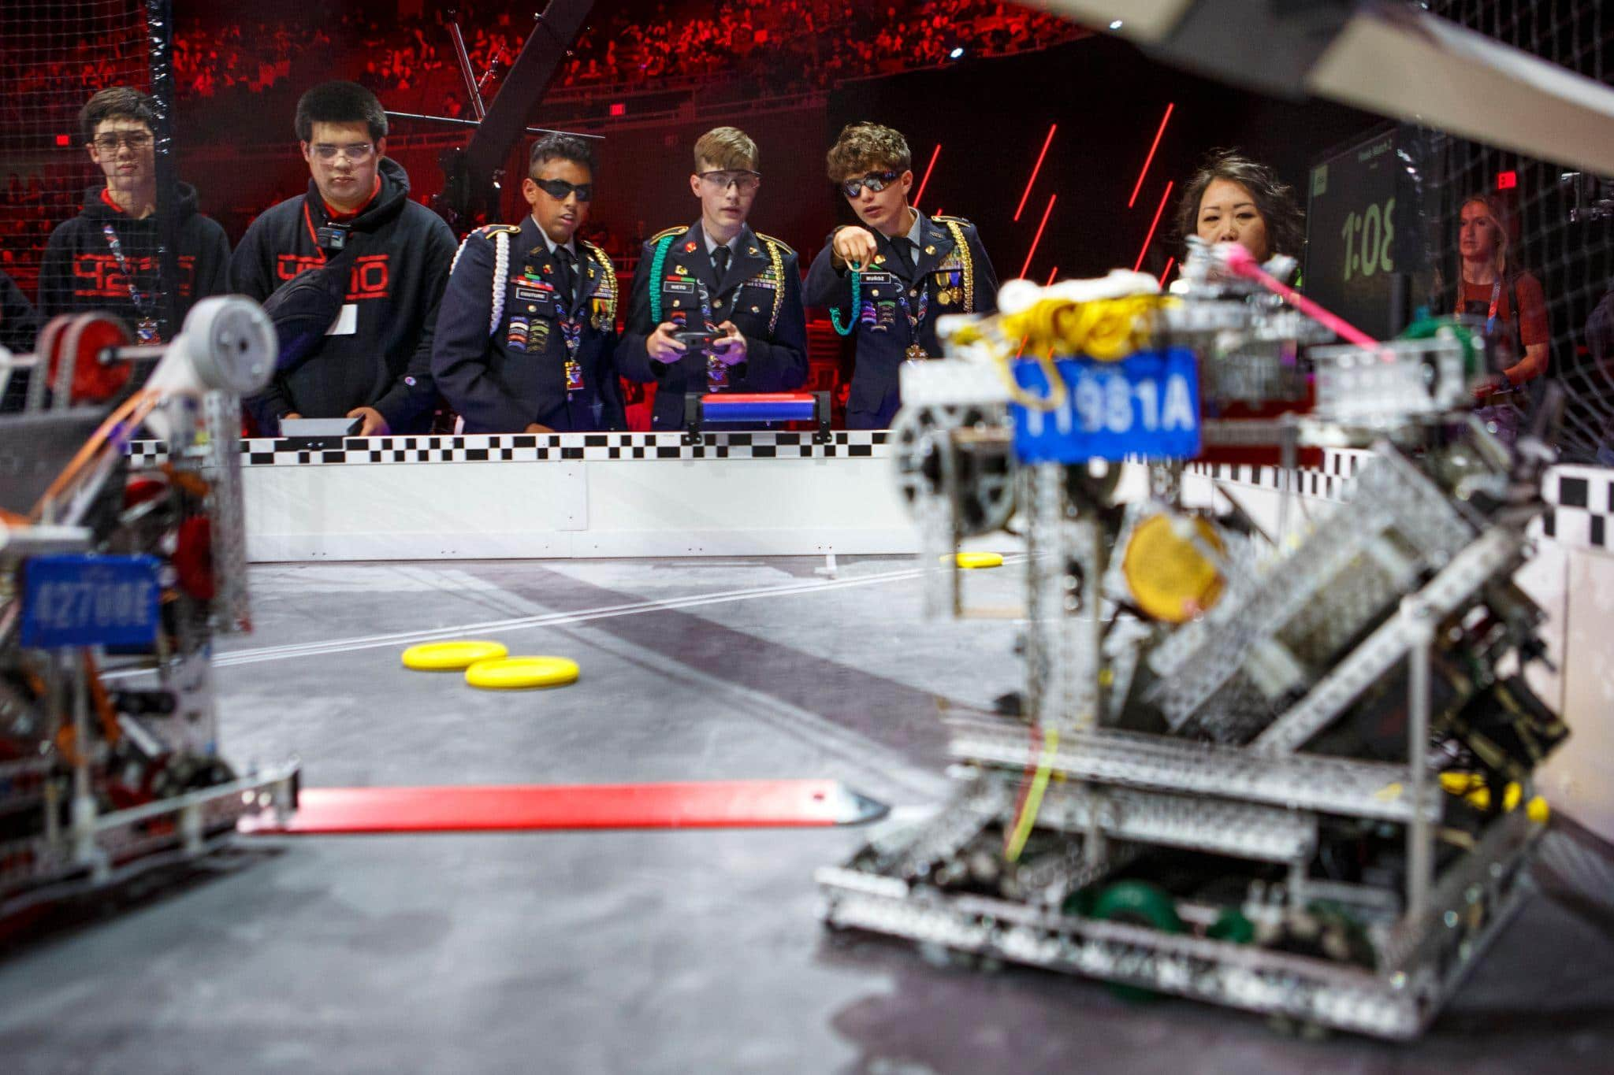
At local VEX Robotics Competition Events
At JROTC Only Events
In Live Remote Skills
How to Compete
This season

Slide 11
Competitions
Student-Centered
High School and Middle School students compete Local, Regional, National, and World Championship
Competition Matches
Team Interviews
Robot Skills Challenge
2 Alliances, of 2 robots each, compete against each other to attain a higher score
Notebooks are reviewed and Teams are interviewed
1 Team Plays Alone Against the Clock
Driving Skills Challenge
Programming Skills Challenge
Robotics Education & Competition Foundation
Educator Training

Slide 12
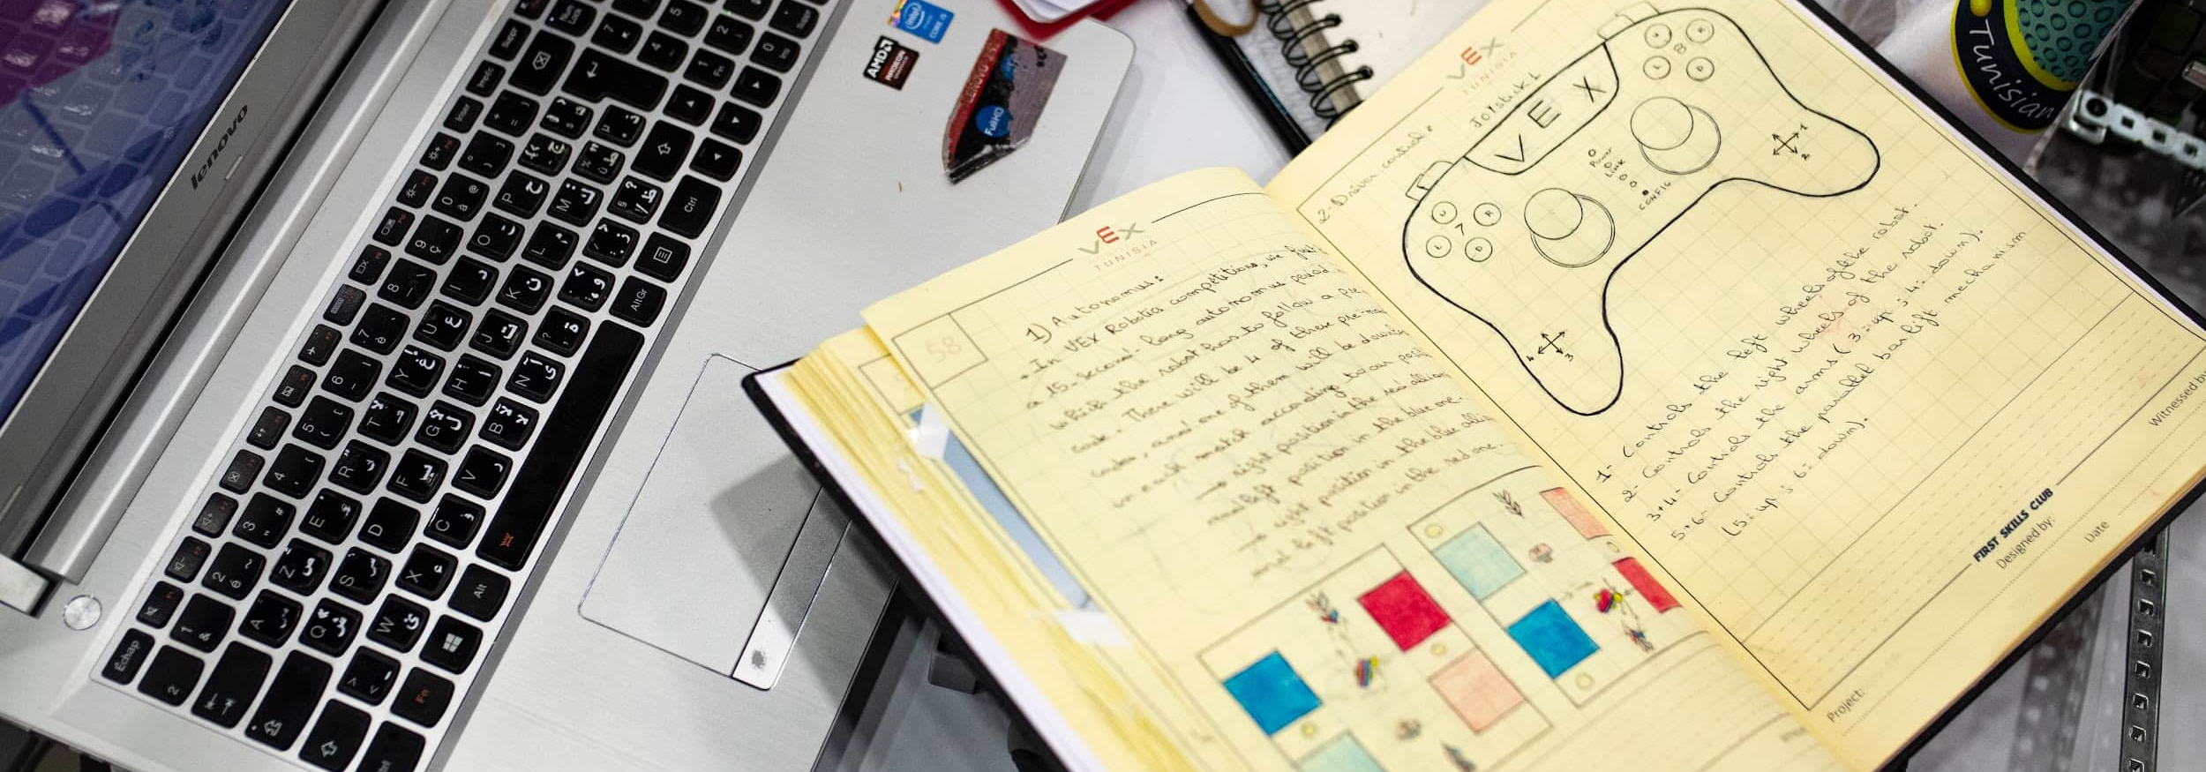
Resources
What is a engineering notebook?
An engineering notebook is a special book where engineers write down and keep track of their ideas, designs, and experiments. It's like a diary where they record all the important information about their projects. In the notebook, engineers draw pictures, write notes, and explain their thoughts and plans.
Robotics Education & Competition Foundation
Educator Training

Slide 13
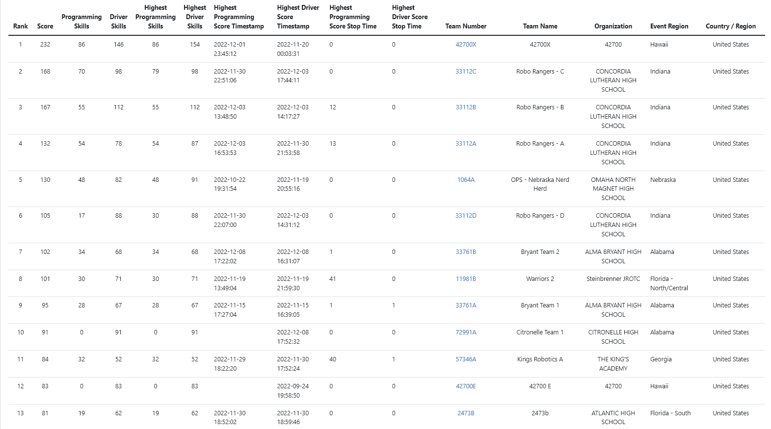

Slide 14
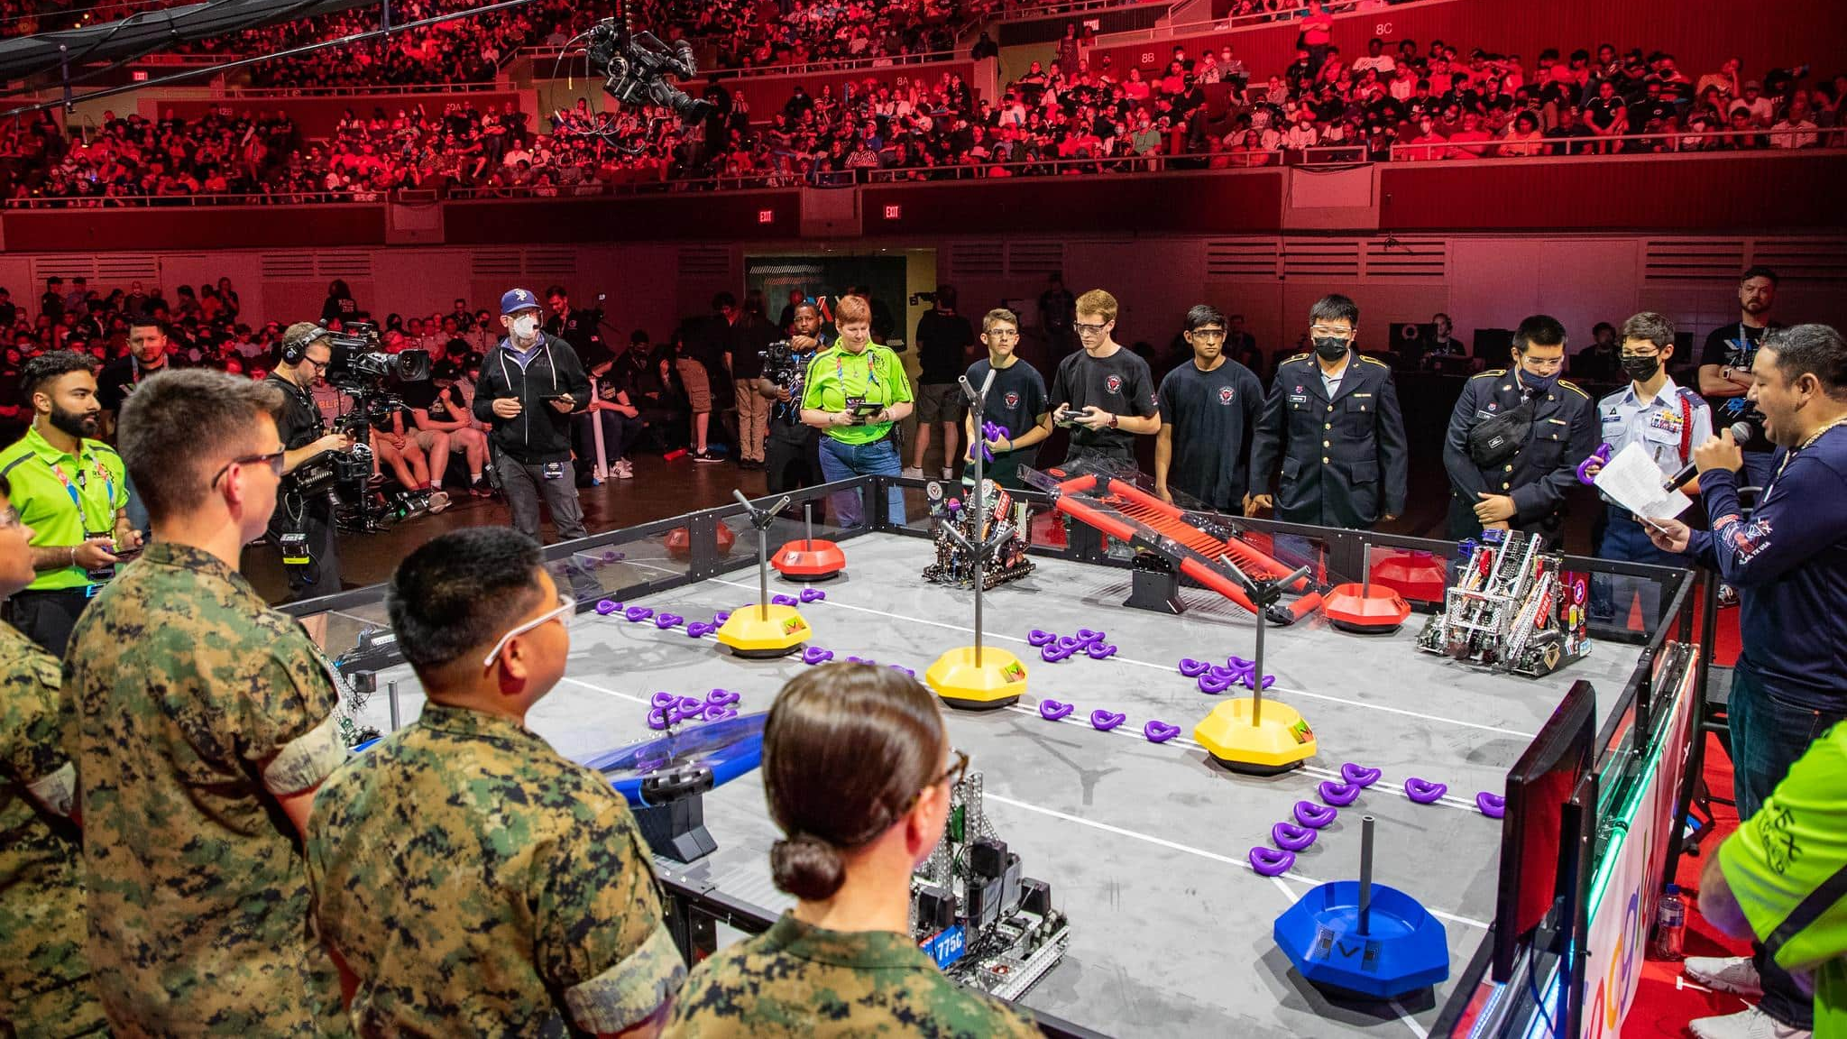

Slide 15
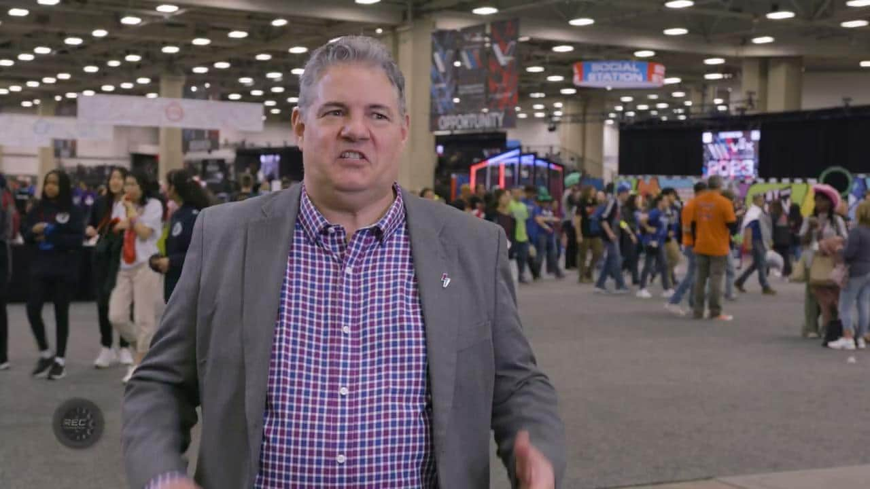

Slide 16
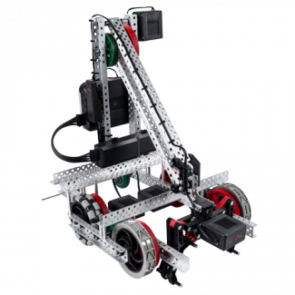
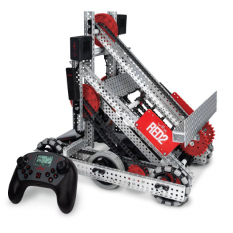
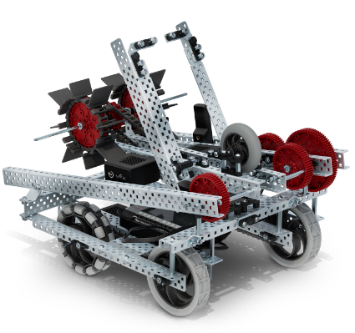
Standard
Robot Builds
Standard Robot Builds are designs created by VEX engineers.
Available for download at www.vexrobotics.com/v5/downloads/build-instructions
Quickly orient new teams to robot building and driving
Can be modified to improve the design for the challenge
Allows students to follow the Design Process while improving the design
Robots for competition do not need to be a standard build!
Notes:
Recommendations on best practices for brainstorm with students - get input from the teachers and/or share classroom experiences (i.e. Think/Pair/Share, refer to robot behaviors in other common devices or animals, researching a "mechanical toolbox" to help you get to your solution, etc.)

Slide 17
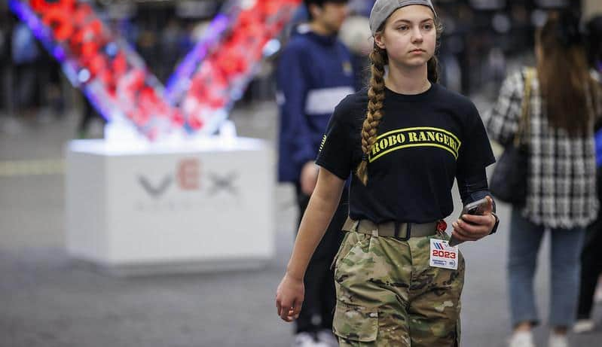
THE GAME

Slide 18



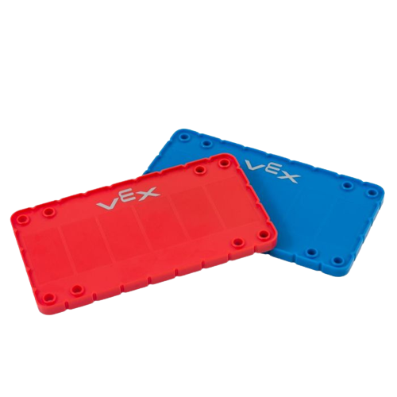
2022-2023 Game
NEW GAME
Over Under
Don’t forget you have to register your teams and display license plates

Slide 19
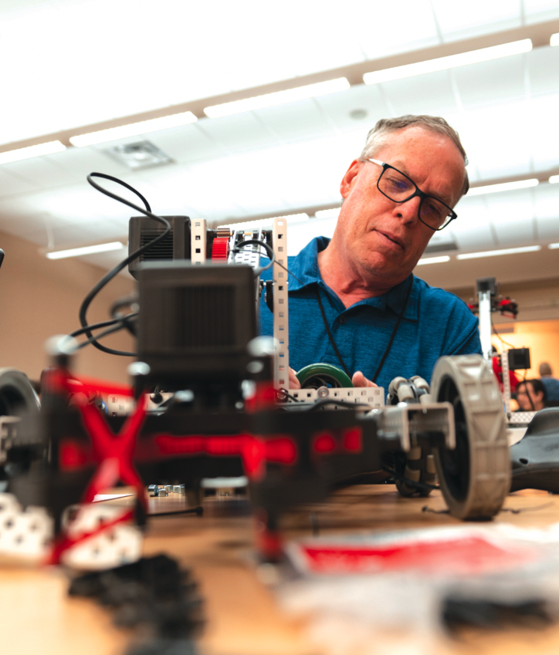

Educator Certifications
Educator Resources
Free Online Training to Help Educators and Coaches at Any Ability Level
Fun and Engaging Lessons
Build Confidence to Support Students
https://certifications.vex.com/educator
https://certifications.vex.com/competition
Robotics Education & Competition Foundation
Inspiring students, one robot at a time.
JROTC Robotics Program Overview

Slide 20
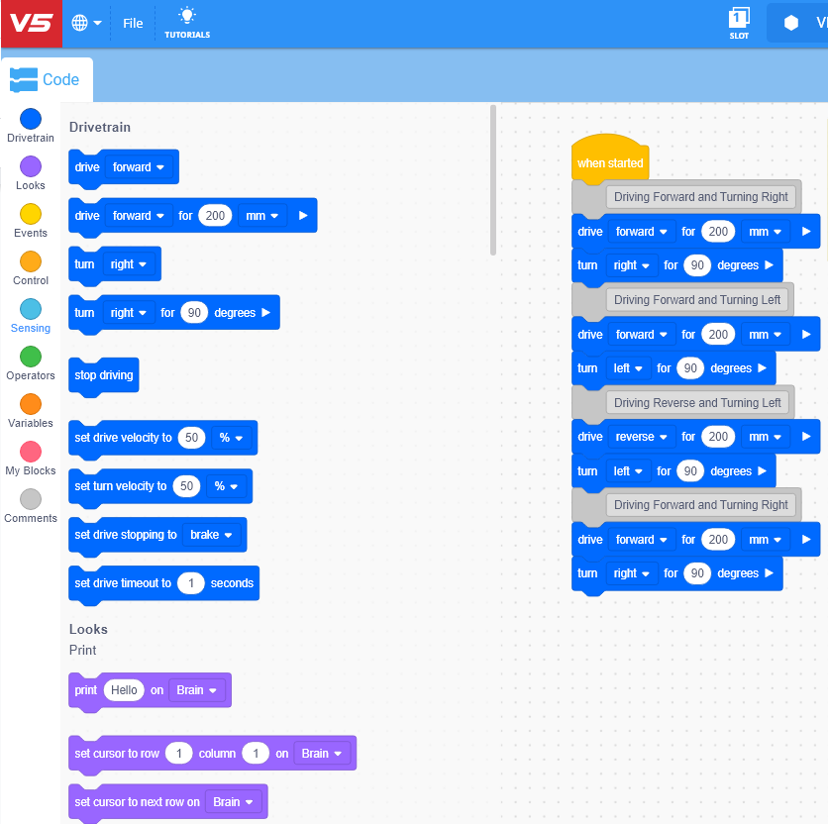


Programming Software
VEXcode V5
VEXcode V5 is the coding environment for programming the VEX V5 Robot. VEXcode V5 is available for several different types of devices. The application needs to be downloaded onto your device.
VExcode V5 Blocks VEXcode V5 Text
V5- Programming Knowledge Base
Robotics Education & Competition Foundation
Inspiring students, one robot at a time.
JROTC Robotics Program Overview

Slide 21
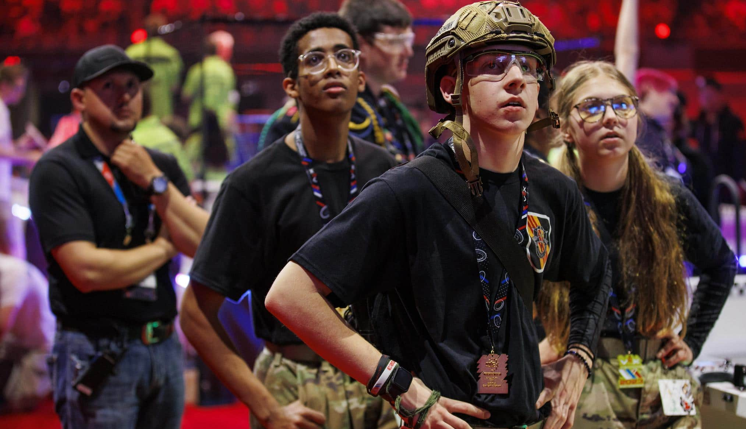

PROGRAM REVIEW
Notes:
Headings Poppins Semi Bold
Body Text -Roboto Normal

Slide 22
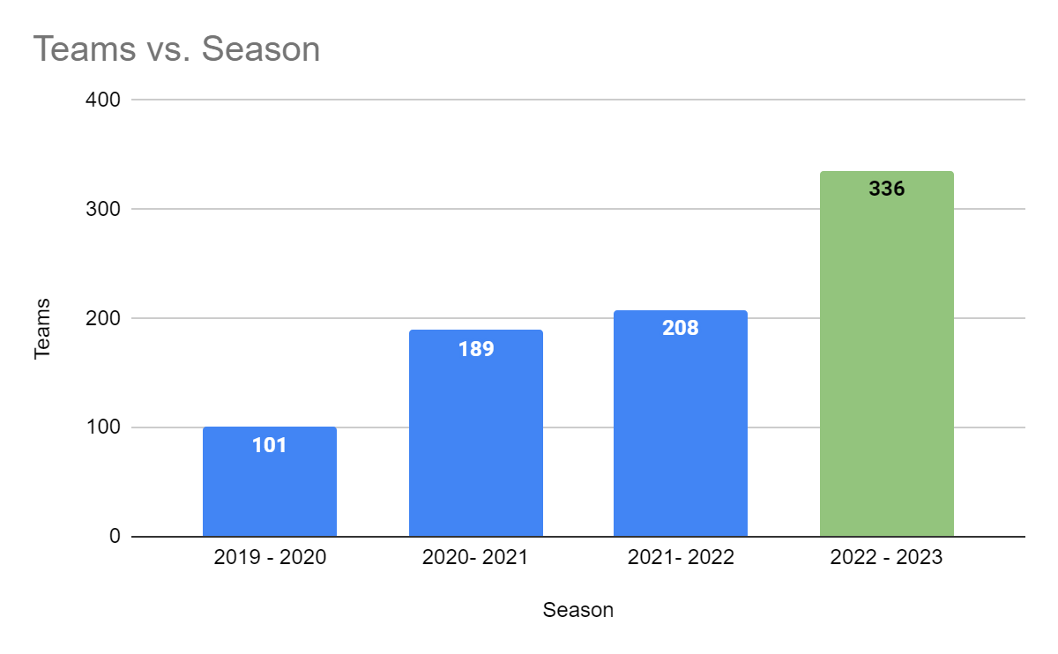

Slide 23
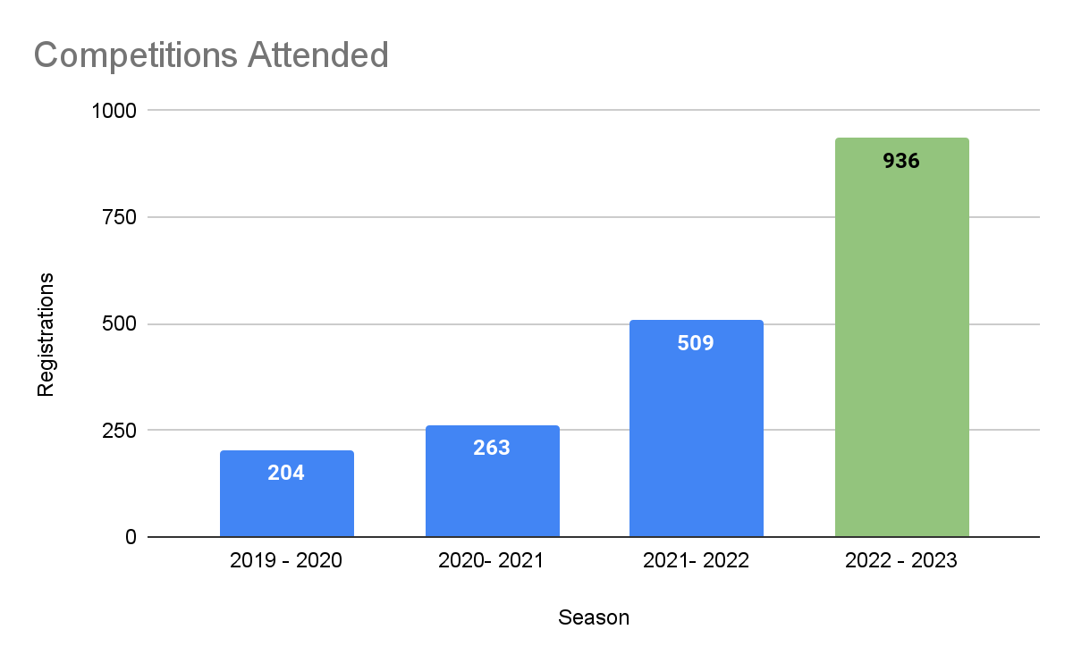
Competitions per team
2.91
2.40
2.01
1.25

Slide 24
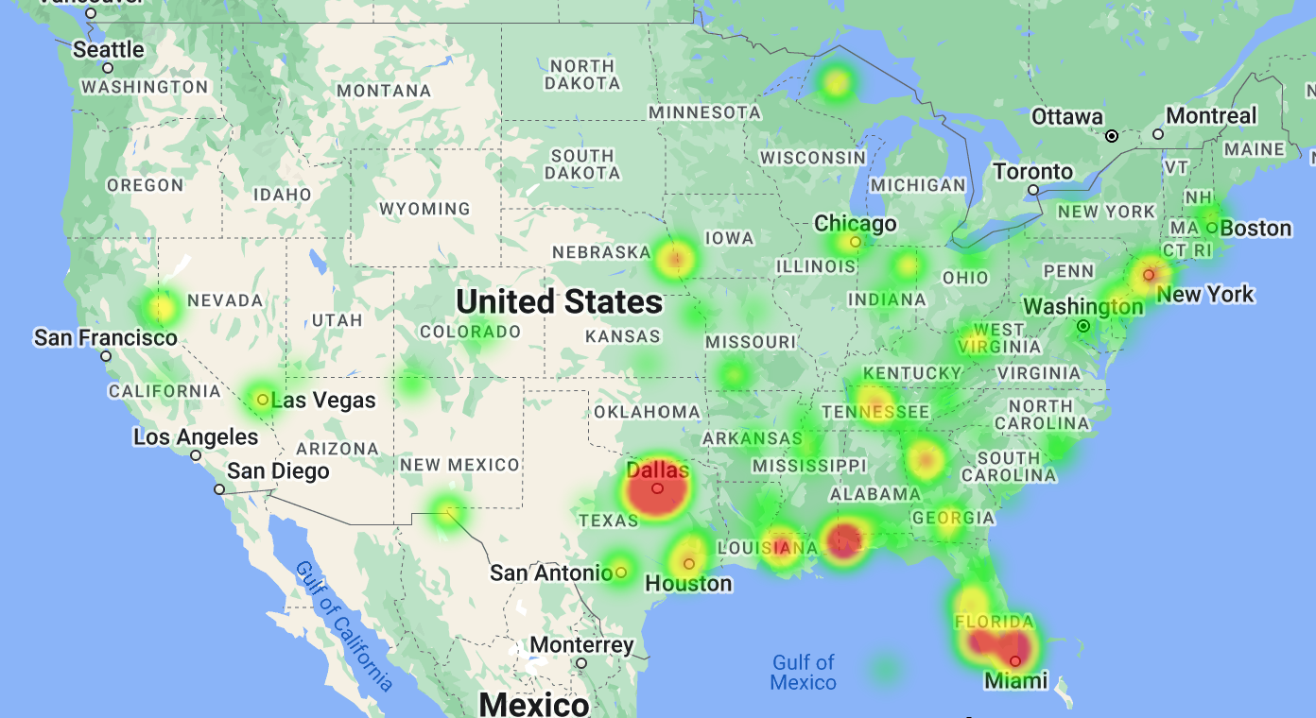

2022/2023 Teams
Robotics Education & Competition Foundation
Inspiring students, one robot at a time.
JROTC Robotics Program Overview

Slide 25
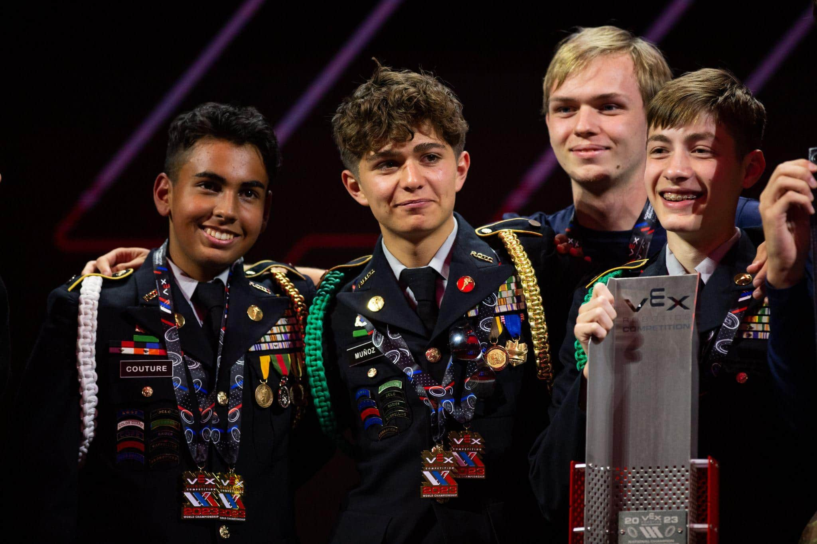

National Championship
Dallas Texas | 27-Apr-2023 - 29-Apr-2023
30K
3.5K
150K
160
Students
Teams
Attendees
JROTC Teams
Notes:
Now, we are going to talk about Behind the Scenes. This would be the organized chaos! Until I attended my first Worlds I had zero idea of what goes on behind the scenes. Hopefully this will help you get a better understanding about what each group does.

Slide 26
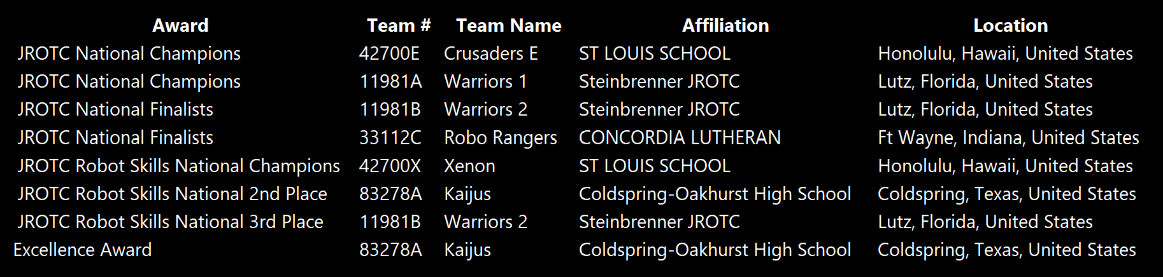
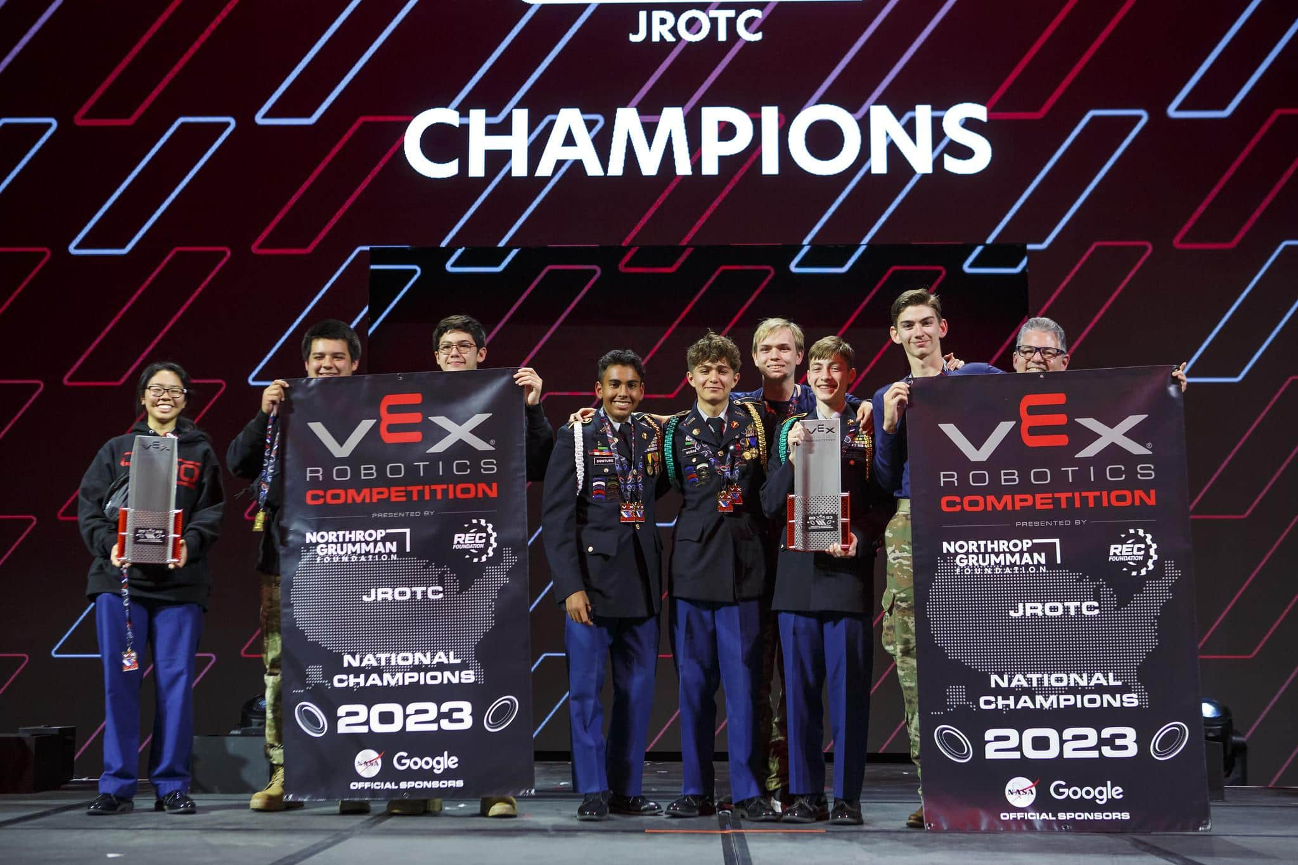
Overview
Overview

Slide 27
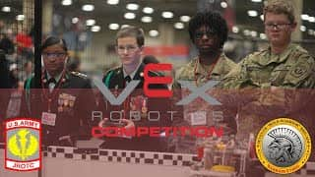

Slide 28
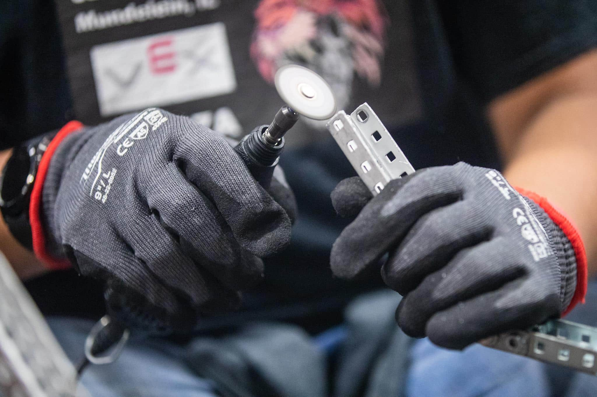
SEASON RESOURCES

Slide 29
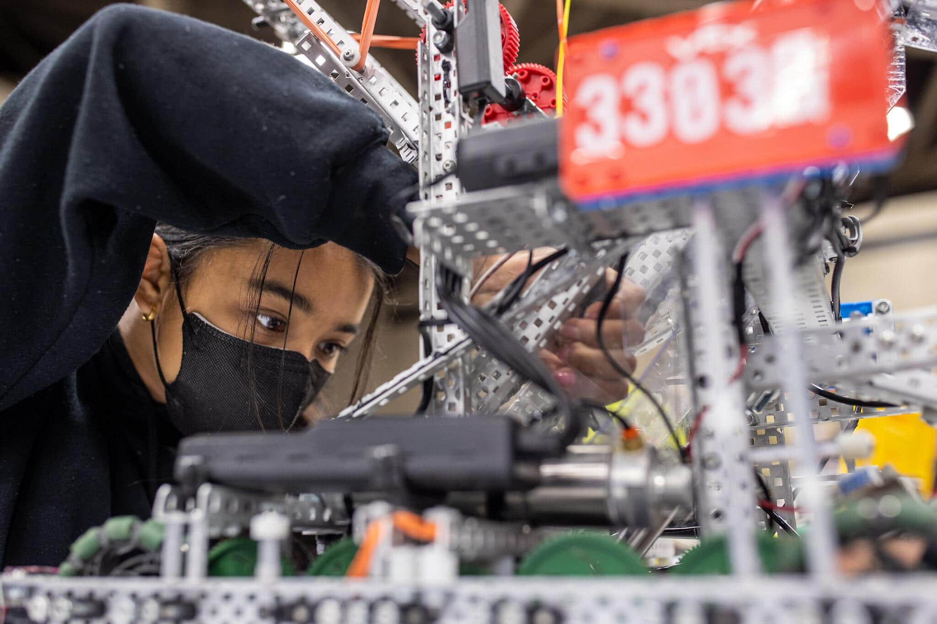


THIS
SEASON!
Schedule
2023-24 Season
Resources
Roboticseducation.org
Robotevents.com
Help.vex.com
JROTC Community
New Team information
Judging information
NEW Game information!
Team Guide Download
JROTC Webpage
Register you Team
Register for Events
Official Game Q&A
JROTC Skills Ranking
See local Teams & Events
Register for JROTC Nationals
Knowledge Base
Quick Start Guides
VEXCode V5
Mechanical
Electronics
Join other JROTC
Instructors around the US.
Free for JROTC instructors
Quick access to support and Q&A information
JROTC Slack Link

Slide 30
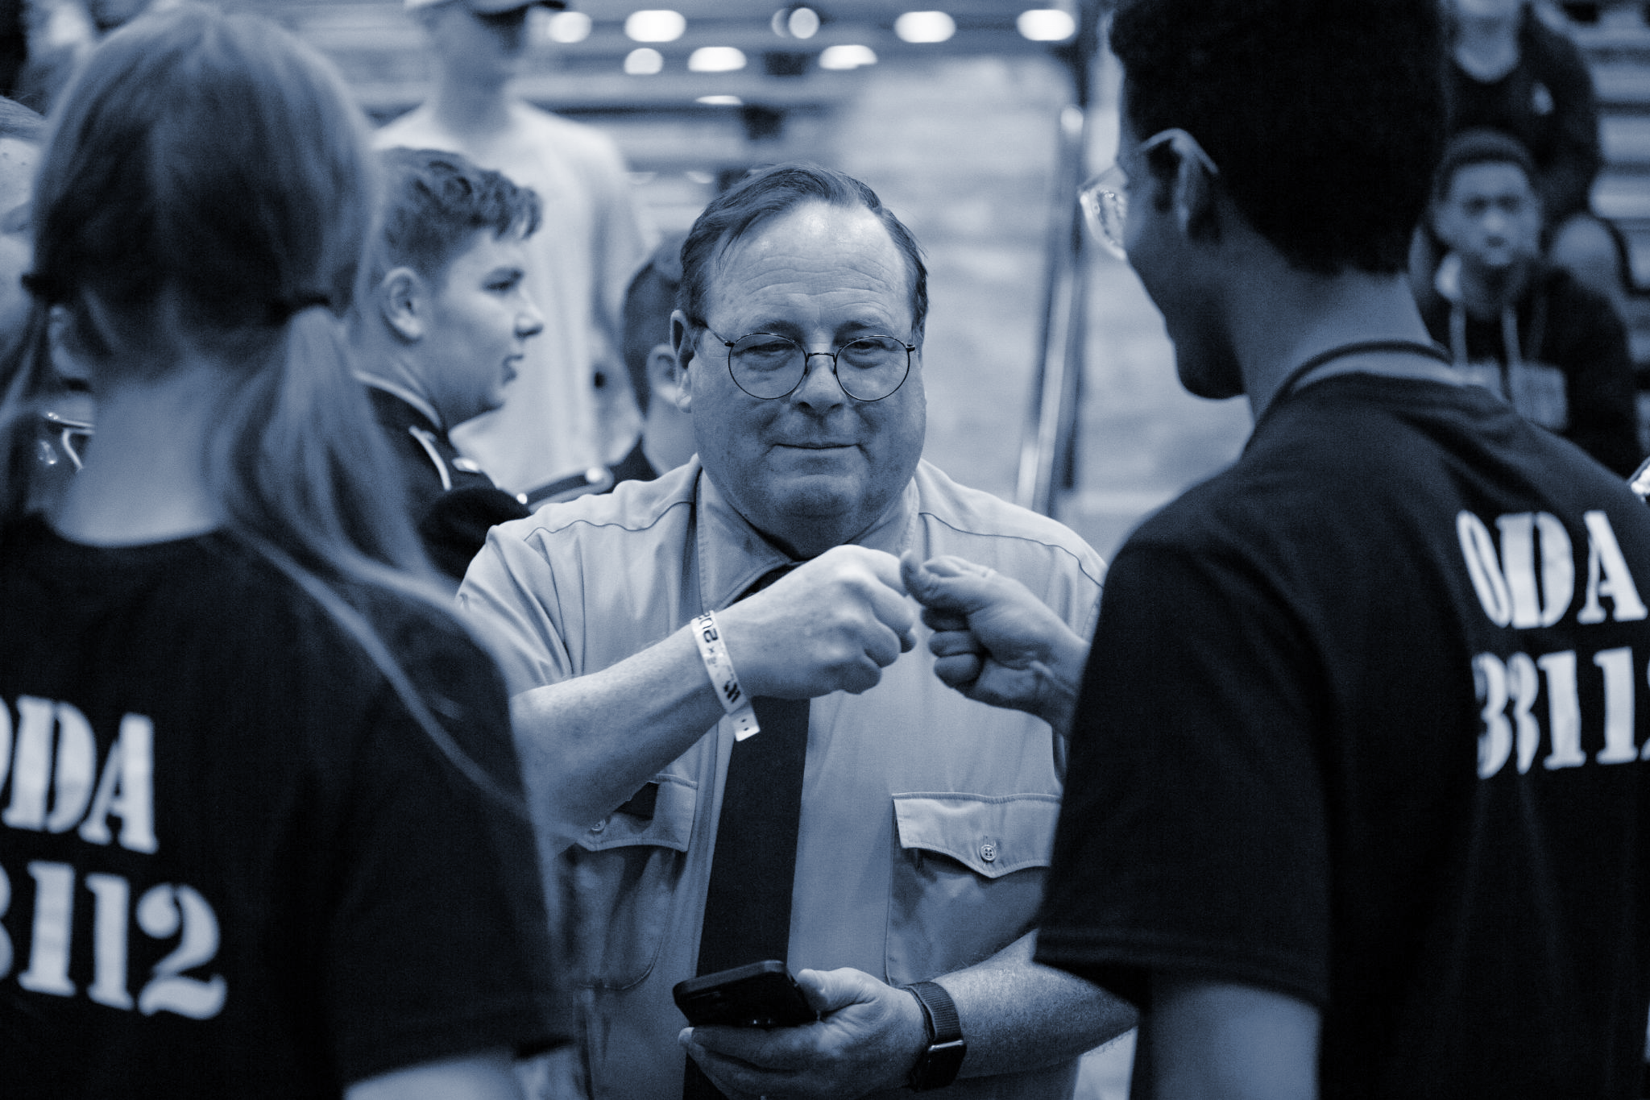

Contact
Dylon Caudill, Program Director
Robotics Education & Competition Foundation
Please reach out to us with any questions or concerns. Thank you for all of your support.
Address
Phone & Email
1519 Interstate 30 West
Greenville, Texas 75402
740 361 5737
JROTC@recf.org
Dylan_Caudill@recf.org

Slide 31
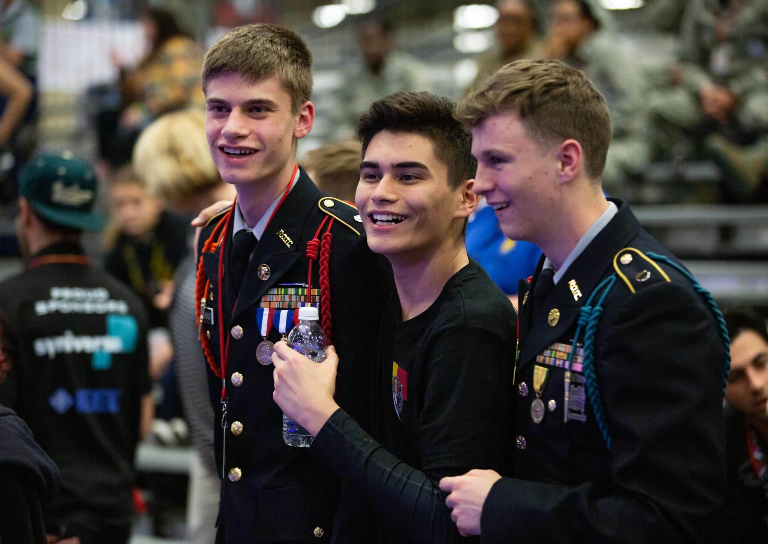
Thank you!
Notes:
Headings Poppins Semi Bold
Body Text -Roboto Normal

Slide 32
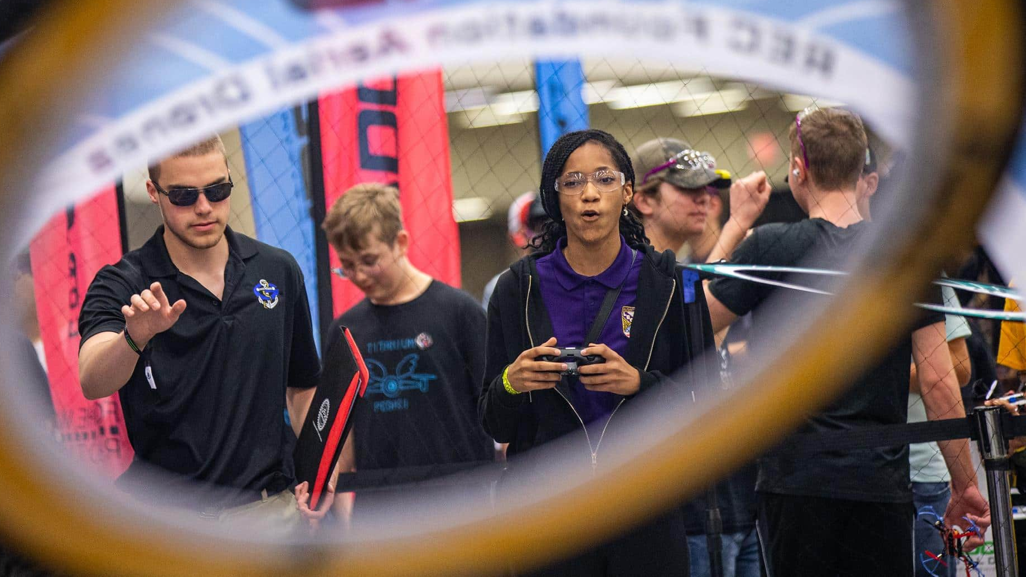


Slide 33

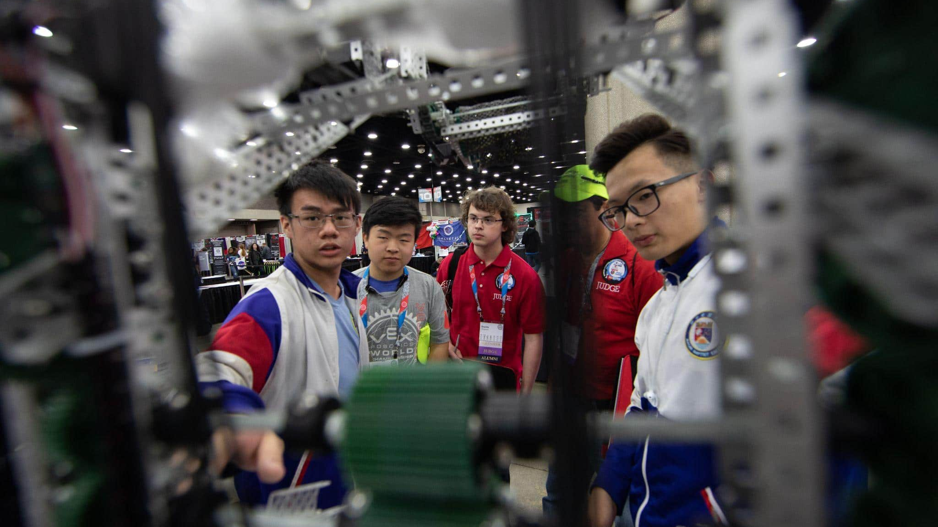

Slide 34
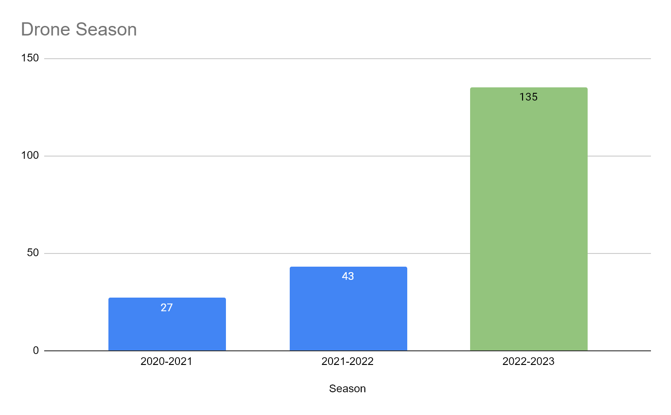
Overview
3 Season Participation
Robotics Education & Competition Foundation
Inspiring students, one robot at a time.
JROTC Robotics Program Overview

Slide 35


Coding Languages
Blockly + Python
Safe, durable, fixable
Simple pairing, stable signal
7 sensors accessible by code
Free curriculum
Approved for Aerial Drone Competition
Notes:
About the CoDrone EDU
A drone designed for the classroom and for learning (3, 4)
Single unit or as a classroom set (3, 4)
Age group (5)
Coding languages (6)
Safe, durable, fixable (7, 8)
Pairing is easy: turn the controller and drone on, they automatically connect (9)
Signal is stable, up to 15 drones (9)

Slide 36
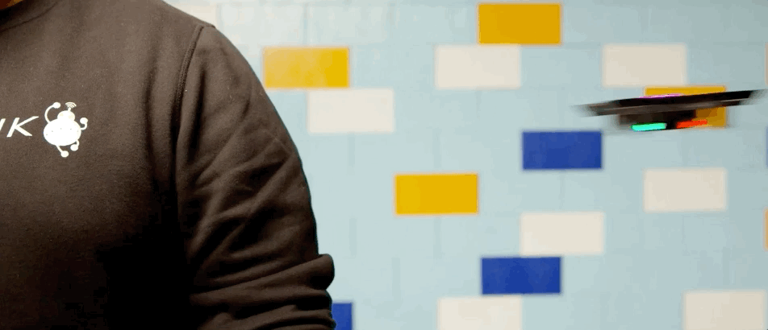
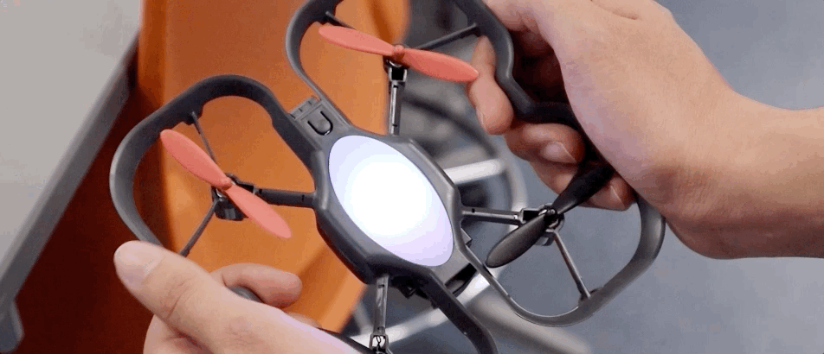
Notes:
About the CoDrone EDU
A drone designed for the classroom and for learning (3, 4)
Single unit or as a classroom set (3, 4)
Age group (5)
Coding languages (6)
Safe, durable, fixable (7, 8)
Pairing is easy: turn the controller and drone on, they automatically connect (9)
Signal is stable, up to 15 drones (9)

Slide 37
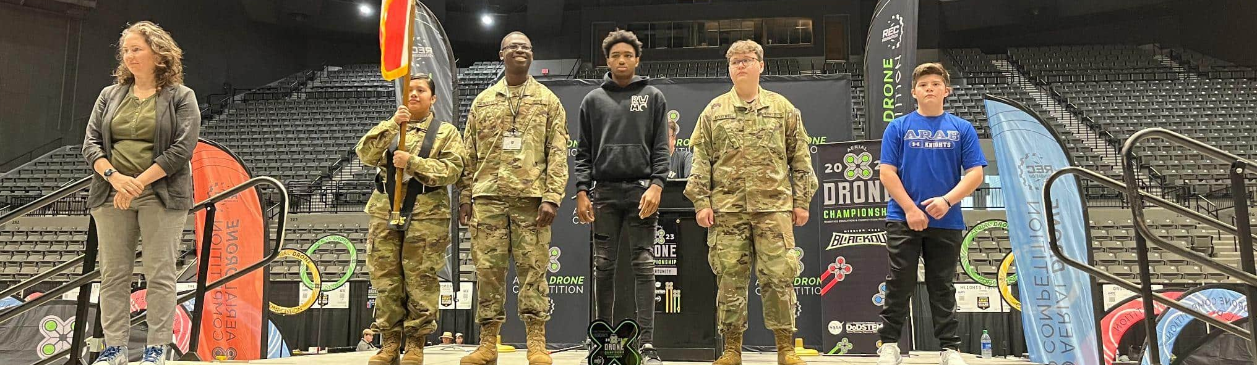
Texas - 15-Apr-2023 - 16-Apr-2023
Mississippi - 21-Apr-2023 - 22-Apr-2023
Michigan - 13-May-2023 - 14-May-2023
West Virginia - 19-May-2023 - 20-May-2023

Slide 38
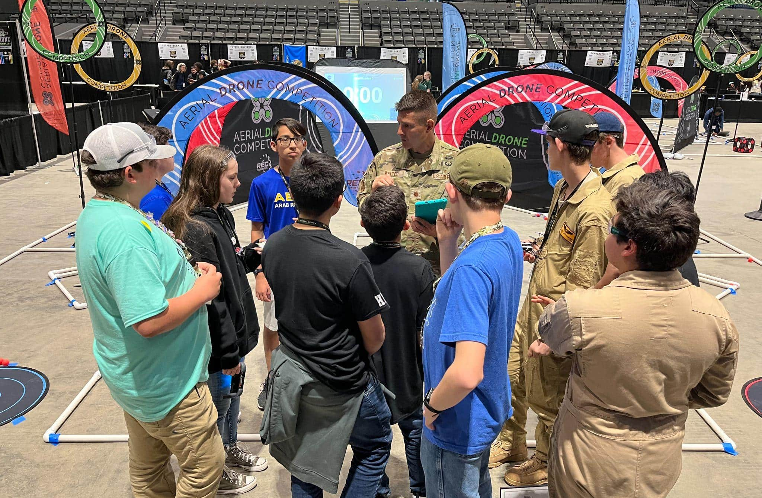
Notes:
Aerial Drone Competition
We are approved for the Aerial Drone Competition (10)
REC Foundation, same folks behind VEX robotics competitions (10, 11)
Annual drone competition, which happened earlier this year (11)

Slide 39
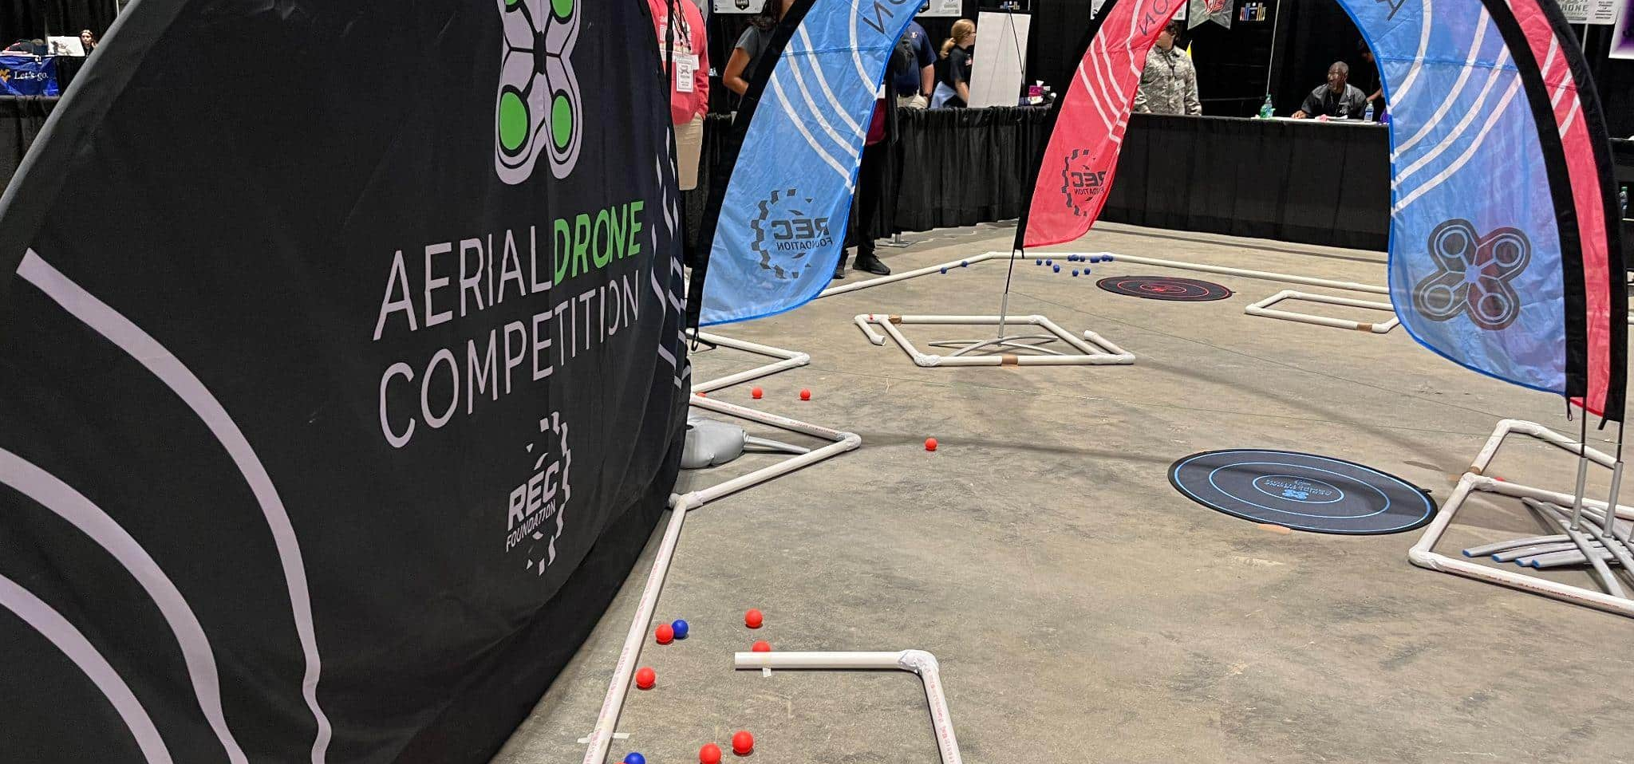
2022 Mission
Notes:
Aerial Drone Competition
We are approved for the Aerial Drone Competition (10)
REC Foundation, same folks behind VEX robotics competitions (10, 11)
Annual drone competition, which happened earlier this year (11)

Slide 40
Contact
Dylon Caudill, Program Director
Robotics Education & Competition Foundation
Please reach out to us with any questions or concerns. Thank you for all of your support.
Address
Phone & Email
1519 Interstate 30 West
Greenville, Texas 75402
740 361 5737
JROTC@recf.org
Dylan_Caudill@recf.org

