Slide 1
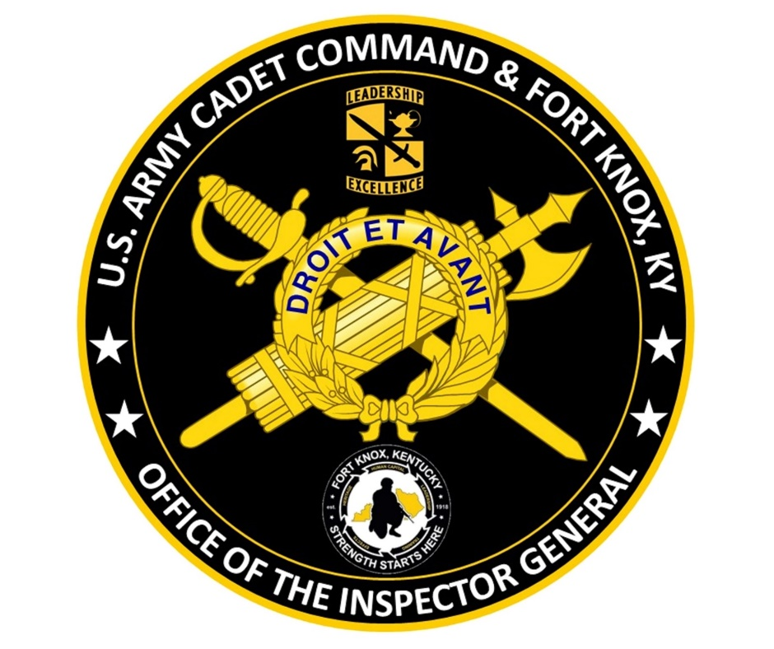
US Army Cadet Command & Fort Knox
Inspector General
JROTC School of Cadet Command
Instructor Training Course
CONTROLLED BY: The Inspector General of the Army (SAIG-ZA)
CONTROLLED BY: USACC IG (ATCC-IG)
CUI CATEGORY: PRIIG
DISTRIBUTION/DISSEMINATION CONTROL: FEDCON
POC: Mr. Anthony Howard, IG, 502-624-7747

Slide 2
What Are IGs and How can they help?
CUI
What is the purpose of the IG?
Enhance readiness and warfighting capability
How does the IG execute his or her duties and responsibilities?
1) Teach and Train; 2) Inspections; 3) Assistance and 4) Investigations
Exercises confidentiality and is a fair, impartial, and objective factfinder – not an advocate for one side or the other – makes calls based on facts and standards.
Who can the IG help?
Anyone
How can the IG help?
Encountered an issue that has leaders baffled? Ask the IG. Chances are that we’ve seen it before and know who to contact to fix it.
Not sure your school policy is right? Ask the IG. IGs can review it to ensure it adheres to all regulatory requirements and Army standards.
Have questions about misconduct trends? Ask the IG. IGs can share non-attributable trends based on your required parameters.
Why establish a relationship with the IG?
IGs are a confidential resource for leadership teams – requests for information, trends, leader development, another opinion from a neutral position.
CUI

Slide 3
CUI
US Army Cadet Command
Inspector General ISO JROTC
Proactive (Ref: ARs 20-1, 1-201, 145-2; USACC Regs 145-2, 145-08)
IG Teaching and Training at JROTC instructor course
IG inspector training for personnel who inspect JROTC programs
IG visits to JROTCs during Academic Year Inspections (approximately 50-60 JROTCs per year)
JROTC inspections are integrated into USACC Organizational Inspection Program
IG contact information flyer posted in JROTC areas
Reactive (Ref: AR 20-1)
Requests from instructors for IG assistance (Instructor Pay)
Allegations of misconduct or wrongdoing (Referred to Brigade Commander or local law enforcement for investigation/inquiry)
CUI

Slide 4
JROTC Unit Highlights
AR 145-2, Junior Reserve Officers’ Training Corps Program
An organized group of Junior ROTC Cadets and authorized faculty at one high school constitutes a unit. (Paragraph 2-2, a.)
Secondary educational institutions will provide suitable safeguards for Government property as prescribed in AR 190-11, AR 710-2, and AR 735-5. (Paragraph 2-5, e.)
A school must be placed on probation for any of the following: (1) Failure to maintain enrollment. The school’s Cadet enrollment falls below the minimum standard set forth on either the DA Form 3126 or DA Form 3126-1 based on the opening enrollment report; (2) Failure to maintain minimum number of instructors; and failure to achieve satisfactory score on the Junior ROTC Program for Accreditation. (Paragraph 2-11, a.)
Acquisition, accountability, and management of uniform, clothing, and equipment are set forth in AR 700-84, AR 710-2, AR 735-5 and DA PAM 710-2-1. (Paragraph 3-3, b.)

Slide 5
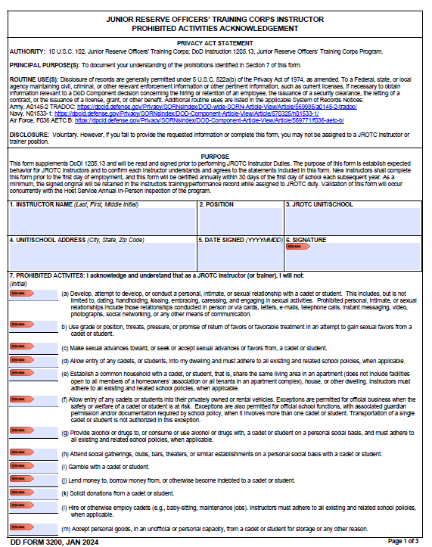
DD Form 3200
DoDI 1205.13
DoDI 1205.13: Will Not
Allow entry of any Cadets, or students, into my dwelling and must adhere to all existing and related school policies, when applicable.
Allow entry of any Cadets or students into their privately owned or rental vehicles. There are exceptions except; transportation of a single Cadet or student.
Solicit donations from a Cadet or student.
Hire or otherwise employ Cadets (e.g., baby-sitting, maintenance jobs). Instructors must adhere to all existing and related school policies.
Must be recertified annually.

Slide 6
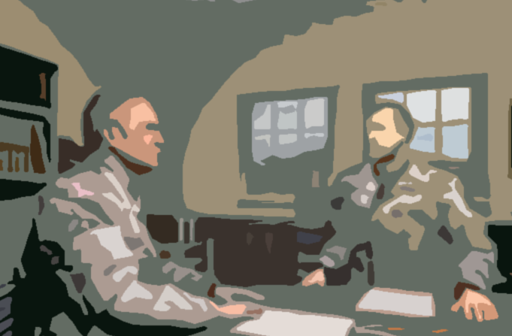
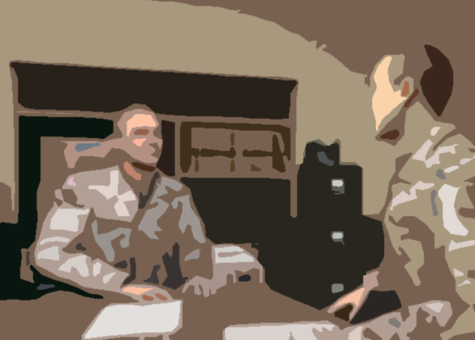
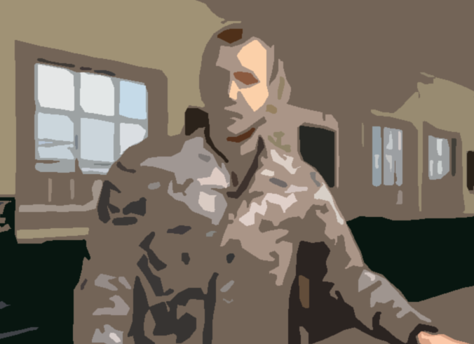
Prohibited Relationships
(AR 600-32, para 3-b(1))
Example: This is NOT what right looks like
LTC(R) Wrongway: “After Color Guard practice this afternoon, I’ll be a little late to the cookout. I’m picking Cadet Smith up at her house since her parents are out of town.”
SFC(R) Smart: “Sir, are you sure about picking the Cadet up at her house in your POV?”
LTC(R) Wrongway: “It’s no big deal, I’ve done it before, and she always sends me a text if it’s an issue.”
Example: This is what right looks like
LTC(R) Rightway: “Before we finish Color Guard practice this afternoon, let’s make sure all Cadets have transportation to the cookout.”
SFC(R) Smart: “Sir, what do want to do about Cadets who don’t have a ride?”
LTC(R) Rightway: “Some of the booster club parents have volunteered to pick up Cadets who don’t have a ride.”

Slide 7
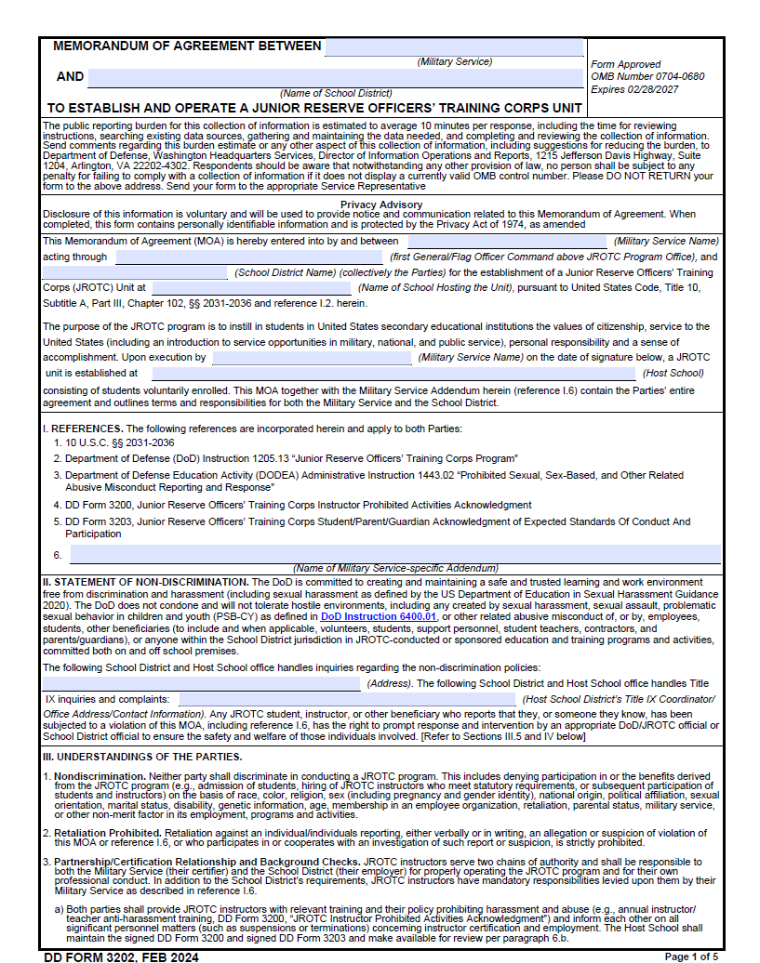
DD Form 3202
DoDI 1205.13
Memorandum of Agreement (MOA) between the military service and school district
Military Service will:
Require all JROTC instructors to authorize the release to the military service of any information the school district determines is necessary to ensure compliance with the terms of this MOA related to the JROTC instructor’s employment and/or conduct.
Assess the instructional performance of at least one instructor per school.
School district will:
Communicate with the military service on all matters concerning instructor performance, conduct, and employment as permitted by state law.
Conduct annual JROTC instructor evaluations/assessments and provide them, by electronic copy, to the military service point of contact.
Maintain and make available for review all JROTC instructor evaluations and program records during program visits and for a period of ten days following the expiration or termination of the MOA.
Maintain the signed DD Form 3200 and 3203 and make available for review.

Slide 8
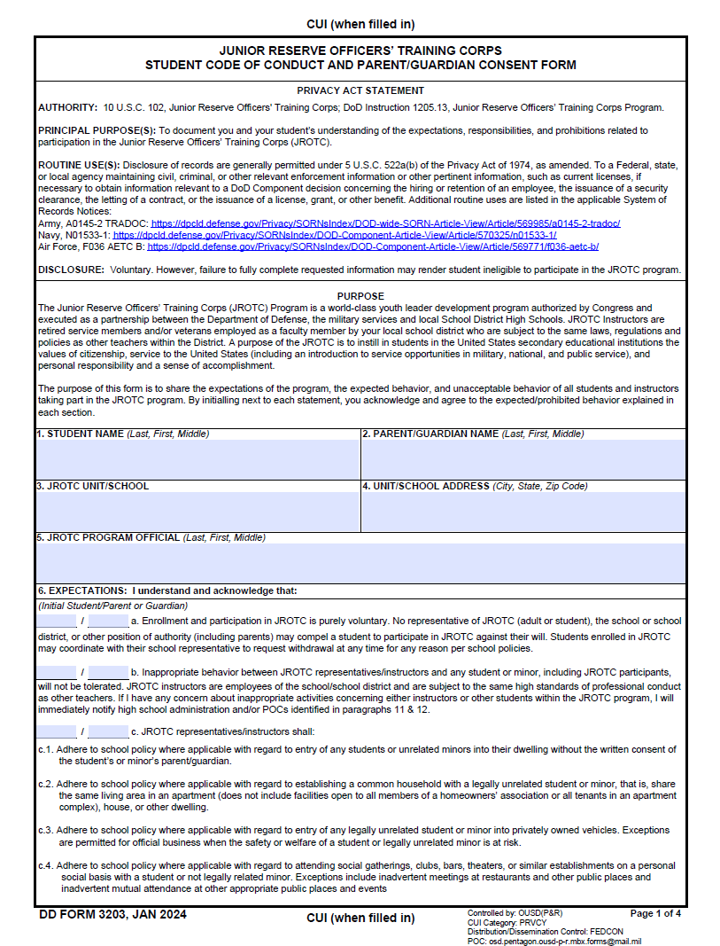
DD Form 3203
DoDI 1205.13
JROTC Student Code of Conduct and Parent/Guardian Consent Form
Purpose: Share the expectations of the program, the expected behavior, and unacceptable behavior of all students and instructors taking part in the JROTC program.
Adhering to school district polices as it relates to:
Entry into instructors’ dwellings.
Entry into instructors’ privately owned vehicles.
Attending social gatherings, clubs, bars, theaters, or similar establishments on a personal social basis with a student or not legally related minor.
Acknowledges the JROTC instructors are employees of the school/school district and are subject to the same standards of professional conduct as other teachers.
IG Contact information provided on page 3

Slide 9
Unsatisfactory Performance
(USACC Reg 145-2, 5-25)
Probation
Performance Improvement Plan (PIP)
Remediable through counseling, professional development, and other corrective measures within a year or less.
Could lead to decertification
Decertification
Performance is of a nature that is unlikely to be resolved within a year or less will be considered for immediate decertification and removal
Instructors will be given the opportunity to submit information for consideration before such action becomes final.

Slide 10
Probation
(USACC Reg 145-2, 5-25)
Not in compliance with the USACC Fitness and Appearance standards.
Unsatisfactory performance on JPA IAW CCR 145-8-3.
Violating public trust, displaying disrespect, misconduct or performance.
Adverse initial counseling and failure to improve in accordance with the performance counseling.
Failure to complete the mandatory training requirements.
Failure to attend JCLC.
Violation(s) of local school policies as they relate to teacher conduct, behavior, and performance.
Failure to properly manage their annual JROTC budget and/or failure to complete required Government Purchase Card actions in a timely manner.
Failure to ensure Cadet participation in JLAB Level I. Instructors must “Reply by Endorsement” to Brigade Commander, in the event their program fails to participate in JLAB Level I.

Slide 11
Decertification
(USACC Reg 145-2, 5-25)
Failure to meet the weight standard in the prescribed time or re-entering the BWCP within 12 months after meeting the standards.
Failing two consecutive JPAs.
Violating public trust, displaying disrespect, misconduct, substance abuse.
Non-favorable Childcare National Agency Check and Inquiries (CNACI).
Failure to meet the requirements associated with the performance counseling.
Failure to complete mandatory JROTC instructor training, IAW this regulation.
Failure to attend JCLC without being excused by Brigade.
Unauthorized wear of rank, awards, and decorations.
Conduct that does not meet the standards expected of an Army officer/WO/NCO.
Knowingly entering fraudulent information on the instructor application for qualification.
Not maintaining a military appearance or standards in accordance with AR 670-1 (hair, mustache, uniform, obesity, etc.).
Inappropriate contact and/or relationship with Cadets and or students as defined by public law and school policies/directives.
Conduct causing discredit or embarrassment to the Army or the JROTC program.
An instructor who resigns to avoid an investigation by school officials or police into allegations of misconduct will be decertified and not eligible for rehire at any JROTC program.

Slide 12
Parting Thoughts
UNCLASSIFIED
Things that can help to minimize issues…based on what IGs have seen and heard.
Build trust and promote dignity & respect
Avoid taking it personal and keep emotions in check.
Maintain open lines of communication, especially during a transition.
Consistency of actions over time…disparate treatment can lead to issues.
Maintain humility, accessibility, and approachability.
JROTC programs can take on the personality and character of its leadership.
Time spent with people is time never wasted
The more time you spend with them, the more they’ll talk, and the more you’ll learn facilitating more informed decisions.
Treat each day like your first….
Example setting…people are watching.
Watch out for misperceptions and miscommunication – think it through first.
You are here for a reason – you are a proven Leader and Role Model
Trust your “Leader Sense”; and when in doubt, talk to an IG.
Positive attitude day to day…it won’t always be easy
UNCLASSIFIED
CUI

Slide 13
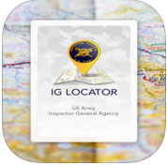
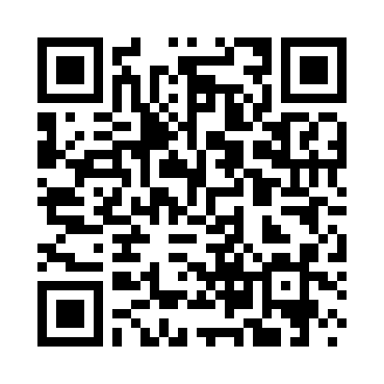
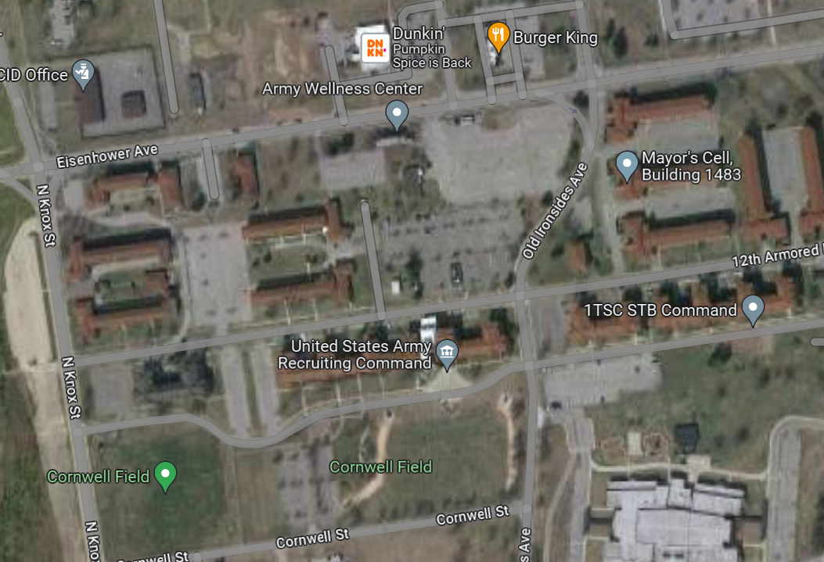
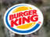

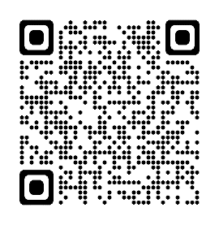
UNCLASSIFIED
How can you contact the IG?
USACC & Fort Knox Office of the Inspector General
1270 Old Ironsides Avenue BLDG 1481
Fort Knox, KY 40121
IG Hotline: (502)624-7747
usarmy.knox.usacc.mbx.hq-ss-ig@army.mil
BLDG 1481
Inspector General Locator
USACC & Fort Knox IG
UNCLASSIFIED

Slide 14
JROTC School of Cadet Command
Instructor Training Course

