Slide 1
Title IX Inquire Phase Exercise
Learning Objectives:​
Describe your understanding of Title IX’s scope and jurisdiction
List the types of sexual harassment that violate Title IX
Categorize examples of programs and activities covered by Title IX
Identify conduct that constitutes sexual harassment
Distinguish what is and is not consent
Review the Sexual Harassment Scenario’s to determine how each violated Title IX provisions

Slide 2
Title IX Inquire Phase Exercise
Essential Question:​
What is Title IX?
No person in the United States shall, on the basis of sex, be excluded from participation in, be denied the benefits of, or be subjected to discrimination under any education program or activity receiving federal financial assistance.
20 U.S.C. § 1681 et seq

Slide 3
Title IX Gather Phase
Focusing Question:
  Who does Title IX apply to?
Title IX applies to:
  All entities that receive federal financial assistance. This includes public schools, colleges and universities.

Slide 4

Title IX History
Women have more opportunities to play college sports
Between 1971-72 and 2011-12 there was a 600% increase in collegiate women athletes, and women received 48% of athletic scholarships compared to 2%
More women earn university degrees
In 1950 only 25% of college graduates were women, now they make up the majority of bachelor degree earners
Women are eligible for more financial support
Women are now eligible for prestigious awards like Rhodes scholarships and more general financial aid
Any gender can study whatever they want
It has opened access to more traditionally female roles (teaching, nursing, etc) as well as more male roles for women.
In 1972 women earned 7% of law and 9% of medical degrees, now earn nearly half in both

Slide 5
Title IX Inquire Phase Exercise
Essential Question:​
What are the institutions’ overall duties?
  Respond to known acts of sexual harassment in a manner that is not clearly unreasonable
  Treat complainants and respondents equitably
  Offer supportive measures
  Utilize a grievance procedure in response to formal complaints and before imposing discipline

Slide 6
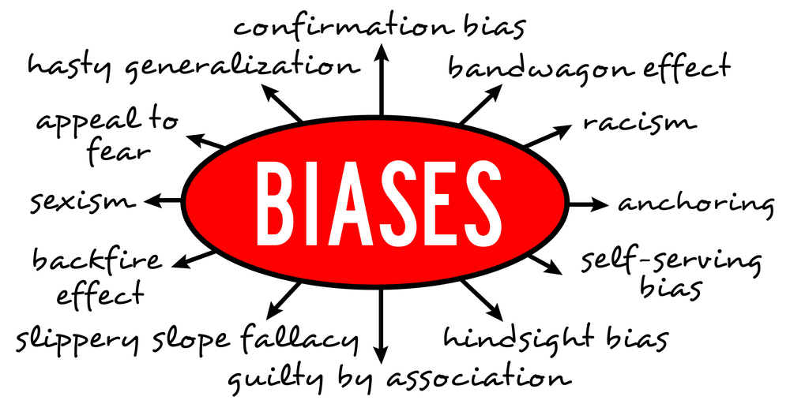
Biases
Reflection and Discussion
Subconscious Bias in Virtual Interviews - HR Daily Advisor (blr.com)
Notes:
Hand out bias worksheet and allow time to reflect and discuss.

Slide 7
Title IX Gather Phase
What types of sexual harassment does Title IX apply to?
  Title IX applies to sexual harassment in the “education program or activity” of a federal funding recipient
    Title IX defines “education program or activity” to include the “operations” of educational institutions
Title IX does not apply to private conduct occurring in private location that is not part of education program/activity

Slide 8
Title IX Gather Phase
Examples of Educational Programs and Education Activities:
  Sports Affiliations √
  School organized off-campus activities √
  School sponsored activities √
  Academics √
  School-owned housing √
  Hiring Practices √

Slide 9
Sexual misconduct falls into one or more of the following 6 categories:
  Hostile Environment: Unwelcome conduct determined by a reasonable person to be so severe, pervasive, and objectively offensive that it effectively denies a person equal access to the recipient’s education program or activity
  Quid Pro Quo: An employee of the University conditioning the provision of an aid, benefit, or service of the University on an individual’s participation in unwelcome sexual conduct
Single occurrence of:
  Sexual assault
  Dating violence
  Domestic violence
  Stalking

Slide 10
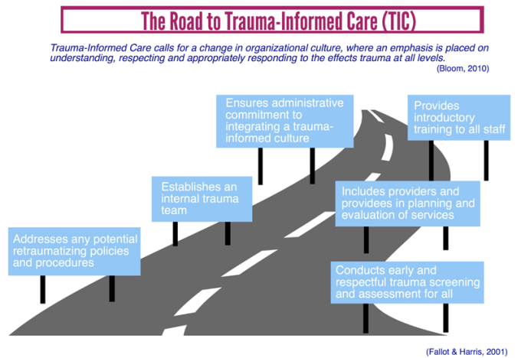
What is TIC?
“Trauma-Informed Care (TIC) is an approach in the human service field that assumes that an individual is more likely than not to have a history of trauma. Trauma-Informed Care recognizes the presence of trauma symptoms and acknowledges the role trauma may play in an individual’s life- including service staff.”
The Institute of Trauma and Trauma-Informed Care (ITTIC)
Notes:
Explain in your own words

Slide 11
Title IX Gather Phase
What is sexual misconduct?
  On the basis of sex, conduct that is:
    Quid pro quo harassment
    Hostile (work) environment
    Sexual assault
    Dating violence
    Domestic violence
    Stalking

Slide 12
Title IX Gather Phase
What is hostile environment?
  “Unwelcome conduct determined by a reasonable person to be so severe, pervasive, and objectively offensive that it effectively denies a person equal access to the recipient’s education program or activity.”
  -Title IX

Slide 13
Title IX Gather Phase
What is quid pro quo?
  When an employee of the educational institution promises some aid, benefit, or service in exchange for another's participation in unwelcome sexual conduct
  This often arises in the employment context or where an employee holds a position of authority over a student

Slide 14
Title IX Gather Phase
What is sexual assault?
  Rape
  Sodomy
  Fondling

Slide 15
Title IX Gather Phase
What is rape?
  Having carnal knowledge of a person, without the consent of the victim, including instances where the victim is incapable of giving consent because of age or because of temporary or permanent mental or physical incapacity. There is “carnal knowledge” if there is a bodily connection with another by way of sexual intercourse. Attempted rape is included.

Slide 16
Title IX Gather Phase
What is consent?
  Freely given agreement by a person with capacity to engage in the sexual activity at issue
  Must be words or perceptible actions reasonably perceived as agreement given totality of circumstances
  A person who is incapacitated is not capable of giving consent
  Consent cannot be procured by coercion
  Be above the minimum age of consent

Slide 17
Title IX Gather Phase
What is incapacity?
  Incapacity refers to a state where a person does not have the ability to make rational decisions as to whether or not to engage in sexual activity because they do not understand the “who, what, when, where, why, or how” of the interaction.

Slide 18
Title IX Gather Phase
What is sodomy?
  Oral or anal sexual intercourse with another person without the consent of the victim, including instances where the victim is incapable of giving consent because of age or because of temporary or permanent mental or physical incapacity.

Slide 19
Title IX Gather Phase
What is fondling?
  Touching of the private body parts of another person for the purpose of sexual gratification, without the consent of the victim, including instances where the victim is incapable of giving consent because of age or because of temporary or permanent mental or physical incapacity.

Slide 20
Title IX Gather Phase
What is statutory rape?
  Sexual intercourse with a person who is under the statutory age of consent as defined by law.

Slide 21
Title IX Gather Phase
What is stalking?
  Engaging in conduct focused on a specific person that would cause a reasonable person to:
    Fear for their safety
    Fear for the safety of others
    Suffer substantial emotional distress

Slide 22
Title IX Gather Phase
Does Title IX also prohibit retaliation?
  Yes – Title IX prohibits intimidation, threats, coercion, or discrimination against any individual for the purpose of interfering with any right or privilege secured by Title IX and its implementing regulations or because an individual has made a report or complaint, testified, assisted, participated in or refused to participate in any manner in an investigation, proceeding, or hearing under the institution’s policy.

Slide 23
Title IX Process Phase – Scenarios
Are these scenarios violations of Title IX?
  1. A Cadet is sexually assaulted on campus. The sexual assault occurs on a Saturday evening during a school event.
  2. The Drill team travels to a different school for a tournament and stays overnight at a hotel. At the hotel where the team is staying, the Instructor sexually harasses a team member.
  3. During spring break, two students travel with their families to another state and stay at an all-inclusive resort. While staying at the resort, one student sexually assaults the other student.
Notes:
1 and 2 are YES and 3 is NO

Slide 24
Title IX Process Phase – Scenarios
Into which category does this incident of sexual harassment belong:
  An Instructor provides a Cadet with several alcoholic drinks and takes them to his home. The Cadet passes into a stupor and the Instructor then has sex with the Cadet.
    Quid pro quo harassment
    Hostile environment
    Sexual assault
    Stalking
Notes:
Sexual Assault

Slide 25
Title IX Process Phase – Scenarios
Into which category does this incident of sexual harassment belong:
  An Instructor is infatuated with a Cadet, who has rebuffed her romantic advances. Thereafter, the Instructor dresses in black and sneaks up to the Cadet’s window at night to watch them. This occurs twice before being caught in the act during the third attempt.
    Quid pro quo harassment
    Hostile environment
    Sexual assault
    Stalking
Notes:
Stalking
*Discuss 1st sentence in scenario. Jq

Slide 26
Title IX Process Phase – Scenarios
Into which category does this incident of sexual harassment belong:
  1. An Instructor tells a Cadet that they will not get a promotion this year unless the Cadet performs sexual favors.
    Quid pro quo harassment
    Hostile (work) environment
    Sexual assault
    Stalking
Notes:
Quid pro quo harassment

Slide 27
Title IX Process Phase – Scenarios
Into which category does this incident of sexual harassment belong:
  An Instructor repeatedly sends text messages using various vulgar terms that suggests a Cadet is promiscuous or has knowledge of another sending similar messages and takes no action to remedy the situation.
    Quid pro quo harassment
    Hostile environment
    Sexual assault
    Stalking
Notes:
Hostile environment

Slide 28
Review:
What is the scope of Title IX’s reach?
Sex
Discrimination
Title IX applies to sex discrimination in the “education program or activity” of a federal funding recipient
  Title IX defines “education program or activity” to include the “operations” of educational institutions
Title IX does not apply to private conduct occurring in private location that is not part of education program/activity
Education program / activities within the U.S.
Notes:
Admissions, hiring, workplace, academic instruction, residence life, events/amenities on campus, sports, work-study, clinical rotations, off-campus trips or experiences organized by the institution, sponsored organization activities, anything else that happens on campus

Slide 29
Review:
Does Title IX apply to off-campus sexual harassment?
Yes, if the conduct at issue occurs in the context of an education program or activity
Yes, if the conduct at issue occurs in a location owned/controlled by the institution or officially-recognized student organization
No, if it occurs in a private location and is not part of an institution’s education program or activity
No, if it occurs outside the United States

Slide 30

Mandatory Reporters
These are individuals who have an obligation to report incidents of sexual harassment to the Title IX Coordinator or a Deputy Title IX Coordinator
This can be determined by the institution or mandated by state law
When a mandatory reporter receives information that might be connected to a Title IX complaint, they should contact the Title IX office.
  Mandatory reporters should not take any steps to gather more information or investigate the claims

Slide 31
Other Types of Employees
Confidential Reporters
Some institutions offer confidential resources for individuals regarding sexual misconduct. Confidential Reporting means details of the incident are kept confidential by law and are not considered an official report of any type of Sexual Misconduct to the institution.
Officials with the Authority to Act
These are individuals who have the ability and obligation to act on a complaint of sexual misconduct.
This includes Title IX Coordinators and designated individuals

Slide 32
Title IX Mandatory Reporters – What to Say to a person who shares allegations of sexual misconduct
“At our institution we take sexual misconduct, sexual assault, dating violence, domestic violence, stalking, and all forms of sex discrimination seriously and are very concerned if this happens to someone in our community.
“As an employee of the institution, I have an obligation to inform the Title IX Coordinator [or law enforcement when regarding child or domestic abuse, neglect, or violence] about an incident like this. There are campus resources that can provide confidential support and discuss options with you (or an alleged victim).”

Slide 33
Clery Act Reporters – Campus Security Authority (CSA)
CSAs include officials of an institution who have a significant responsibility for student and campus activities, including, but not limited to, student housing, student discipline, and campus judicial proceedings. Most of these mandatory reporters are specifically not required by the Clery Act to disclose PII.
  34 C.F.R. §668.46(a)

Slide 34
Does refusal to use chosen names and pronouns create a hostile environment?
Federal law does not (presently) mandate the use of chosen (a/k/a “preferred”) names or pronouns for any student (cisgender, transgender, or otherwise)
But the refusal to use chosen names and pronouns based on protected status and/or the use of non-chosen names and pronouns based on protected status may constitute discrimination or harassment based on the facts
Sexual harassment under Title IX does not include conduct that is protected by the First Amendment
The subjective offensiveness of speech, alone, is not sufficient to create a hostile environment
Notes:
While sexual harassment can be verbal or written in nature, sexual harassment under Title IX does not include conduct that is protected by the First Amendment
The subjective offensiveness of speech, alone, is not sufficient to create a hostile environment

Slide 35
Transgender Students
State Laws
Army Policies
Institutional Policies
Title IX Regulations
Treat all students with dignity and respect!

Slide 36
Pregnancy/Parenting & Title IX
“Schools must not discriminate against any student, or exclude any student from their education program or activity, including any class or extracurricular activity, based on a student’s pregnancy, childbirth, false pregnancy, termination of pregnancy, or recovery therefrom. 34 C.F.R. § 106.40(b)(1). A school also must not discriminate against or exclude from employment any employee or employment applicant on these bases. 34 C.F.R. § 106.57(b).”
-Department of Education October 2022 Fact Sheet
Notes:
Pregnancy protections have long been a part of Title IX expectations. In short, an institution cannot discriminate or exclude someone because of pregnancy status. This means that if a student needs to step out because of pregnancy or childbirth, they must be allowed to return at the same level as before.

Slide 37
Title IX prohibits retaliation
No institution or other person may intimidate, threaten, coerce, or discriminate against any individual for the purpose of interfering with any right or privilege secured by title IX or this part, or because the individual has made a report or complaint, testified, assisted, or participated or refused to participate in any manner in an investigation, proceeding, or hearing under this part.
Intimidation, threats, coercion, or discrimination, including charges against an individual for code of conduct violations that do not involve sex discrimination or sexual harassment, but arise out of the same facts or circumstances as a report or complaint of sex discrimination, or a report or formal complaint of sexual harassment, for the purpose of interfering with any right or privilege secured by title IX or this part, constitutes retaliation. [Example: removing an instructor for failing to follow Army Values; suspending instructor funding; suspending scholarship funds]
Allow the institution to complete their Title IX process before acting!

Slide 38
Title IX Apply Phase
Does the First Amendment matter?
  While sexual harassment can be verbal or written in nature, sexual harassment under Title IX does not include conduct that is protected by the First Amendment
  The subjective offensiveness of speech, alone, is not sufficient to create a hostile environment
  Questions / Observations
Notes:
Stalking

Slide 39
Title IX Inquire Phase Exercise
Learning Objectives:​
Describe your understanding of Title IX’s scope and jurisdiction
List the types of sexual harassment that violate Title IX
Categorize examples of programs and activities covered by Title IX
Identify conduct that constitutes sexual harassment
Distinguish what is and is not consent
Review the Sexual Harassment Scenario’s to determine how each violated Title IX provisions

Slide 40
Title IX Apply Phase
  What else can you do with what you’ve learned today?
  Review this lesson’s Essential Question.
Essential Question:​
What is Title IX?
Notes:
Stalking

Slide 41
Ethical Decision-Making Framework Exercise
Each table group will facilitate a discussion with the class about the decisions you have made regarding your assigned scenario.
Include the following in your discussion:
  a. Read your scenario aloud to the class.
  b. Briefly present to the class the pros and cons of each of your decisions.
  c. Solicit feedback from the class. You must control the discussion and the class.

