Slide 1

U.S. Army Cadet Command
JROTC Director
“Motivating Young People to be Better Citizens”
Notes:
Welcome to the Army Junior ROTC Onboarding Course. This is an overview of the Army Junior ROTC Program.

Slide 2
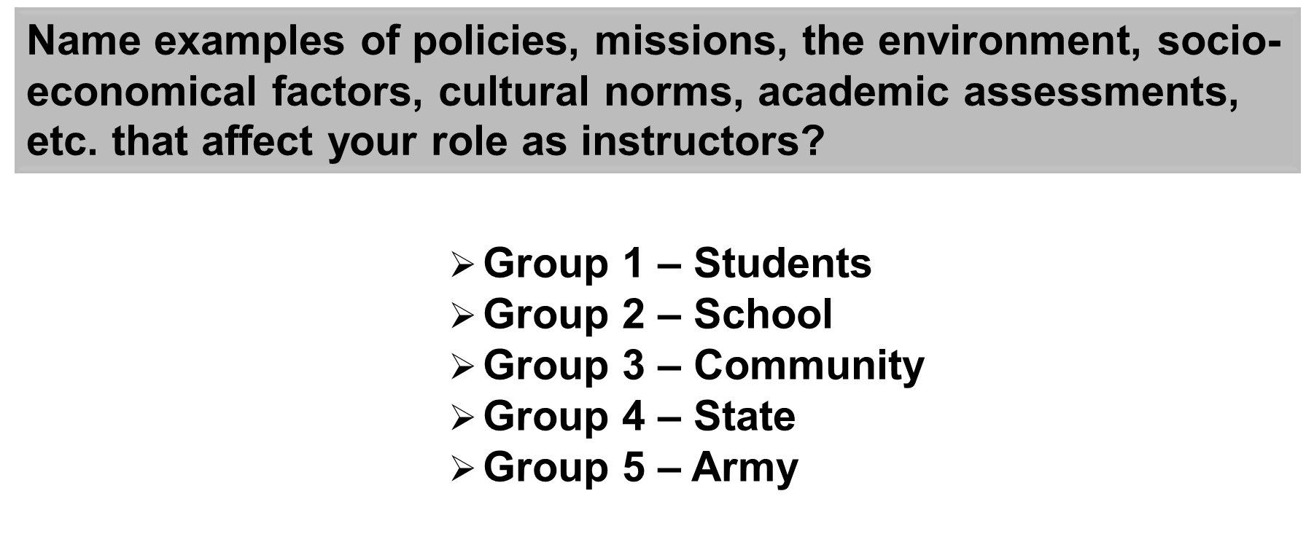
Activity

Slide 3
Agenda
Mission and Goals
Power of JROTC
Unit Status
Program Priorities
Cyber Pilot Program
JROTC Expansion
Talent Acquisition
Modernize Curriculum/STEM Opportunities
Co-Curricular Events
Overcoming Challenges
Questions

Slide 4
Mission and Goals
Title 10 USC Mission:
It is a purpose of the Junior Reserve Officers' Training Corps to instill in students in United States secondary educational institutions the values of citizenship, service to the United States (including an introduction to service opportunities in military, national, and public service), personal responsibility and a sense of accomplishment.
Goals of the JROTC Program:
High school students graduate prepared to succeed in post-secondary options and career pathways
Make decisions that promote positive social, emotional, and physical health
Value the role of the military and other service organizations
Act with integrity and personal accountability as students learn to lead others to succeed in a diverse and global workforce
Engage in civic concerns that impact the community and society at large

Slide 5
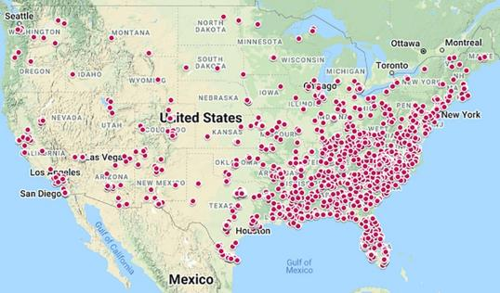
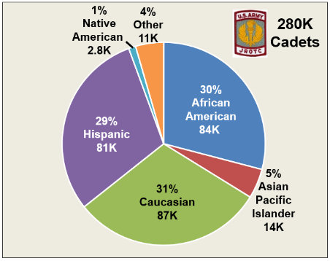
The Power of JROTC Dollar for Dollar the Army’s Best Investment in Our Nation’s Youth
Title 10 USC Chapter 102: JROTC is a 180 hour per year high school elective youth citizenship program focused on Civics, Leadership, Teamwork and STEM
Army in 1744 schools (5% of US High Schools); ~50% of DoD JROTC programs
Led by ~4K Soldiers for Life “Giving Back”
Low Cost – High Impact (~$800 Per Cadet for Curricula, Equipment, Uniforms and Instructors)
Students at schools with Army JROTC twice as likely to enlist
44% RA enlistments (FY19-21) came from schools with JROTC
21% came from schools with an Army JROTC program
JROTC Cadets outperform their peers:
Higher Attendance (3.5% ↑)
Graduation Rates (9% ↑)
GPA (11% ↑)
JROTC Builds Propensity
JROTC Cadets earned 32% of SROTC scholarships in FY23
23% of JROTC Seniors indicate they plan to enlist; 9% plan to pursue a commissioning program
Current JROTC Distribution
1744 Army JROTC Programs (as of NOV 24); ½ DoD portfolio
Army JROTC
Largest & Most Diverse Institution
JROTC Builds Public Awareness, Produces Better Citizens and Increases Propensity to Serve
Notes:
This slide represents the distribution of programs across the nation including our territories and overseas locations. We currently have 1729 JROTC units and 43 National Defense Cadet Corps programs. The states in green are over represented with JROTC programs based on the number of high schools in that state. The states in blue are under represented. As you can see, we are weighted heavily in the South and Southeastern areas of the Nation.
Another significant factor about JROTC is that Cadets generally outperform their peers in the high school and students in schools with Army JROTC are twice as likely to enlist for military service. Additionally, JROTC Cadets earn 26% of scholarships offered for Senior ROTC. However, our primary focus is to prepare the students to become better citizens when they graduate.

Slide 6
FY24 Current Unit Status
Geographic Distribution (Number of Schools in the State / Total of High Schools in the Nation (36023)
(Example: MI (1439/36023) * 1744 = 70
(AE)
Germany 6 Italy 1
6/14
AK
14/46
WA
2/7 NH
5/9
ME
2/10
MT
2/9
ND
3/6 VT
4/21
OR
4/58
MN
12/29 MA
1/16
ID
3/11
SD
7/38
WI
28/92/2/1
NY
3/5 RI
4/6
WY
29/70
MI
5/17 CT
3/20
IA
30/60/1
PA
11/18
NE
21/31/1 IN
25/61
OH
26/38/1 NJ
19/10/2
NV
53/60
IL
20/10
WV
4/4/2 DE
5/18/1
UT
23/31
CO
56/31/1 VA
24/22/2 MD
80/167
CA
10/22
KS
32/43/1
MO
KY
62/25/4
127/47/3
8/6/1 DC
TN
NC
16/26/1
OK
72/34/8
79/22/3
27/50/2 AZ
16/15
NM
25/20
AR
SC
Hawaii 18/6
48/23/4
MS
76/31/6
AL
124/41/1
GA
Am. Samoa 5/29
205/142/2/4
TX
52/24/1/3
LA
167/109/3
FL
Guam 3/44
Virgin Islands 4/19
(MP) North Marianas 5/29
Puerto Rico 5/144
(AP)
Korea 2
Japan 1
JROTC Units – 1744
NDCC Units – 52
CYBER – 9
OCONUS
JROTC – 56
As of 6 November 24
OCONUS and CYBER included in overall count
Key
# of JROTC programs / Authorized # of JROTC Programs
Oversubscribed States
Undersubscribed States
Neither Over/Undersubscribed areas

Slide 7
Program Priorities
New Instructor Expanded Eligibility Requirements (authorized NDAA FY23)
New JROTC Standardized Instructor Pay Scale (JSIPS) (authorized NDAA FY24 - effective AUG 2024)
Enhanced Oversight
DD Form 3200 JROTC Instructor Prohibited Activities Acknowledgement (on-going)
DD Form 3202 Memorandum Of Agreement Between Military Service and School District to Establish and Operate a JROTC Unit (on-going)
DD Form 3203 JROTC Student Code of Conduct and Parent/Guardian Consent Form (on-going)
USACC Transition to USAREC – (on-going)
JROTC Program Guide for Administrators (working 2nd Edition)
JROTC Instructor Handbook (working 2nd Edition)
Audits:
TRADOC IRAC
Army Audit Agency
Government Accountability Office

Slide 8
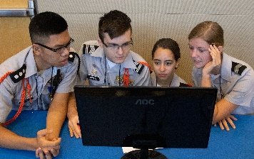
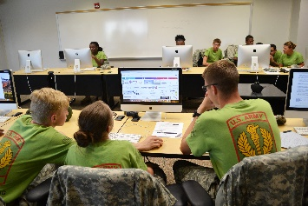
JROTC Cyber Program Pilot
Shortridge HS Indianapolis, IN
1/2 Instructors
Missouri Military Academy
Mexico, MO
1/2 Instructors
Thomas Edison HS
Queens, NY
2/2 Instructors
Putnam City West HS
OKC, OK
1/2 Instructors
Francis Lewis HS
Fresh Meadows, NY
1/2 Instructors
Vanguard HS
Mesquite, TX
1/2 Instructors
Jackson-Reed HS
Washington, D.C.
1/2 Instructors
Sidney Lanier HS
San Antonio, TX
1/2 Instructors
Liberty HS
Baton Rouge, LA
1/2 Instructors
JROTC Cyber is a 130-hour high school elective with 82 hours of Cyber-security training and 48 hours of Traditional JROTC instruction
Opened 9 schools in 4th QTR, FY22 (SY 22/23)
Future expansion after SY23-24 on hold
Initial Pilot program assessment completed in Fall 2023
Second Pilot program assessment completed at USACC and submitted through USAREC to ASA M&RA – JUL 2024

Slide 9
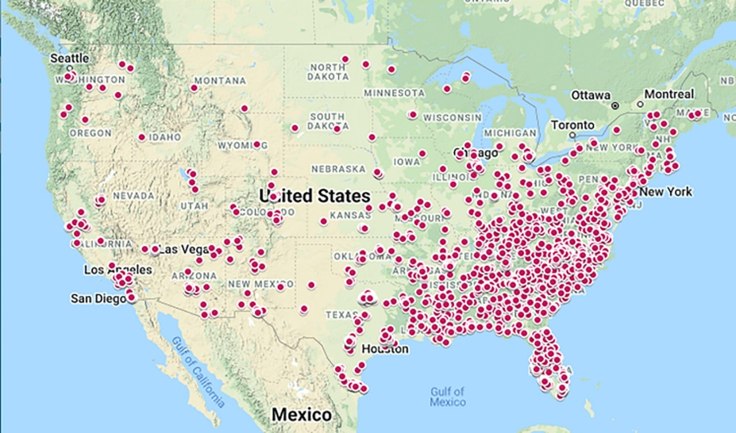
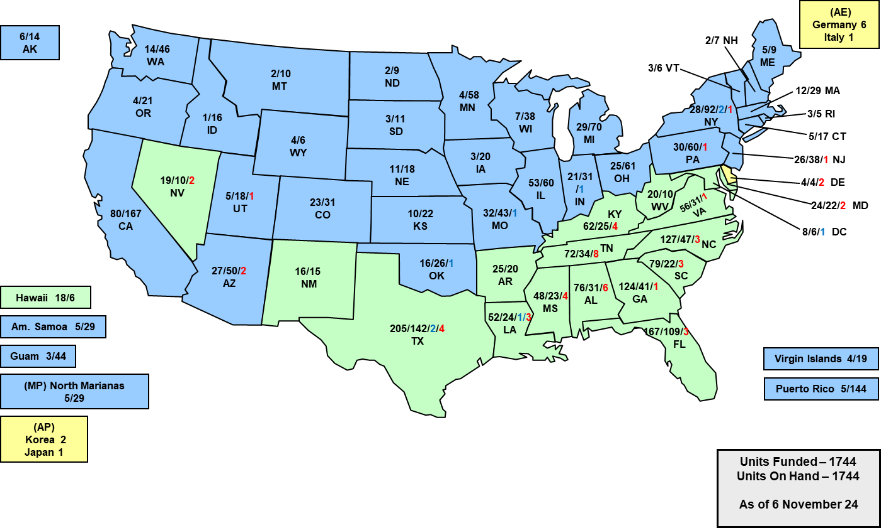
JROTC Expansion
JROTC new program expansion has been focused on Northeast, Midwest and West
JROTC has high-level Congressional Visibility (Oversight & Expansion)
Expanding JROTC Access:
FY22: Launched the JROTC Cyber Pilot (9 Schools)
FY23: Opened 29 new JROTC programs in diverse markets to achieve the funded level
FY24: Brought total programs to 1,734 funding cap in undersubscribed markets (blue states/red circles)
FY25: Bring total programs to 1,744 funding cap – (schools identified)
FY26: Bring total programs to 1,754 funding cap – (schools identified)
FY27 and beyond: Evaluate further expansion opportunities in accordance with Army Senior Leader Guidance
JROTC Program Distribution
JROTC Expansion Plans
Expanding JROTC Helps Produce Better Citizens for America
Notes:
Per Army People Strategy Memorandum, USACC is continuing to expand the Army JROTC Program into under represented areas of the Nation. We recently opened nearly 30 new JROTC programs in coordination with our Order of Merit List (OML). We will expand to 1734 JROTC units in FY24 and currently have nearly 240 high schools on the OML who have asked to host a JROTC program.

Slide 10
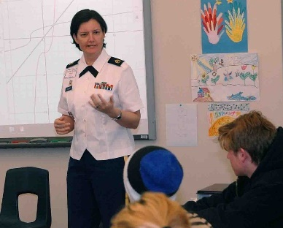
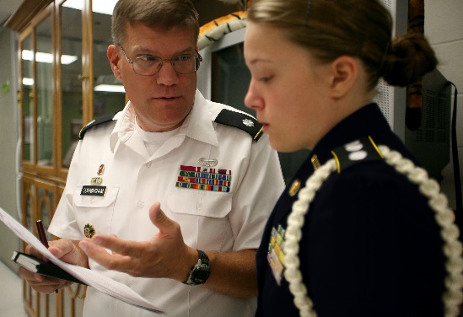
Talent Acquisition
Need to attract the appropriate talent for a modernized program
Expanded eligibility-Army officers and noncommissioned officers who are retired or who are separated with an honorable discharge within the past 5 years with at least 10 years of service may serve as instructors in Army JROTC units. Additionally, officers and noncommissioned officers who are active participating members of the selected reserve may serve as instructors
Recent outreach steps
Coordination with SFL-TAP and Army Retirement Services
Service-wide MILPER messages
Assistance from CASAs and Army Reserve Ambassadors
Future outreach efforts
Army Reserve and National Guard AGR
USACC PAO outreach program
Quality Instructors are the Foundation of a Successful JROTC Program

Slide 11

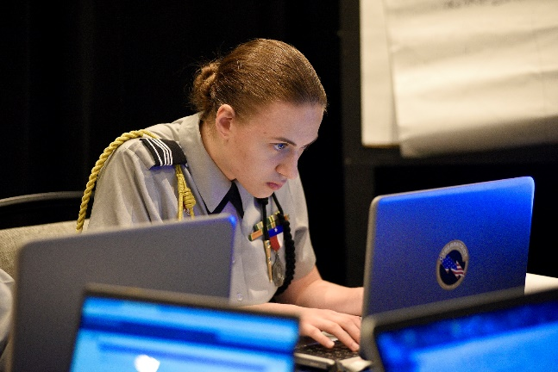
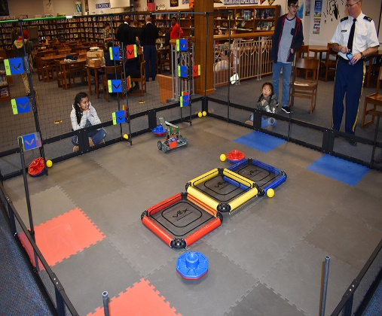
Modernize Curriculum/STEM Opportunities
JROTC Modernization policy required USACC to incorporate STEM curriculum in JROTC courses per Section 512 of FY20 NDAA
Curriculum changes
Cyber lesson electives from cyber.org
Access to multiple STEM based activities
Digital applications
- First aid
- Land navigation
Cadet distance learning applications
Co-curriculars
Providing CyberStart program to all Cadets
Investing in VEX robotics kits and competitions
Growing the number of CyberPatriot teams
Inclusion of STEM into JROTC Cadet Leadership Camps (JCLC) – rocketry, forensic sciences, FAA UAV licensing
Additional summer STEM camps
Exploring additional STEM and cybersecurity co-curriculars

Slide 12
SY 24/25 JROTC Co-curricular Events
National JROTC Events
Title | Event_Begin | Event_End | Venue_City | Venue_St | Location
2024 Raider Championships | 24-Oct-24 | 27-Oct-24 | Fort Knox, KY |  | 1-Mile Track & Sander Springs
2025 Cyber Patriot | 14-Mar-25 | 18-Mar-25 | Bethesda, MD | 5701 Marinelli Rd | N Bethesda Marriot
2025 Army JROTC Drone Championship | 7-Mar-25 | 9-Mar-25 | Fort Moore, GA
2025 National Air Rifle | 20-Mar-25 | 22-Mar-25 | Camp Perry, OH | Lamonse Drive | CMP North
2025 JROTC National Drone Championship | 3-Apr-25 | 3-Apr-25 | Batesville, MS | 290 Civic Center Dr | Batesville Civic Center
2025 NASP Western Archery Championship | 25-Apr-25 | 26-Apr-25 | Sandy, UT | 9575 State St | Mountain America Expo center
2025 VEX Robotics World Championship | 27-Apr-25 | 29-Apr-25 | Dallas, TX | 650 S Griffen St | Kay Bailey Hutchison Convention Center
2025 Army Drill Team Championships | 2-May-25 | 2-May-25 | Daytona Beach, FL | 100 N Atlantic Ave | Ocean Center
2025 Nat'l Fitness Championships | 3-May-25 | 4-May-25 | Daytona Beach, FL | 600 N Atlantic Ave | Ocean Center & Plaza Resort & Spa
2025 Nat'l HS Drill Comp (NHDTC) | 3-May-25 | 4-May-25 | Daytona Beach, FL | 100 N Atlantic Ave | Ocean Center
2025 NASP Eastern Archery Championship | 8-May-25 | 10-May-25 | Lousiville, KY | 937 Phillips Ln | Kentucky Expo center
2025 JLAB | 15-Jun-25 | 26-Jun-25 | Washington DC | 620 Michigan Ave NE | Catholic University
2025 Raider Championships | 23-Oct-25 | 26-Oct-25 | Fort Knox, KY |  | 1-Mile Track & Sander Springs
Regional/Brigade JROTC Events
2025 Western Regional Air Rifle | 7-Feb-25 | 9-Feb-25 | Sandy, UT | 9575 State St | Mountain America Expo center
2025 Southern Regional Air Rifle | 7-Feb-25 | 9-Feb-25 | Anniston, AL | 1470 Sentinal Drive | CMP South
2025 Northern Regional Air Rifle | 13-Feb-25 | 15-Feb-25 | Camp Perry, OH | Lamonse Drive | CMP North
2025 Southeast Drone Championship | 11-Apr-25 | 12-Apr-25 | Jackson, MS | 1207 Mississippi St | Mississippi Coliseum
2025 Rocky Mountain Drill Classic | 19-Apr-25 | 19-Apr-25 | Denver, CO | 4655 N Humboldt St | National Western Complex
2025 North Central Drone Championship | 16-May-25 | 18-May-25 | Flint, MI | 1700 University Ave | Connie & Jim John Recreation Center, Kettering University
2025 Northeast Drone Championship | 16-May-25 | 17-May-25 | Fairmont, WV | 1201 Locust Avenue | Falcon Center, Fairmont State University
2025 West Drone Championship | 30-May-25 | 31-May-25 | Farmington, UT | 151 S 1100 W | Legacy Event Center
New JROTC Events in 2024/25
The event dates/locations are subject to change. Please check the information periodically prior to completing competition correspondence.

Slide 13
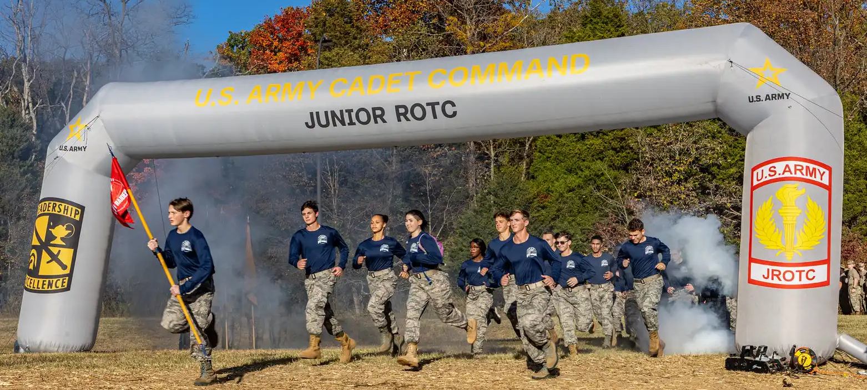
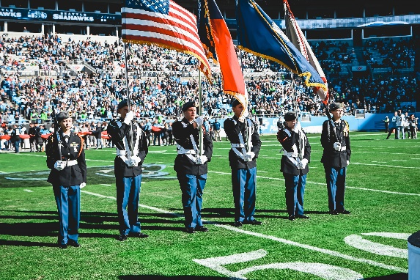
Overcoming Challenges
Achieving our strategic priorities poses challenges to JROTC
Every member of the JROTC team from USACC to instructors plays vital roles in overcoming our challenges
Tell the story of the great things you do in the school and community
Maintain property accountability
- Turn in old, inoperable or excess items
- Return DD250s upon receipt of items
JROTC Growth
Provide quality school candidates
Promote instructor opportunities
Recommend ways that we can reach out to schools and instructor candidates
Develop positive ways to retain and award instructors for work above & beyond
JROTC is postured to continue service to students and communities

Slide 14
Questions
?

Slide 16

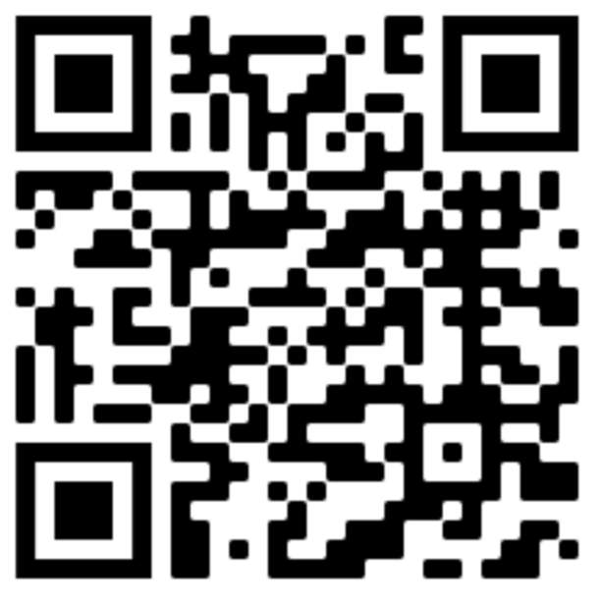
JSOCC Basic Certification Course Documents
https://www.usarmyjrotc.com/jsocc-basic-course/

