Slide 1

JPA Revision (SY 25-26)
“Motivating Young People to be Better Citizens”
Notes:
Welcome to the Army Junior ROTC Onboarding Course. This is an overview of the Army Junior ROTC Program.

Slide 2
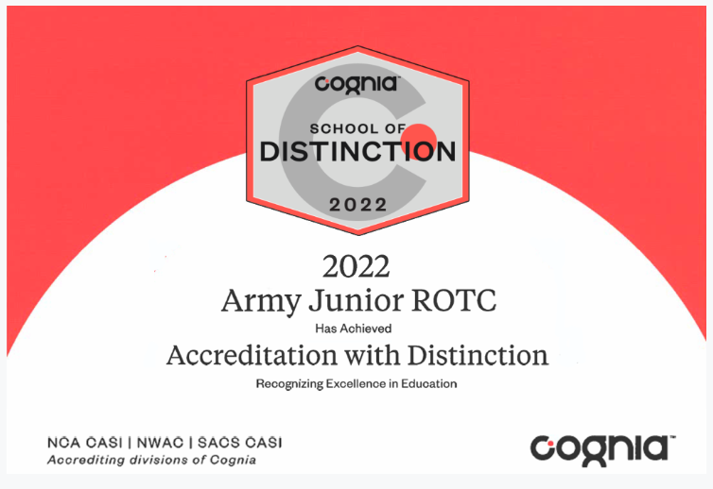
Accreditation
The reaccreditation of the Army JROTC curriculum is scheduled for the spring of 2027, but the review process is already underway.
The ‘special programs’ status we previously held has been retired.

Slide 3

Cognia Key Characteristics
The Cognia Performance Standards for K-12 and Postsecondary Institutions are now being applied to JROTC.
The majority of the revisions to CCR 145-8-3 consisted of cross walking the old standards to new Key Characteristics
https://www.cognia.org/wp-content/uploads/2021/08/Performance-Standards.pdf

Slide 4
Cognia Key Characteristics
Cognia Key Characteristics:
CULTURE OF LEARNING: the institution’s focus on the challenges, joys, and opportunities for learning, and the coherence with its mission and vision
LEADERSHIP FOR LEARNING: the responsibility of an institution’s leaders to influence and impact all aspects of the institution in positive ways
ENGAGEMENT OF LEARNING: the inclusion of all learners in the learning process, and their development of confidence and love of learning
GROWTH IN LEARNING: the growth of learners in the programs and curricula provided by the institution and their readiness to successfully transition to next levels of learning

Slide 5
JPA Changes
Minor Revision(s) – Crosswalk of Cognia Key Characteristics
Appendix B-4 Cadet Drill
Appendix B-5 In-Ranks
Appendix B-6 Color Guard
Appendix B-9 JPA School Visit (Point Summary Worksheet) – Scale change
Appendix B-10 JPA Report
Major Revision(s)
Appendix B-3 Cadet Interview
Appendix B-8 Instructor Interview
Appendix C-3 Program Compliance

Slide 6
The Cadet / Instructor Interview
Maintaining a portfolio is no longer a requirement of the JPA process for either Cadets or Instructors.

Slide 7
Appendix B-3 Cadet Interview
Cadet Interview:
The SAI/AI will choose 10 Cadets:
Three LET 1s
Three LET 2s
Two LET 3s
Two LET 4s
The Cadet Interview
Centered on 5 Core Lessons. 1 required lesson and 4 chosen by the SAI/AI.
The Personal Skills Map (PSM) is required 2x a year as a pre and post assessment (Evidence of 1 completed PSM is required for the Cadet Interview scoring)

Slide 8
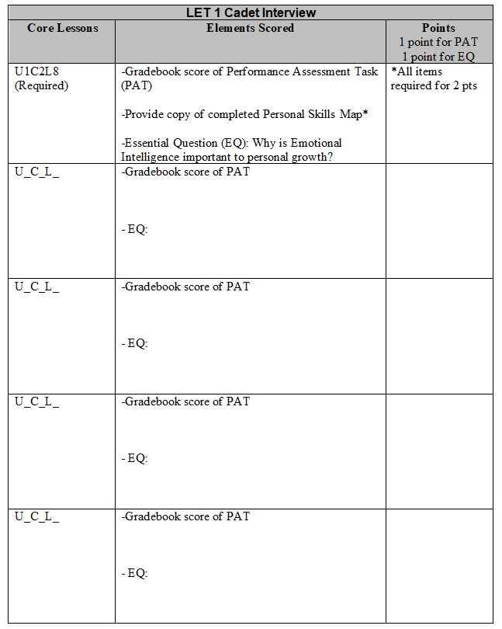
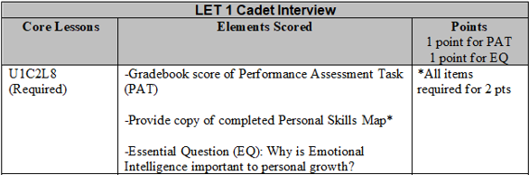
Cadet Interview LET 1

Slide 9
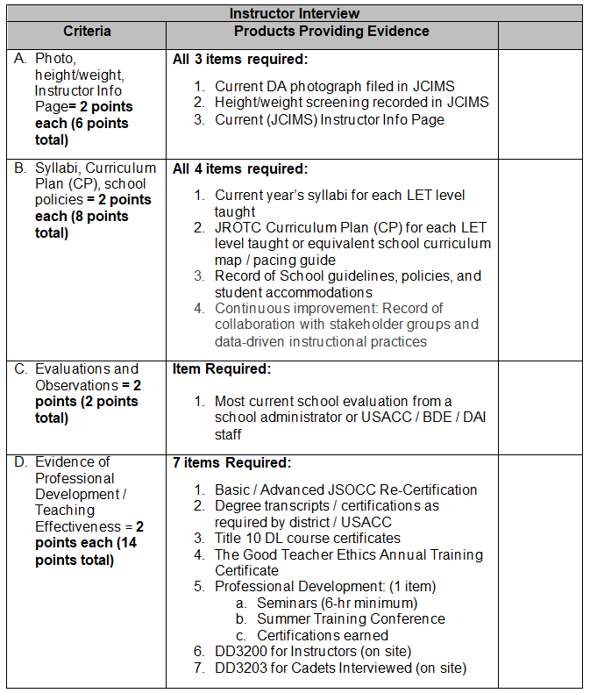
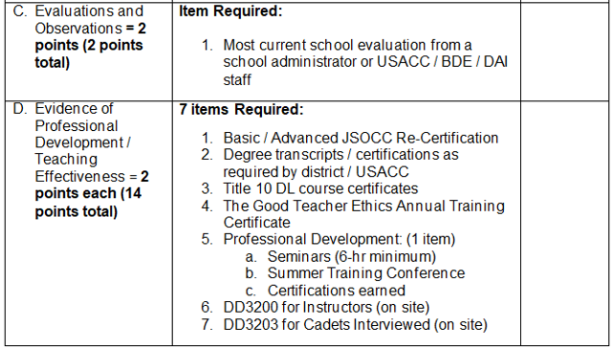
Appendix B-8 Instructor Interview

Slide 10
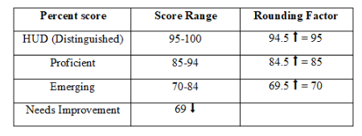
Appendix B-9 JPA School Visit (Point Summary Worksheet)

Slide 11
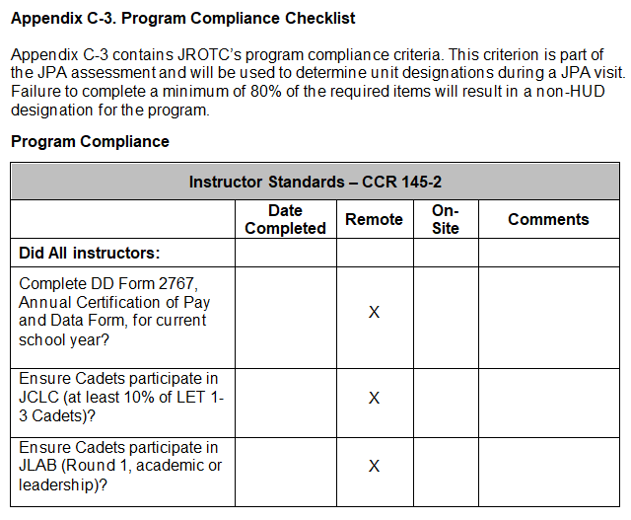
Appendix C-3 Program Compliance Checklist

Slide 12
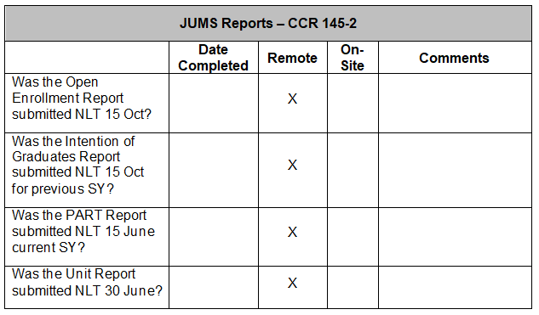
Appendix C-3 Program Compliance Checklist

Slide 13
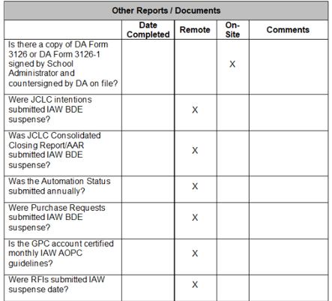
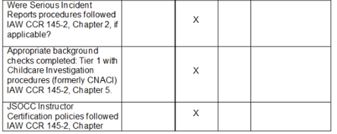
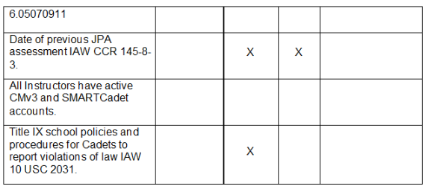
Appendix C-3 Program Compliance Checklist

Slide 14
JPA Revision (SY 25-26)
?

