Slide 1
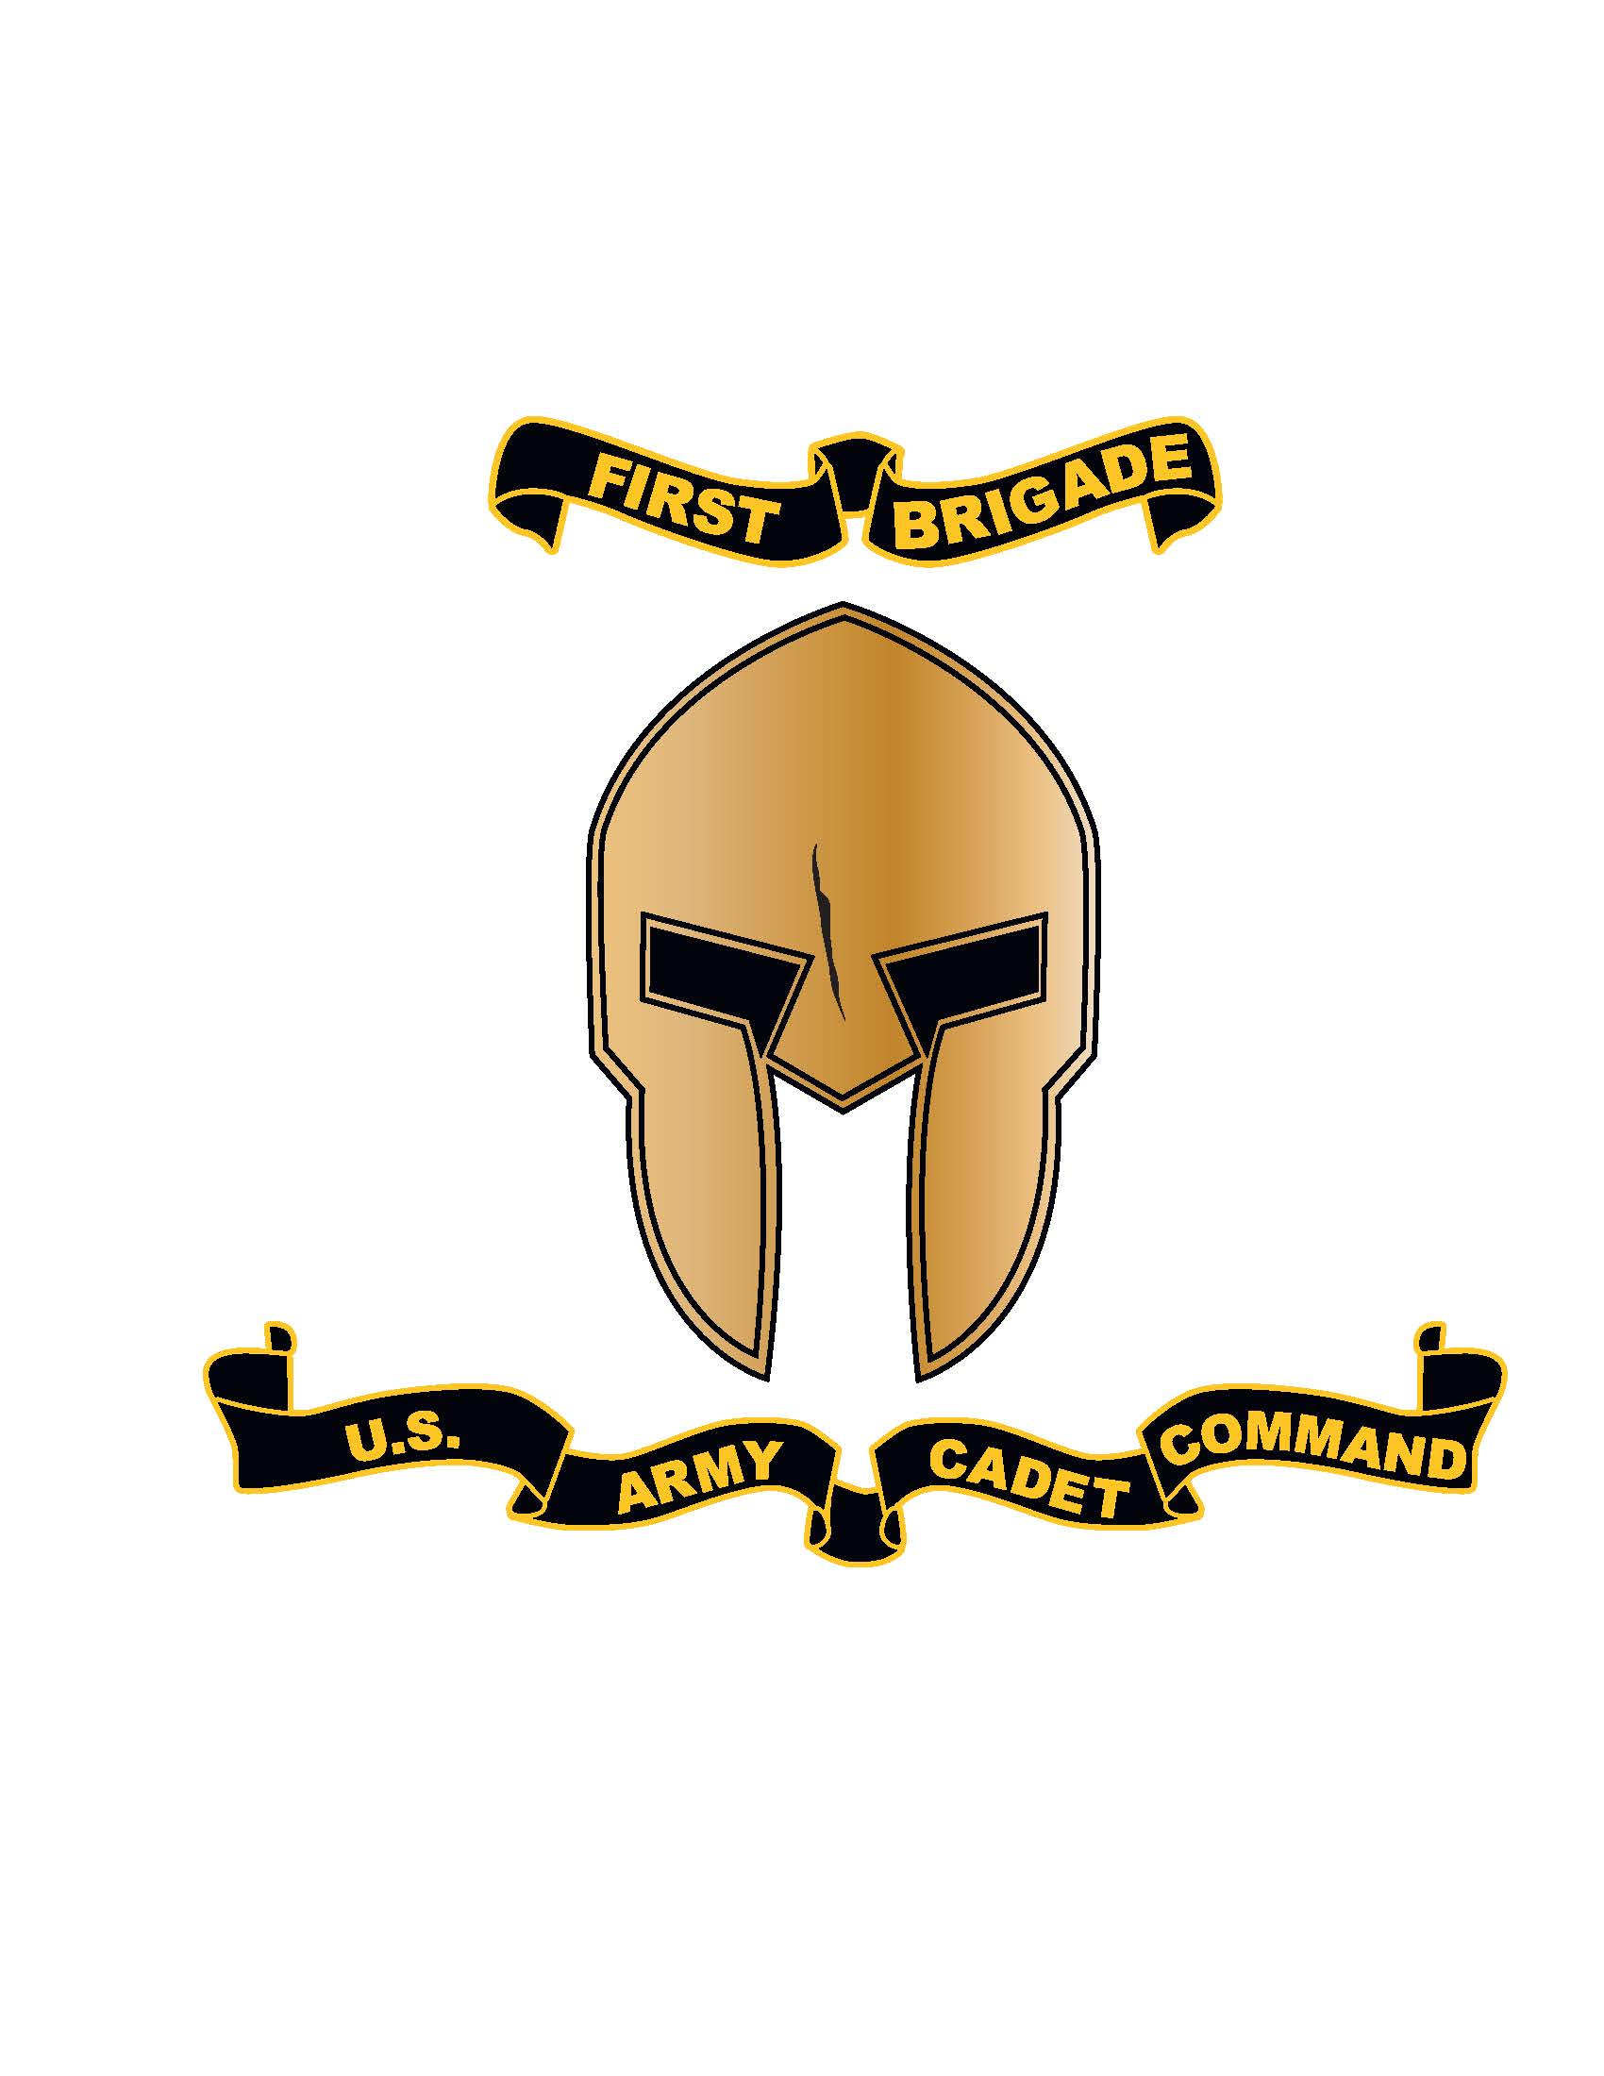
ROTC Military Colleges

Slide 2
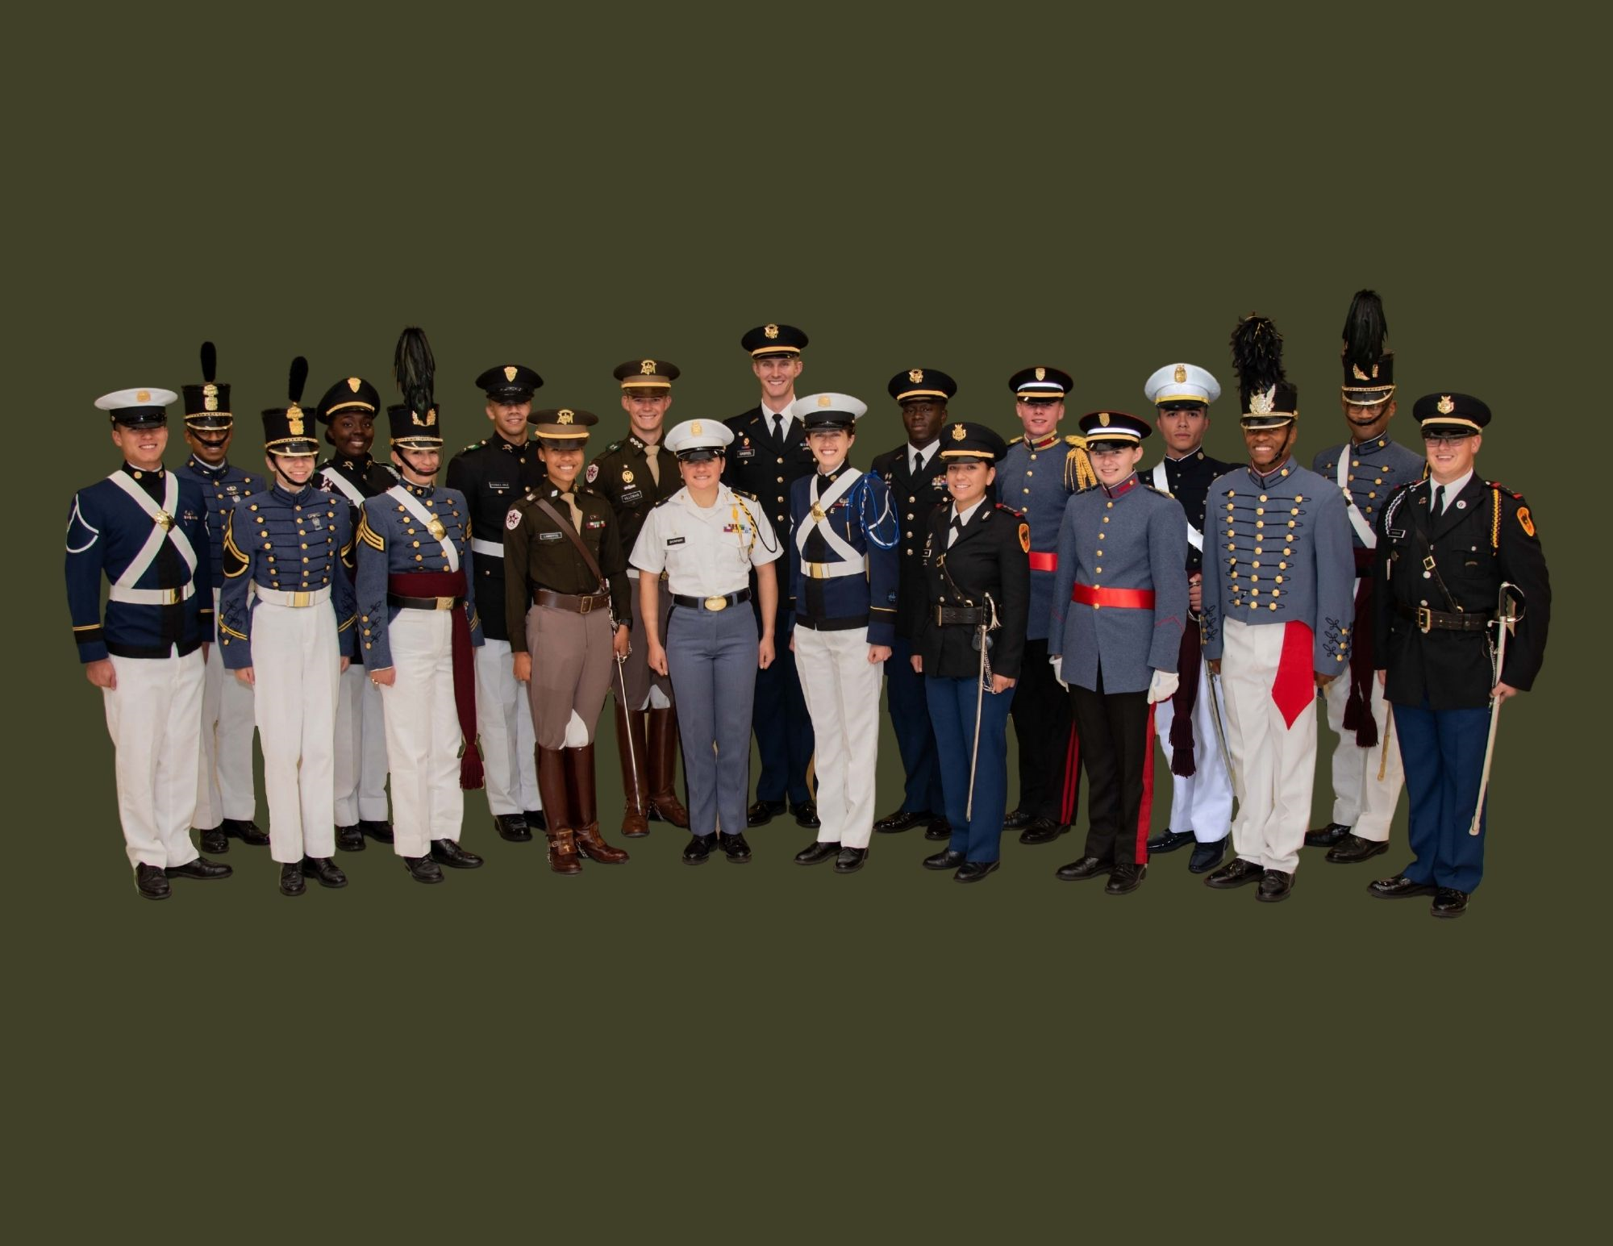
The Spartan Brigade
The Spartan Brigade

Slide 3
Agenda
Senior Military Colleges
Military Junior Colleges
Early Commissioning Program (ECP)
Educational Assistance Program (EAP)
Questions

Slide 4









Army ROTC Military Colleges
THE CITADEL
Texas A&M
Virginia Military
Institute
New Mexico
Military Institute

Slide 5
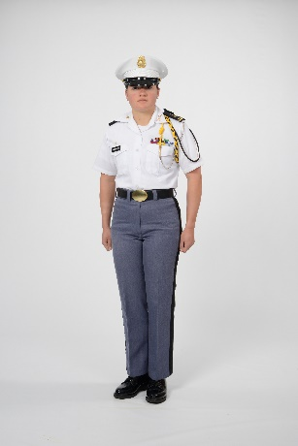
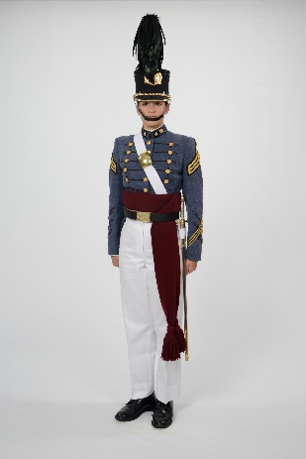
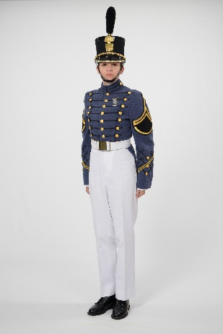


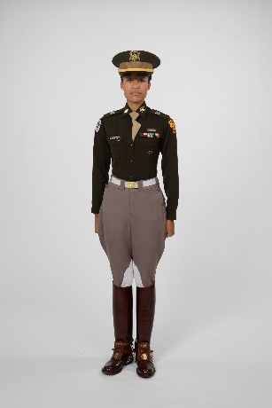
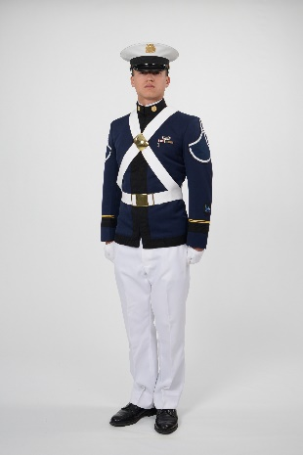
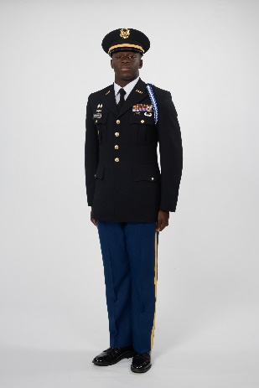


Senior Military Colleges (SMC)
THE CITADEL
Norwich University
(Northfield, VT)
Established 1819
Virginia Military Institute
(Lexington, VA)
Established 1839
The Citadel
(Charleston, SC) Established 1842
Texas A&M
(College Station, TX)
Established 1871
Virginia Tech
(Blacksburg, VA)
Established 1872
University of North Georgia
(Dahlonega, GA)
Established 1873

Slide 6
Senior Military Colleges (SMCs)
Why apply to a Senior Military College?
Assessed onto Active Duty upon recommendation from the Professor of Military Science
SMCs offer more Scholarships than other colleges and Universities
SMCs are very traditional and offer students an organized and structured lifestyle
Superb Alumni networking
SMC’s have their own training facilities
SMC ROTC programs are part of a Corps of Cadets, giving cadets a well-rounded view of what it is like to be a leader in the Army.
Uniform allowance to pay for Corps of Cadet Uniform

Slide 7
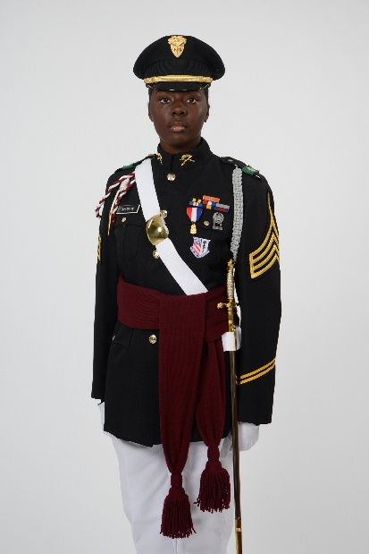
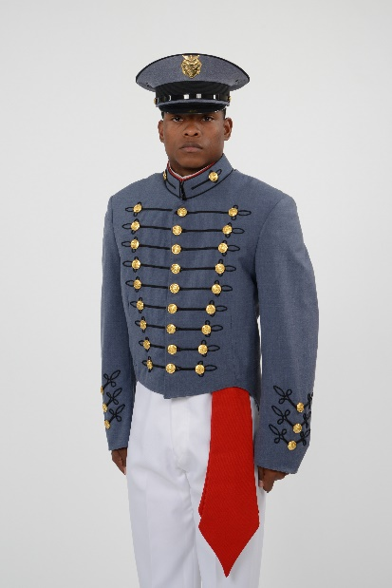
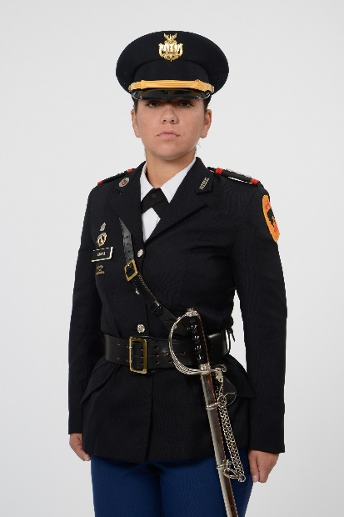
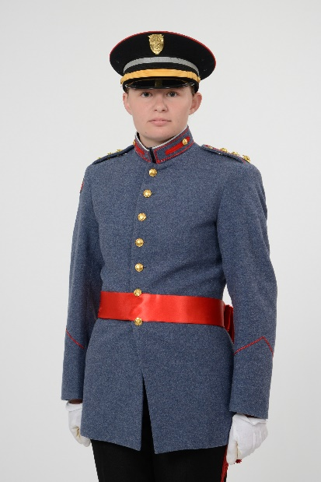


Military Junior Colleges (MJC)
Marion Military Institute
(Marion, AL)
Established 1842
Georgia Military College
(Milledgeville, GA)
Established 1879
New Mexico
Military Institute
(Roswell, NM)
Established 1891
Valley Forge Military
Academy & College
(Wayne, PA)
Established 1928

Slide 8
Military Junior Colleges (MJC)
Why Apply to a Military Junior College?
Commission as a 2LT in 2 years instead of the traditional 4 years
Each MJC offers up to 44 Scholarships per year
Mandatory study hall creates good study habits for follow-on College/University
Inspires Pride and Self-Confidence through Leadership Roles, Teambuilding, and Promotions
Cadet Teamwork & Esprit de Corps
Uniform allowance to pay for Corps of Cadet Uniforms
Simultaneous Membership Program (SMP) in USAR/ARNG (Over $300 for 2 days of training each month)

Slide 9
Educational Assistance Program (EAP)
The EAP for Military Junior College (MJC) officers is available to all MJC Cadets who have commissioned
This program provides 100% Tuition or $10K for Room and Board
These funds are in addition to any previous funds received at the MJC. Funding will be provided for a maximum of two (2) academic years, i.e., 4 semesters or 6 quarters
The Cadet, with assistance from the school, must apply for EAP scholarship during their last semester at the MJC
An additional 2-year obligation is incurred if EAP is accepted (On the plus side, Cadets earn 2 years time in service during their Junior and Senior year of college)

Slide 10
Minimum Requirements
Minimum eligibility requirements for a MJC Scholarship are:
Cumulative 2.5 GPA on a 4.0 scale.
Pass a MEPs Physical
Be at least 17 years of age and less than 30
Be a U.S. citizen of good moral character

Slide 11
MCINFO Tour
60 Minute Briefing (Can be adjusted shorter or longer)
Multiple schools in one area during each week Monday – Friday
Briefing will cover the following
The ROTC Scholarship process
The different kinds of scholarships available
Senior Military Colleges
Military Junior Colleges
The Early Commissioning Program
The Education Assistance Program
Very interactive briefing
Contact Mr. Glen Johnson to schedule your briefing, (502) 624-1904, glen.a.johnson6.civ@army.mil

Slide 12
Whole Person Score
PMS Board – 25%
SAT / ACT – 18%
Cadet Background and Experience
Form – 18%
PMS Interview – 14%
Scholar, Athlete, Leader (SAL) – 14%
ROTC Physical Fitness Test – 11%
PMS Input to WPS ~40%

Slide 13

Early Commissioning Program vs. 4-Year ROTC Program
Early Commissioning Program
CST Advance Camp
Promotion First Lieutenant
Commissioning Second Lieutenant
Graduation
Promotion
Captain
About this time
Promotion
Major
About this time
Basic Training, CST Basic Camp, or JROTC
Contracting No Later Than
Graduation
Accessions
EAP Contract
Before freshman year starts
Freshman Year
Sophomore Year
Junior Year
Senior Year
8-yr service obligation
Non-Deployable
2-yr EAP service obligation
4-Year ROTC Program
CST Advance Camp
Commissioning Second Lieutenant
Promotion to
Captain
About this time
Contracting No Later Than
Graduation
Senior Captain
About this time
Accessions
Promotion to
1LT 2 yrs after 2LT
No Requirement
Before freshman year starts
Freshman Year
Sophomore Year
Junior Year
Senior Year
8-yr service obligation
Non-Deployable

Slide 14




1st Brigade Social Media Pages
1Arotc
1stbrigadearmyrotc
1st Brigade Army ROTC - Spartans
1st Brigade, United States Army Cadet Command

Slide 15
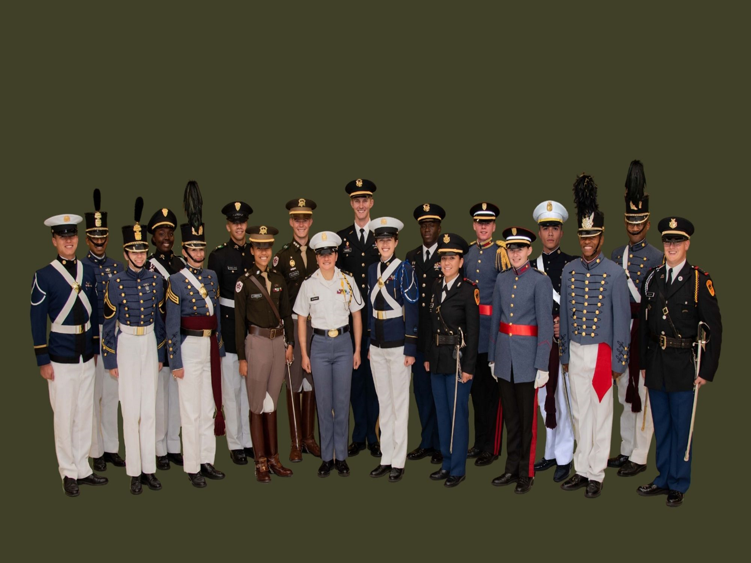
Questions?
Recruiting Operations Officer: Mr. Glen Johnson, (502) 624-1904, glen.a.johnson6.civ@army.mil
Recruiting, Marketing & Incentives Supervisor: Mr. Charles Green, (502) 624-1665, charles.green1.civ@army.mil

