Slide 1
Army Civilian Careers Internship, fellowship, and scholarship opportunities
JANUARY 2024

Slide 2
Agenda
Introduction
Setting goals
Opportunities for High School Students
College Internships & Fellowships
Army Civilian Careers: Who We Are
Student Intern Program
Army Fellows Program
Networking
Things to Consider
Background Checks
Finding Army and Department of Defense vacancies
Notes:
My goal is to share information to help you achieve your goals. Information is golden!
Setting goals & then putting together a plan to meet those goals helps for a smoother glide path
I will describe recommendations to help try out various career opportunities prior to college graduation.
Things change and that is OK! The purpose of this presentation to show that change is OK and to help provide a safe landing
Also, I will provide options that are available for those that may not be sure what you want to pursue now.
Do you know who the largest employer in the US is? A hint—it’s not Amazon, or Walmart, or Starbucks, but the Federal Government.
As a civilian working for the Federal Government, you can have impact in many areas. You can be employed in many places in the US and worldwide, with generous leave and health benefits, and flexible work schedules. This briefing will talk about the careers within Army and the Department of Defense and answer your questions about how to find jobs as well as qualifications.
If you think you may want to set yourself up for a civilian career, I have 5 recommendations for you—5 things you can do. First, you can get enrolled in a federal summer program or apprenticeship during summers while you are in high school; second, when you get to college, you can seek out summer employment or an internship or fellowship with Army—or seek scholarships; third, once in these programs, you need to network with the professionals that you meet; and finally, you need to keep a clean background—meaning paying off your debts, no police records, and a neutral social media presence. These recommendations will set you up for the flexibilities you need for success in obtaining federal employment. I will go over these steps in detail in the following slides.
When you gain an understanding of civilian positions, you will be able to make decisions and set goals in a manner that will allow you to get rewarding and productive work—a job that you love and that has meaning for our defense. Even more important, what you learn here will allow you to have knowledge of the Federal marketplace and what is required for those positions. These are both critical tools necessary to enhance your career development and will maximize your ability to motivate others to support the mission. Show ATEC’s 3-min video. https://youtu.be/pi6cYLjY034

Slide 3


Army Civilian Careers
Largest Civilian Workforce in Department of Defense (DoD)
Approximately 260,000 Army Civilians
Over 400 occupational series
Global Opportunities
Job opportunities throughout the United States and abroad
Superior Career Support
Career-long competitive training, education, and professional development
84% of all federal jobs are located outside of Washington D.C.
Notes:
We are a values-based community of over 260,000 federal civilian employees committed to providing superior management and support services to the United States Army. We serve in the Pentagon and at bases in the US and overseas. We have over 400 occupations, from accountant to zoologist, to include:
TRANSITION: There are Army civilian jobs that you probably are not aware that exist—reflecting a huge span of occupations.

Slide 4
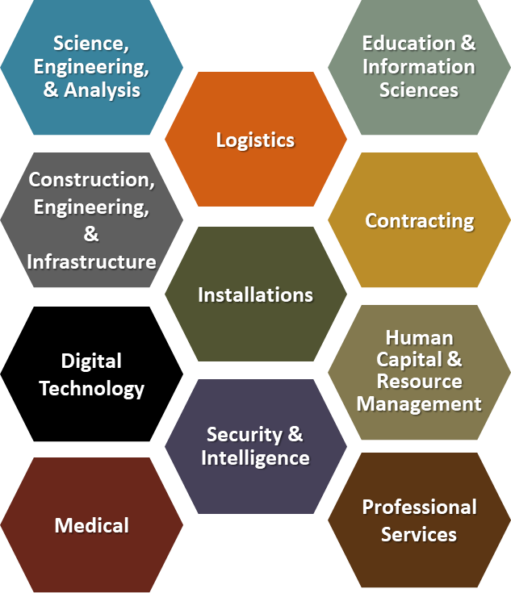
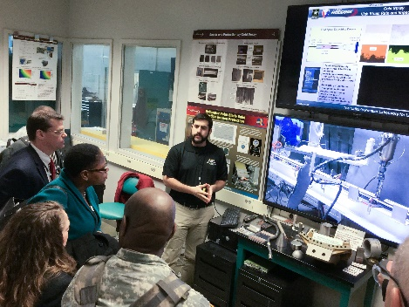
Army Civilian Careers
Many Occupations in 11 Broad Career Fields
Notes:
Since 1776, the Army has employed civilians to work alongside Soldiers in uniform, filling critical support roles in more than 400 career fields. With more than 230,000 employees, Army Civilian Corps is one of the largest, busiest, and most successful organizations within the Department of Defense. There are 11 broad Career fields that cover all of these opportunities and allow flexibility in training and developmental opportunities. . For example, Science, Engineering and Analysis includes non-construction engineers and scientists of all types—such as electrical and mechanical engineers, analysts in modeling and simulation, and data analysts. Construction engineering and infrastructure includes occupations that operate construction equipment, locks and dams and electrical power facilities. Logistics careers include supply management, as well as transportation, ammunition, and quality assurance management. Security and Intelligence encompasses physical security, such as criminal investigators, police, and intelligence officers. Professional services include inspectors general, public affairs and attorneys.
Civilians have no civilian service commitment unless you accept a recruitment bonus or similar incentive. There is no requirement to live on a base or to pass a military fitness test. You can expect a competitive salary and benefits package designed to offer you a comfortable and secure work-life balance. These benefits include paid holidays, sick leave, and vacation time; various health and life insurance options; retirement program with matching employer contribution; bonuses, awards, and other incentives for job performance.
TRANSITION: Army civilians make a difference. We serve the public and have job security. We also have significant opportunities to learn and gain experience. Our next slide will describe fundamental advantages to Army civilian careers.

Slide 5

Army Civilian Careers
Approximately 50% of the Army Civilian Corps do not have previous military experience
Army Civilians are Federal employees just like civilians in other Federal agencies such as Department of Homeland Security, Department of Labor, and Department of Housing & Urban Development
Locations Army Civilians work in locations which include Continental United States, Hawaii, Alaska, Europe, and Asia
Opportunities exist for the Army Civilian Expeditionary Workforce* which includes locations such as Poland, Bulgaria, Romania, Kuwait, & Qatar (locations vary depending on mission)
*The Army Civilian Expeditionary Workforce program is the designated Army organization to recruit, train, and mobilize Army civilian employee volunteers in support of global missions.
Notes:
We are federal civilian employees like those in other federal organizations such as the Department of Justice, the Department of State, and Department of Homeland Security. Most of us have never, and will never, serve in a military uniform. We don’t wear a military uniform and are not required to attend boot camp or enlist in the Army. We are graduates of public and private universities across the United States. We are lifelong learners who are afforded career-long professional growth opportunities such as voluntary assignments overseas and funded formal training and education.
Civilians also support military operations through the Civilian Expeditionary Workforce. The deployments are voluntary, and civilians perform a variety of roles in theater helping with military operations or training the host nation government and local industries.
TRANSITION: Army civilians have significant opportunities to learn and gain experience. Next, we will look at ways to start Army civilian careers.

Slide 6
Opportunities for High School Students
High School Apprenticeships/Summer STEM opportunities: Army Educational Outreach Program AEOP
Joint Science and Technology Institute JSTI: Joint Science and Technology Institute (orau.gov)
Society of American Military Engineers (SAME) Summer Camps: STEM/Engineering & Construction Camps – SAME
There may be more in your local area or near a Department of Defense (DoD) base. Check with us for more information.
Notes:
There are nationwide programs for high schoolers that demonstrate the types of work civilians do in DoD careers. In addition to these, some DoD installations run programs that are local to the base itself.
I will first mention the High School Apprenticeship and the Gains in the Education of Mathematics & Science (GEMS) programs. Both programs are part of the Army Educational Outreach Program (AEOP) and are located at various locations across the U.S. GEMS II is a one-week program oriented to students entering 9th to 12th grade. rising 5th through 12th graders. GEMS III consists of three 4-day sessions (Robotics or Computer Science Principles or Networks & Cyber) and there is a GEMS Near-Peer Mentor: Students entering 11th, 12th or current college student which will earn a stipend for four-day participation (currently $125). Both GEMS and the High School Apprenticeship Program are available for rising 9th-12th graders, which will be approximately 8 weeks long and pay a stipend of $3000.
The Joint Science & Technology Institute (JSTI) – is a two-week, resident program located in Towson, MD and Albuquerque, NM for high school students (Rising 10th-12th grade). They offer research topics which vary by year and include microbiology, engineering, 3D printing, mathematical modeling, cyber security, and more. Applications open in early Winter and closes in early January. You should enter you name & email address online to be notified of opening date. Participants receive an $800 stipend.
The Society of American Military Engineers (SAME) conducts Summer Camps at various locations, to include US Army Corps of Engineers – Vicksburg, MS; US Navy – Port Hueneme, CA; US Air Force – Scott Air Force Base, IL; US Air Force Academy – Colorado Springs, CO;
and the US Marine Corps – Camp Lejeune, Jacksonville, NC. These are open to all rising 10th, 11th, and 12th graders, and are aimed at engineering and construction, with activities such as building competitions. Applications open in spring – and are due Mid-March. There is a cost associated--approximately $800 + transportation to/from – but local SAME Chapters may provide scholarships to offset cost.
At local Army bases such as Aberdeen Proving Ground, there are real world internships that are open to high school students (16 or older) that allow students to work in labs, side by side with scientists, and also participate in leadership discussions. There is a $1250 stipend paid out for participation.
TRANSITION: With that understanding of opportunities during high school, let’s discuss the opportunities for scholarship and internship once you are in college.

Slide 7
College Internships & Fellowships
For more information on these opportunities:
Summer STEM Opportunities/Undergraduate Apprenticeship: AEOP
Student Intern Program (using the search function, locate positions titled "Student Trainee.” Opportunities are posted in Sep/Oct - with occasional outliers beyond Oct. Summer internships will be announced in September for the following year.): Army Civilians | goarmy.com
Army Fellows Program: Army Civilian Careers
Scholarships: SMART Program
Cybersecurity Opportunities: Cybersecurity Talent Initiative (CTI)
College Degree/Course requirements OPM Quals Standards
Questions? Email us at:
armyciviliancareers@army.mil
Notes:
Summer STEM opportunities are also available at the college level with AEOP. The Undergraduate Apprenticeship Program is open current college students, It offers a summer work experience that is approximately eight weeks long and earns approximately a $3,000 stipend for participation.
In addition, the Student Intern Program (SIP) is a paid summer internship that enables participants to be exposed to the civilian workforce of the Army. One- to three-year appointments Internships occur during the summer months for up to 12 weeks Up to $10,000 towards tuition per academic year. In addition, there is a potential conversion into full-time positions such as the Army Fellows Program after graduation (without further competition). To search these opportunities, go to
Army Civilians | goarmy.com
Locate positions titled "Student Trainee." Summer internships will be announced in September for the following year. Students selected for summer internships will be notified in December. There is one link that hosts SIP and Army Fellows Program positions. During the year, it is mostly AFP positions, as we have quarterly allocations. For SIP, we post in Sep/Oct - with occasional outliers beyond Oct.
The Army Fellows program attracts, recruits, and hires top civilian talent. Those selected earn full pay and benefits a soon as they begin training and are guaranteed job placement on a career promotion track upon successful completion of a two-year program. AFP Job Opportunities - AFP (army.mil)
If you have any questions about this program—email at: usarmy.belvoir.chra-hqs.mbx.accma-optalentacquistion@army.mil
Science, Mathematics, and Research for Transformation (SMART) Scholarship-for-Service Program—open to anyone pursuing one of 24 STEM disciplines, who is accepted to college/university and at least 18 years old. Selectees receive full college tuition (undergrad, grad, or PhD), an annual stipend of $30,000-$46,000 (in FY23), book & health allowance, a summer internship with DoD, an experienced mentor for networking and guaranteed employment with DoD upon graduation. In return, the scholarships require a year of Government service for each year in the program. Applications open August 1st and close o/a December 1st.
SMART Program
And finally, for those interested in pursuing a career in cybersecurity (computer science, engineering, information science and mathematics), consider joining the ranks of cyber defenders who safeguard our nation’s digital infrastructure from global threats. The Cybersecurity Talent Initiative (CTI) offers students in undergraduate or graduate degree programs an opportunity to work for the federal government for two years. Additionally, an opportunity to network with program participants at other federal agencies as well as with private sector program partners and both mentoring and leadership development opportunities while in the two-year program.
TRANSITION: The Intern and Fellows programs will be discussed in the next slides

Slide 8

Student Intern Program (SIP)
The SIP allows students to explore our values-based community and gain a foundation for continued success with future employment in the Army by providing opportunities to:
Current college students
Build and enhance technical and leadership skills
Network
Apply knowledge from coursework and perform meaningful work
Work with experts in field of study
Earn $15 to $23 per hour and tuition assistance up $10,000 per academic year
Receive bonuses for some difficult-to-fill positions
Transition to full-time employment
Eligibility requirements:
U.S. Citizen
Enrolled in a full-time degree program
2.5 minimum GPA
Completion of at least 30 semester hours/ 45 quarter hours
Notes:
As I noted previously, the Student Intern Program is a paid summer internship with opportunities for tuition assistance and follow-on positions.
We hire for a wide range of occupations and afford students an experience that provides exposure to the exciting and important work of Army Civilians perform in labs, research centers, test facilities, the Pentagon, and other locations on and off Army bases.
Some interns will work with the US Army Corps of Engineers in the field. Others may work with Space and Missile Defense. Interns will earn $15-$23 per hour, will gain valuable experience, and will be able to explore multiple facets of careers as an Army Civilian. Signing bonuses, ranging from a few to several thousand dollars, may be offered for difficult-to-fill intern positions.
In addition, the Student Intern Program (SIP) is a paid summer internship that enables participants to be exposed to the civilian workforce of the Army. One- to three-year appointments Internships occur during the summer months for up to 12 weeks Up to $10,000 towards tuition per academic year. In addition, there is a potential conversion into full-time positions such as the Army Fellows Program after graduation (without further competition). To search these opportunities, go to
Army Civilians | goarmy.com
Locate positions titled "Student Trainee." Summer internships will be announced in September for the following year. Students selected for summer internships will be notified in December. There is one link that hosts SIP and Army Fellows Program positions. During the year, it is mostly AFP positions, as we have quarterly allocations. For SIP, we post in Sep/Oct - with occasional outliers beyond Oct.

Slide 9
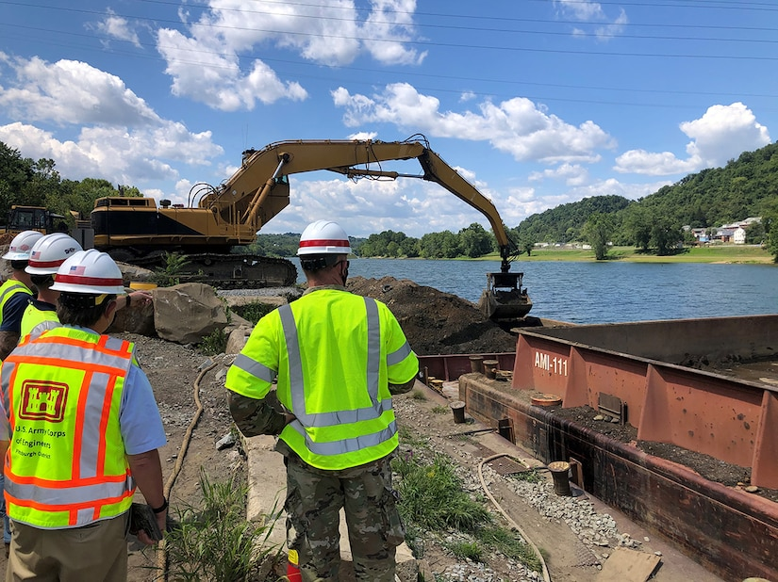

Army Fellows Program (AFP)
Two-year program that provides opportunity to embark on an accelerated career path as an Army Civilian employee
Planned development through a blending of progressive and sequential work assignments, rotations, formal training, and self-development
Two promotions within 2 years
Upon successful completion of the AFP, Fellows will then be non-competitively promoted into a permanent position
Relocation expenses paid and signing bonuses for some difficult-to-fill positions
Eligibility requirements:
U.S. Citizen
Ability to obtain and maintain a clearance if required
Degree requirements vary by position, most require 3.0 or higher GPA
Notes:
The Fellows Program provides an accelerated path as an Army Civilian. It consists of two promotions (typically GS-7 to 9; GS-9 to 11) with a difference of $19,000 pay increase at the end of the two-year period.
The Army Fellows program is a competitive program that provides selectees full pay and benefits a soon as they begin training and are guaranteed job placement on a career promotion track after 2 years. AFP Job Opportunities - AFP (army.mil)

Slide 10



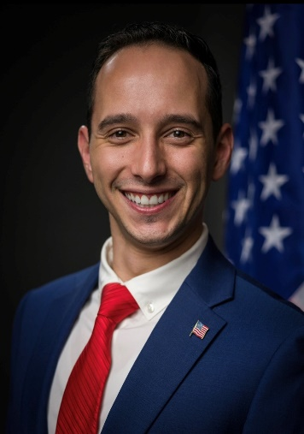


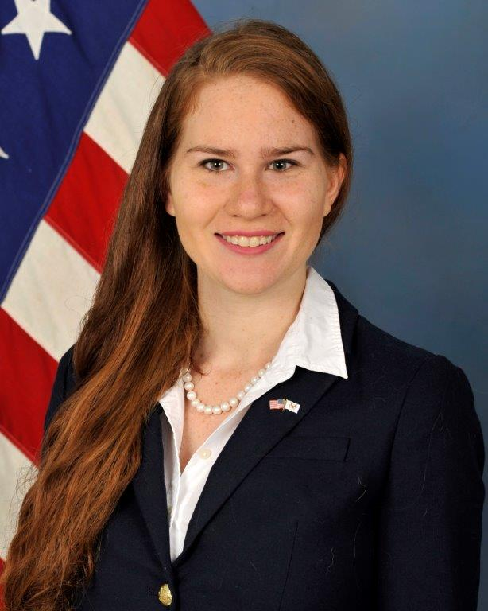

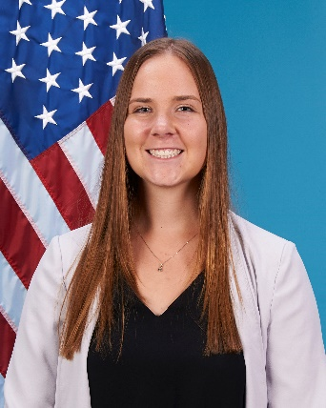

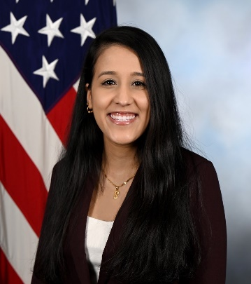

Current and Former Army Fellows
Notes:
For those employees who are in Fellows positions, they may obtain student loan repayment. I will go into that and other hiring incentives in the next slides.
Army Fellows have great opportunities to do meaningful work. They come from many different backgrounds.

Slide 11

Federal Student Loan Repayment Program (FSLRP)
Employees are eligible to receive a student loan repayment of up to $10,000 each calendar year, and an aggregate limitation of $60,000 per employee
Continued service agreement is three years
SIP interns are eligible to apply for FSLRP after degree conferral and if they transitioned to an eligible position (Army Fellows positions)
Notes:
The Army has discretionary authority to repay certain types of Federally made, insured, or guaranteed student loans as a recruitment or retention incentive for highly qualified candidates or current civilian employees. Student loan repayments may be paid only for student loans that are still due and owing.
An employee receiving this benefit must sign a service agreement to remain in civilian service of the Army for a period of at least 3 years.
SIP interns are eligible to apply for FSLRP after degree conferral and if they transitioned to an eligible position (Army Fellows positions)
TRANSITION: Even if you do not obtain FSLRP, other hiring incentives may be available to you

Slide 12
Hiring Incentives
Tuition Assistance of $10,000 per academic year (SIP)
Higher starting salary based on superior qualifications (SIP & AFP)
Hiring bonus for “difficult-to-fill” occupations (SIP & AFP)
Paid relocation (AFP)
Qualified student loan repayment (AFP)
Paid training (AFP)
Up to $60,000 hiring bonus (AFP)
Formal developmental program with promotions (AFP)
Designated “Difficult-to-Fill” Occupations: Architect, Engineer (Civil, Computer, Safety, Mechanical, Electrical, Computer, Environmental, Electronic), Computer Scientist, Operations Research Analyst, Quality Assurance Specialist, Information Technology Specialist, Educational Services Specialist, and Instructional Systems Specialist, Landscape Architect
Notes:
The Army may pay a recruitment incentive to a newly-appointed employee if the position is likely to be difficult to fill in the absence of an incentive.
"Newly appointed" refers to the first appointment (regardless of tenure) as an employee of the Federal Government,
Before receiving a recruitment incentive, an employee must sign a written agreement to complete a specified period of employment with the agency. The service agreement must specify the length of the service period, to include the beginning and end dates; the amount of the incentive; the method and timing of incentive payments; and the conditions under which an agreement will end.
TRANSITION: I have just explained that there are 5 phases to this process; we’ve gone through the first two—that is, getting into Federal programs for students either in high school or college. Keep in mind that you don’t have to do any of these steps to become an Army or DoD employee, but it helps. The programs let you experience being an Army/DoD employee. Now we’ll go on to my next recommendation, which is Networking.

Slide 13
Networking
Benefits
Best locations to network
Perspectives from professionals
How to Network
Notes:
CLASSROOM DISCUSSION: Let me ask you this: : Why do many people think that networking is hard to do? Can you think of explanations for this?
Networking from professional perspective—networking is establishing a work connection with another Army civilian employee may lead to knowledge sharing, new opportunities, support and guidance from others in the field, recommendations, and establishing your reputation/visibility
Best locations for networking
Federal summer camps/programs/apprenticeships and internships; other Federal programs, such as Civil Air Patrol.
JROTC guest speakers
Career fairs (may be virtual)
Professional organizations such as the Society of American Military Engineers (SAME) Teachers and professors
How to network
Meet professionals at events and/or summer camps. Be engaged in what they are discussing. Ask questions, stay curious. Ask for and hold onto their email address.
Create your resume NOW. Then build on it.
Periodically (one a year) drop them an email to say hello and ask for employment opportunities. Provide copy of updated resume with brief paragraph discussing your recent accomplishments.
Ask questions
Stop & listen
Take notes. Keep folder to reference when following up a year or so later.
Practice!
CLASSROOM DISCUSSION: What are the tools you might use and the skills you need to network?
TRANSITION: The last recommendation that I have is one that involves the requirements of background checks, which are required for civilian positions. Let’s move on to discuss what to expect.

Slide 14
Background Checks
Army and DoD positions may require you to fill out a form asking whether you’ve done drugs and how recently (includes marijuana & cannabis-derived products, even if they are ingested legally in your state)
Drug testing before employment and random testing afterward may also be required
Background clearance
Financial check
Police check
Check with friends, neighbors, and acquaintances
Online presence (social media)
Vulnerabilities
Paid relocation (AFP) Potential periodic checks throughout employment
Notes:
Army and DoD positions may require you to fill out a form asking whether you’ve done drugs and how recently. Some states have legalized marijuana although it is still a prohibited substance on Federal property and during the workday. Marijuana-based products, such as edibles, patches, cosmetics, etc. are also prohibited on Federal property. Your recent use of legal, recreational marijuana may still be considered in any application.
As with any Army forms, you should be honest in your responses. In addition, drug testing may also be required before you are hired, and then afterward at random intervals. The testing may detect levels of drugs that were ingested weeks before testing.
You will also be asked about finances—meaning whether you pay your debts. For example, if you’ve defaulted on any loans or credit cards, that may impact your background check.
It goes without saying that a police record will be checked. Even if you have a juvenile offense on the books, which is supposed to have been scrubbed from your record, I recommend honestly admitting it on the form.
Security clearance checks often involve contacts with neighbors and acquaintances to ask whether you are trustworthy and show good judgement. Your presence on social media may also be checked, so ensure that your posts and links reflect how you would like to appear to the Army/DoD.
Vulnerabilities are any situations that could be used to threaten you –things that you have kept secret but could be used against you if revealed. For example, if you joined an extremist group for a time, but no one knows. You have a vulnerability to be blackmailed with this information if you keep it a secret.
After you are hired, you will be subject to periodic background checks
TRANSITION: If you have no more questions about background checks, I’d like to go into how you can find Army/DoD Civilian jobs

Slide 15
Where to Locate Army and DoD Vacancies
USAJOBS
Yello
Indeed, LinkedIn, etc.
Generally, positions are competitive (must apply to the USAJobs announcement
While attending job fairs/hiring events, you may be offered positions on the spot for hard-to-fill and student positions
There are other non-competitive appointment authorities (Veterans Preference, Disability, and Direct Hire Authority)
As discussed in the previous slides, Student Intern and Fellows opportunities (SIP and AFP) can be reached at SIP&AFP Opportunities (primarily for current college students and recent graduates)
Notes:
USAJOBS is usually the ‘go to’ place for finding current vacancies in the federal government.
May be filtered using “student internships” and location, salary, position, etc.
Don’t use too many filters
May create search and then save to have jobs forwarded to you as they become available.
Many jobs will also be posted on other websites such as Yello, Indeed, Linkedin, etc.
Generally, positions are competitive appointment authorities (must apply to announcement)
While attending job fairs/hiring events, you may be offered positions on the spot for hard-to-fill and student positions.
Generally, positions are competitive appointment authorities (must apply to announcement). While attending job fairs/hiring events, you may be offered positions on the spot for hard-to-fill and student positions. There are other non-competitive appointment authorities (Veterans Preference, Disability, and Direct Hire Authority (which may encompass non-competitive hiring for hard-to-fill positions))

Slide 16




Launch your federal government career as an Army Civilian!
Notes:
SUMMARY: I have given you 5 things you can do that will open opportunities for Army/DoD civilian employment. First, you can get enrolled in a federal summer program or apprenticeship during summers while you are in high school; second, when you get to college, you can seek out summer employment or an internship or fellowship with Army—or seek scholarships; third, once in these programs, you need to network with the professionals that you meet; and finally, you need to keep a clean background—meaning paying off your debts, no police records, and a neutral social media presence. These recommendations will set you up for the flexibilities you need for success in obtaining federal employment. Finally, I have also given you links to the programs as well as how to generally find a civilian position with the Army/DoD.
RE-MOTIVATION:
You have now gained an understanding of the civilian hiring process to enable you to position yourself to have opportunities that will be rewarding and serve others. Even more importantly, what you have learned here will allow you to find rewarding work while giving you critical tools necessary to enhance your career development.
CLOSURE: Don’t hesitate to reach out if you have more questions and think of civilian careers as a possible option. If you have any questions about this program—email at: usarmy.belvoir.chra-hqs.mbx.accma-optalentacquistion@army.mil

