Slide 1

JROTC Heraldry Overview
“Motivating Young People to be Better Citizens”

Slide 2
The Institute of Heraldry
Designs: Flags, Guidons, Streamers, Shoulder Sleeve Insignia (SSI) & Shoulder Loop Insignia (SLI) (also known as Unit Patch & Crest) are requested through The Institute of Heraldry (TIOH).
References:
Army Regulation (AR) 145-2, Junior Reserve Officers’ Training Corps(JROTC): Organization, Administration, Operation and Support, 28 April 2023
AR 840-10, Flags, Guidons, Streamers, Tabards and Automobile and Aircraft Plates, 17 July 2020
Cadet Command Regulation (CCR) 145-2, JROTC Program: Organization, Administration, Operations, Training and Support, 12 August 2022
The Institute of Heraldry (TIOH) is responsible for the design of JROTC shoulder loop insignia (SLI) (metal and enamel devices), shoulder sleeve insignia (SSI) and organizational flags.
To obtain designs for an organizational flag, SSI or SLI, submit a written request for authorization along with the ROTC Request for Insignia form through the school district, JROTC Brigade Chief, JROTC Directorate and TIOH.
TIOH does not charge for the design of JROTC insignia. However, each school is responsible for SSI and SLI procurement using a TIOH Certified Manufacturer.
The Institute follows Army policy and will not authorize changes to JROTC insignia once approved.
JROTC Instructor-TIOH Web Page with these instructions:
https://www.usarmyjrotc.com/institute-of-heraldry/

Slide 3


Overview
Shoulder Loop Insignia (SLI)
  Size: Not larger than 1 1/4 inches (3.18 cm).
  Purpose: Promotes esprit de corps.
  Acceptable design elements: Military/educational items showing nature of the organization; historical items; special achievement; mission of the school, unit or area; elements of school seal. The school motto may appear on a scroll attached to the SLI.
  Unacceptable design elements: Cartoon characters, logos, dates, cities, states and letters "ROTC" or other letters as part of the design.
Shoulder Sleeve Insignia (SSI)
  Size: Not larger than 3 1/2 inches (8.89 cm).
  Purpose: Worn on the right shoulder sleeve; identifies ROTC unit.
  Acceptable design elements: Mascot, distinctive buildings, landmarks, geographical or regional features (but not actual county or state outlines). The school's name or nickname may appear on a designation band or may be attached above/below the design.
  Unacceptable design elements: Cartoon characters, logos, dates, cities, states and letters.
Organizational Flag and Guidons
  Each school is entitled to an organization flag and guidon(s). TACOM maintains standard base drawings from which organizational flags and guidons are produced.
  No charge to replace guidons and an organizational flag with wear and tear every 5 years.

Slide 4

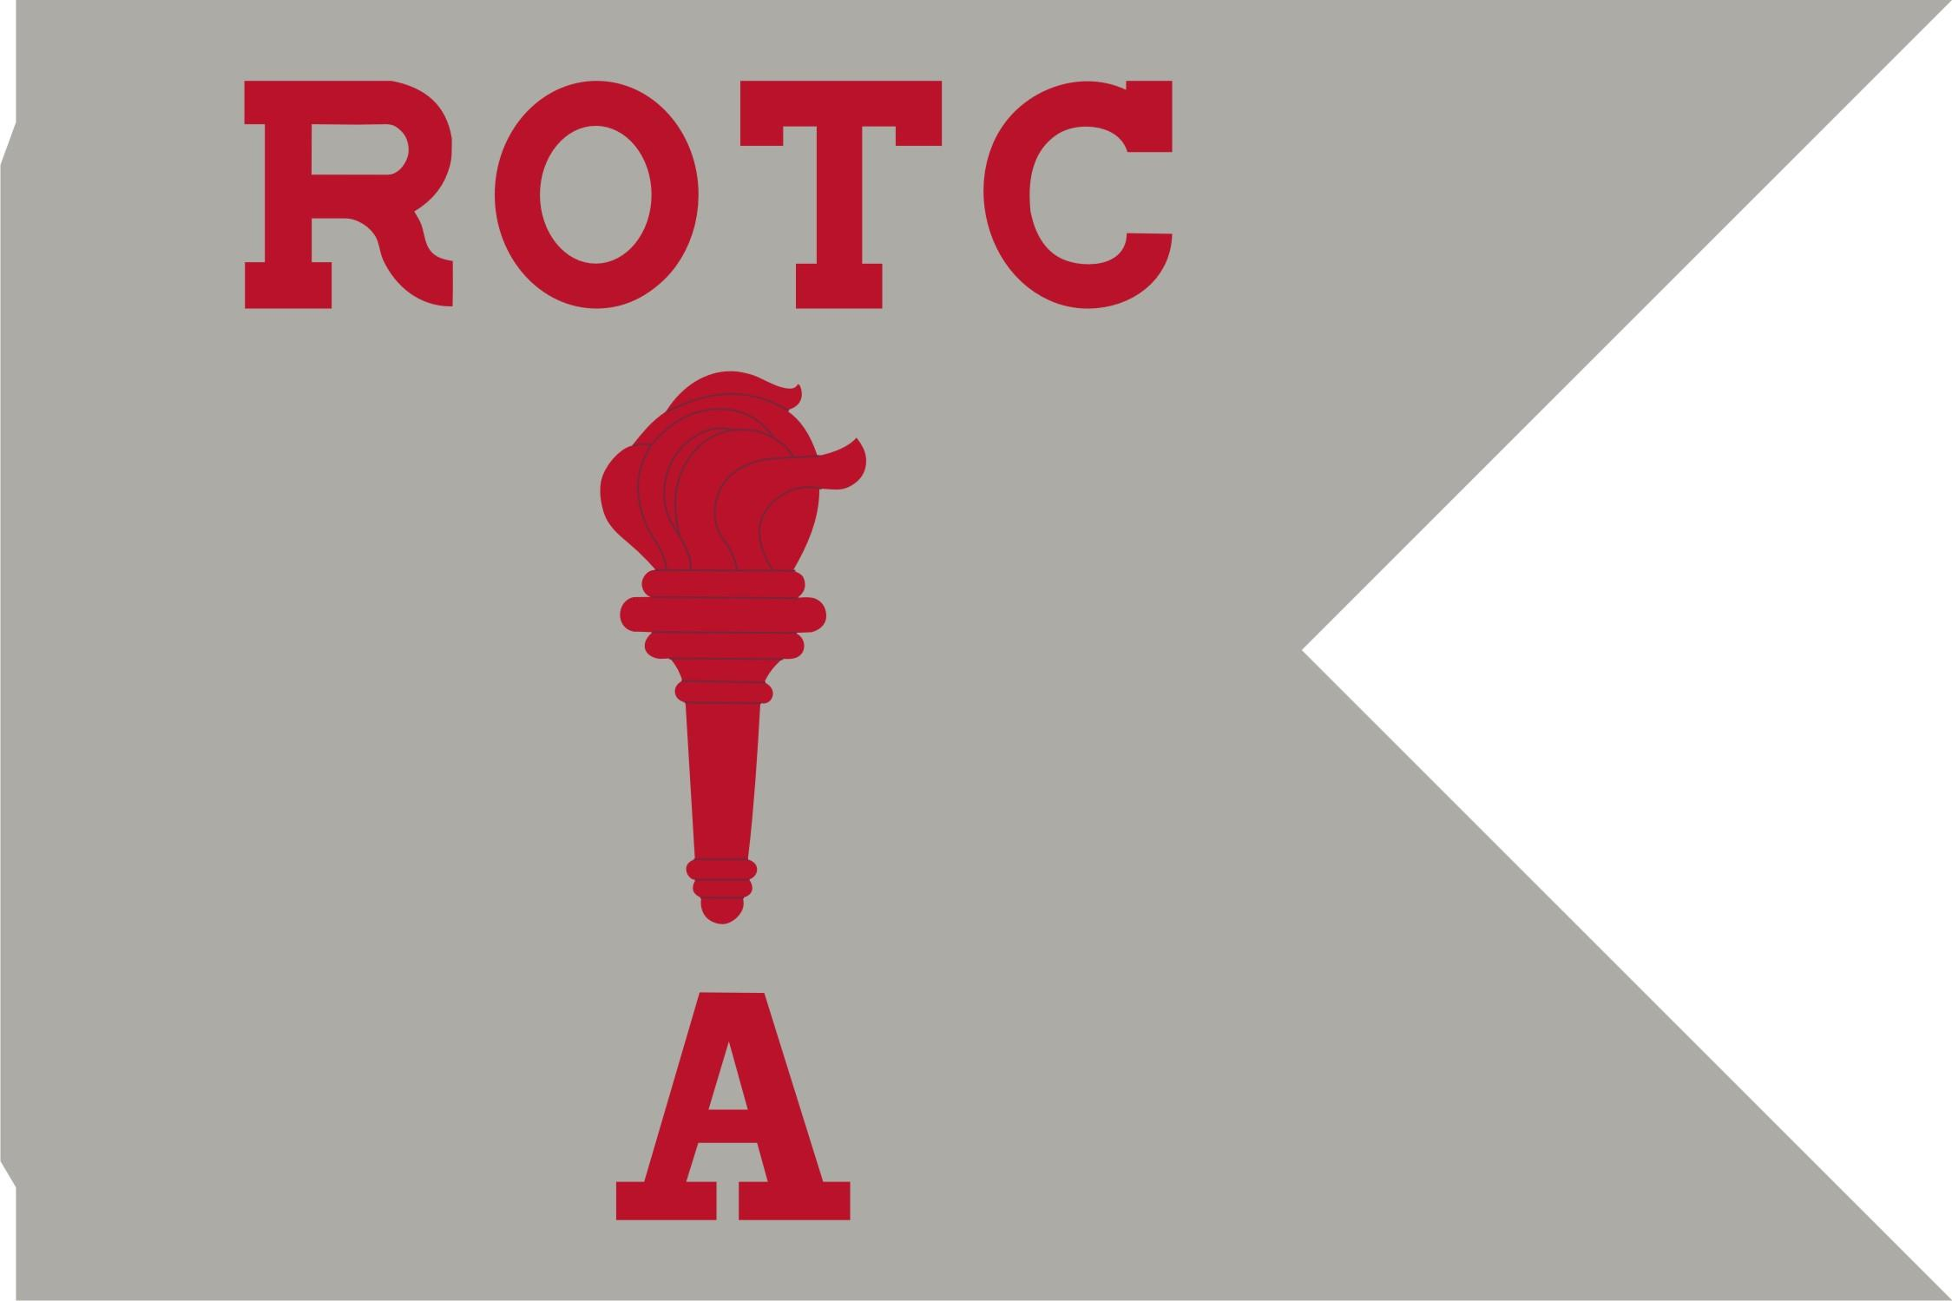
AR 840-10 Approved Designs
Junior Reserve Officers Training Corps (JROTC)
The flag is silver gray fringed in scarlet. In the center is the JROTC device consisting of two arched olive branches with stems conjoined in base, forming a wreath, surmounted by a sheathed saber and rifle in saltire. Overall, in the vertical center is the ROTC torch enflamed, all in yellow. Around the center device is a white band edged in scarlet and inscribed with the name of the school in scarlet letters. The device with designation scroll is 16 inches in diameter. In the upper hoist is the monogram “ARMY ROTC” in scarlet on a white disc edged in scarlet, 6 1/2 inches in diameter.
Junior Reserve Officers' Training Corps Companies or Batteries
Guidons are silver gray with the ROTC torch enflamed between “ROTC” above and the company designation below. All letters are in scarlet.

Slide 5
AR 840-10 Approved Designs
National Defense Cadet Corps (NDCC)
The flag is silver gray with ultramarine blue fringe. Centered on the flag is the National Defense Cadet Corps (NDCC) SSI in proper colors, 15 inches high. An ultramarine blue scroll with the school's name in white letters is below
Companies of National Defense Cadet Corps
Guidons are silver gray with the ROTC torch enflamed, centered between “NDCC” above and the company designation below all in maroon.

Slide 6
Design Request Procedures
Step 1: To request the design of JROTC heraldic items (SSI, SLI and organizational flag) - schools submit a memorandum and an ROTC Request for Insignia form (available on TIOH website-https://tioh.army.mil) through their Brigade to the JROTC Directorate for review and approval. The JROTC Directorate will submit your request for the design to TIOH.
Step 2: TIOH will contact the POC on the request form to confirm your information.
Step 3: Once the design is completed, TIOH will electronically transmit your authorized heraldic designs and procedures on how to obtain flag, guidons and streamers along with a certified manufacturer list.
Step 4: Submit your request (DD1348-6) online at www.heraldry.army.mil. Further steps are listed on the requisition document.
Costs: There is no charge for the design of an organizational flag, SSI or SLI. However, each school pays for the manufacture of the SSI and/or SLI from their JROTC budget. Schools can use Military Personnel Army (MPA) funds and donated funds, but schools cannot use Operations and Maintenance Army (OMA) funds. There is no charge to replace guidons and an organizational flag with wear and tear every 5 years.
Note: Just because a vendor is in FedMall, does not mean they are a certified manufacturer.

Slide 7
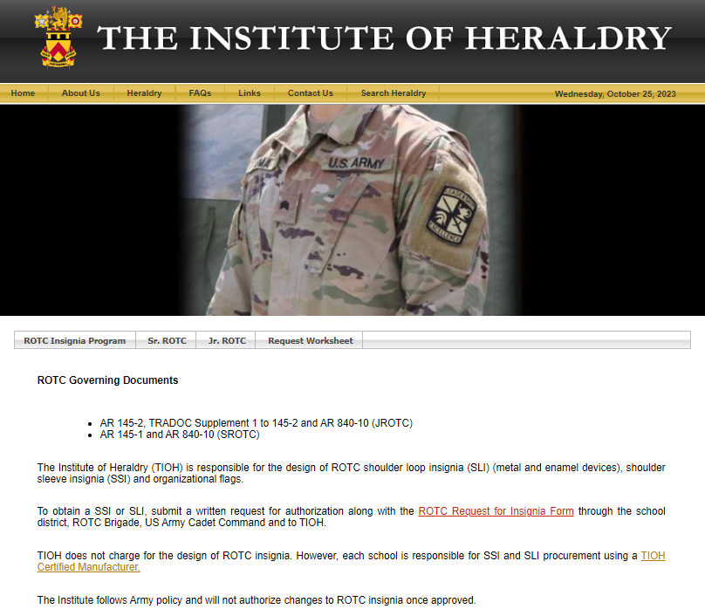
TIOH Website
https://tioh.army.mil
Click “Heraldry”
Click “ROTC”
Jr. ROTC Tab for Schools
Request Worksheet
TIOH Certified Manufacturers for SSI and SLI

Slide 8
ROTC Request for Insignia Form

Slide 9
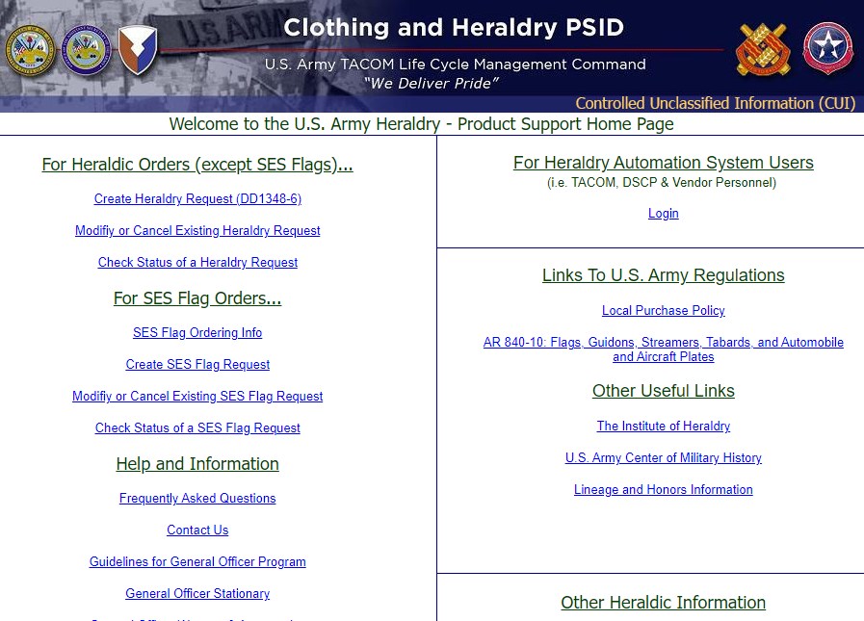
Ordering Guidons, Streamers and Flags
  Go to https://www.heraldry.army.mil

Slide 10
New Heraldry Request

Slide 11
New Heraldry Request

Slide 12
Procedures for Obtaining Flags, Guidons or Streamers
As prescribed in AR 840-10, flags, guidons and streamers may be obtained by submitting a requisition online at www.heraldry.army.mil.
All stocked items can be ordered online at https://dod.emall.dla.mil.
Points of contact at the TACOM Clothing and Heraldry Directorate are:
Ms. Jodi Robinson-Franklin*
Heraldry Team Lead IM: Army general officer and positional flags, guidons, streamers, shoulder sleeve insignias, controlled requirements (Army Flag etc.)
DSN: 444-2515
COMM: (215) 737-2515
EMAIL: jodi.robinson-franklin.civ@army.mil
Ms. Denise Marsico
SES requirements
streamers, unit campaigns and decoration
government purchase card POC
DSN: 444-3108
COMM: (215) 737-3108
EMAIL: denise.m.marsico.civ@@army.mil
Ms. Marianne Gallagher
Shoulder sleeve insignias, ROTC guidons(training)
DSN: 444-2083
COMM: (215) 737-2083
EMAIL: marianne.j.gallagher.civ@army.mil
Chanh Le
Heraldry Office Team Leader
DSN: 444-2506
COMM: (215) 737-2506
EMAIL: chanh.q.le.civ@army.mil
Ms. Tina Davis
Medals Program
Inventory Management Specialist
DSN: 444-2502
COMM: (215) 737-2502
EMAIL: tina.m.davis149.civ@army.mil
Mr. John Moore
Battalion flags and guidons, general officer shipment and back up
DSN: 444-2511
COMM: (215) 737-2511
EMAIL: john.n.moore2.civ@army.mil
Ms. Kimberly Arnold
Heraldry Office Supervisor
DSN: 444-2504
COMM: (215) 737-2504
EMAIL: kimberly.a.arnold14.civ@army.mil

Slide 13
Points of Contact
  JROTC Directorate
    Steve Fusinetti
    steven.r.fusinetti.ctr@army.mil
  The Institute of Heraldry
    Karen Wilson
    karen.d.wilson.civ@army.mil

Slide 14

Questions ?

