Slide 1

JROTC Unit Management System (JUMS) User Guide/Navigation
JSOCC

Slide 2
JUMS Topics
Resources ........................................................ 3
Schedule .......................................................... 4
JROTC staff and Cadre JUMS Accounts ........ 5
Troubleshooting Instructors JUMS Accounts .. 6
Accessing JUMS ...................................... 7 - 11
Create Cadet Logins ...................................... 12
Recover a Forgotten Cadet Password ........... 13
Create a Cadet JUMS Account ...................... 14
Annual School Year Set-Up ........................... 15
Review and Update School Information ........ 16
How to Update School Information ................ 17
Review and Update Unit Information ............. 18
Input Cadet Senior Graduation Plans ............ 19
Graduate Last Year’s Seniors ........................ 20
Assign Next School Grade, LET Level, and Class Period .................................................. 21
Add New Cadets ............................................ 22
Import New Cadets from a File into JUMS .... 23
Edit Cadet Data in the Cadet Detail Screen .. 24
Transfer a Cadet’s Record to Another JROTC Program ......................................................... 25
Accept Cadet Transfers from Another JROTC Program ......................................................... 26
Create Cadet Positions .................................. 27
Assign, Change or Remove Cadet Positions. 28
Download a Cadet Roster for Import into Curriculum Manager ...................................... 29
Promote an Individual Cadet ......................... 30
Rescind a Cadet Promotion ........................... 31
Demote a Cadet ............................................. 32
Cadet Awards ................................................ 33
Navigation ..............................................

Slide 3

Resources (JROTC Unit Management System User Guide page 5)
JUMS Help:
JUMS Training Site: JUMS Login (usarmyjrotc.com)
JROTC Unit (JUMS) User Guide download: JUMS User Guide
There are instructional videos located on www.usarmyjrotc.com/jums-help
United States Army Cadet Command (USACC) Regulation CCR 145-2
The JUMS Help desk is supported by USACC Service desk support team:
Contact the Service Desk at 512-969-6465 or email usarmy.knox.usacc.mbx.helpdesk@army.mil
You can also self submit to https://usacc-g6.my.site.com/support/s
Non-technical questions can be addressed to usarmy.knox.usacc.mbx.hq-jrotc-jumshelp@army.mil
JROTC staff and Cadre account permissions for JUMS are assigned and managed in JCIMS by the brigade S6 staff. Click here to access the Brigade S6 Point-of-Contact List.

Slide 4
Schedule
TIME | ACTIVITY | FACILITATOR | REFERENCE
1105-1150 | JUMS | Mr. Logsdon/Ms. Miller | JUMS User Manual
1150-1300 | Lunch | Class Leader
1300-1400 | JUMS | Mr. Logsdon/Ms. Miller | JUMS User Manual

Slide 5
JROTC staff and Cadre JUMS Accounts
JROTC staff and Instructor account permissions for JUMS are assigned and managed in JCIMS by the Brigade S6 staff. Once the new hire process is complete the Brigade S6 can create an account in JCIMS for JROTC staff and manage Instructor permission with the roles below. JROTC Instructor accounts are automatically created during the hiring process at USACC JROTC.
Brigade JROTC Staff – JCIMS Roles
DD2767 Validation
JMS-B
JUMS_User
Director Army Instructors (DAI), Military Property Specialist (MPS), District Office Personnel (DOP) JCIMS Roles
JMS-B
JMS-D
JUMS_User
Senior Army Instructor (SAI) and Army Instructor (AI) – JCIMS Roles
Instructor
JMS-S
JUMS_User

Slide 6
Troubleshooting Instructors JUMS Accounts
JROTC Instructor that cannot access JUMS can follow the steps below:
What account are you using to access JUMS?
DS Logon / CAC are the only mechanisms to access JUMS.
Every account holder must have a DS Logon premium account; this includes CAC holders. TOKEN Cards will not work. When an instructor attempts to login JCIMS with a basic DS login account they will be recycled backed to the JUMS login screen, if this occurs the instructor needs to upgrade their DS Login account to a premium account. This is an individual user responsibility and can be accomplished from the DS logon page in JUMS.
Instructors who require assistance, creating a DMDC – DS Logon account or resetting your account password please call: DMDC – DS LOGON TECHNICAL SUPPORT at telephone 1-800-477-8227, select “option 2.”
What web browser are you using?
Internet Explorer 11 is the browser to use when accessing JUMS.
If the instructor is using the correct account and web browser
The Instructor must contact their Brigade JROTC staff to determine the status of their hiring or resignation action and their assignment action. “Non-Working” or “Hire in Progress” or any other entry will not have access to JUMS. If an Instructor is not assigned to a position, they will not have access to JUMS.
If the Instructor is in a working, status assigned to a position and school or school district
The Instructor must contact their brigade S6 to determine their account is ENABLED AND ACTIVE and the Instructor has the CORRECT ROLES assigned.
The first time a new user logs in, they must login to JCIMS. This step validates their account and automatically populates their DOD ID number into their account.

Slide 7
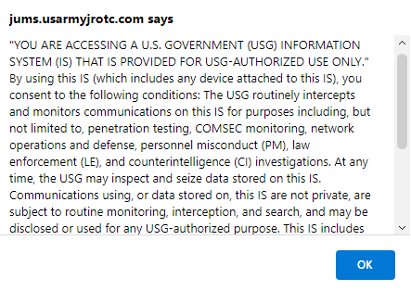
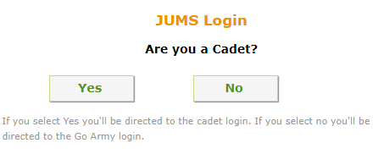
Accessing JUMS (JROTC Unit Management System User Guide page 7, 1-1)
All HQ USACC, Brigade Staff, JROTC DAI, and JROTC Instructors must have a Common Access Card (CAC) or a Defense Manpower Data Center (DMDC), Defense Services (DS) Logon Premium account to access JUMS.
JUMS homepage URL: JUMS (usarmyjrotc.com).
JUMS training site URL: JUMS Login (usarmyjrotc.com)
To log in, read the Privacy and Policy statement then select OK in the blue box.
Select Yes to be directed to JUMS Cadet login page.
Select No to be directed to the JUMS DS Logon page.

Slide 8
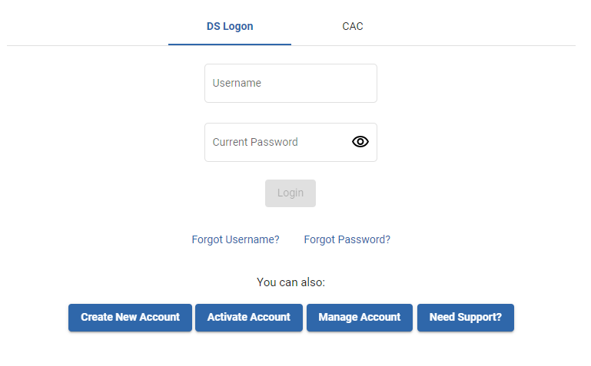
Creating a DS Logon Account (JROTC Unit Management System User Guide page 7, 1-1)
UNCLASSIFIED
If you do not have a CAC or DS Logon account, you may create an account from the JUMS Logon page by selecting the blue hyperlink, Create Account.
If you require assistance, creating a DMDC – DS Logon account or resetting your account password please call: DMDC – DS LOGON TECHNICAL SUPPORT at telephone 1-800-477-8227, select “option 2.”
Please DO NOT email or call the JUMS Help Desk or the HRC Service Desk for assistance with creating a DS Logon account or resetting your DS Logon password.

Slide 9
Logging into JUMS with a DS Logon Account (JROTC Unit Management System User Guide page 7, 1-1)
UNCLASSIFIED
If you do not have a CAC, you can use a DS Logon account to log into JUMS. On the JUMS DS Logon page, enter your Username and Password, then select Login.
If you require assistance resetting your DS Logon account password please call: DMDC - DS LOGON TECHNICAL SUPPORT at telephone 1-800-477-8227, select “option 2.”

Slide 10

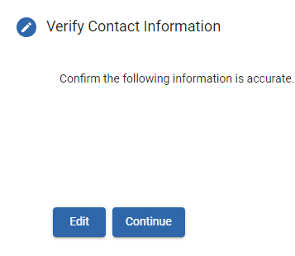
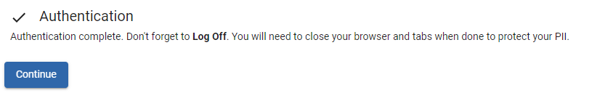
Logging into JUMS with a Common Access Card (JROTC Unit Management System User Guide page 7, 1-1)
UNCLASSIFIED
If you have a CAC, you can access JUMS by selecting CAC then Login from the JUMS DS Logon page. Next verify your contact information then click Continue. On the Authentication message select Continue to complete your login.
1
2
3
4

Slide 11
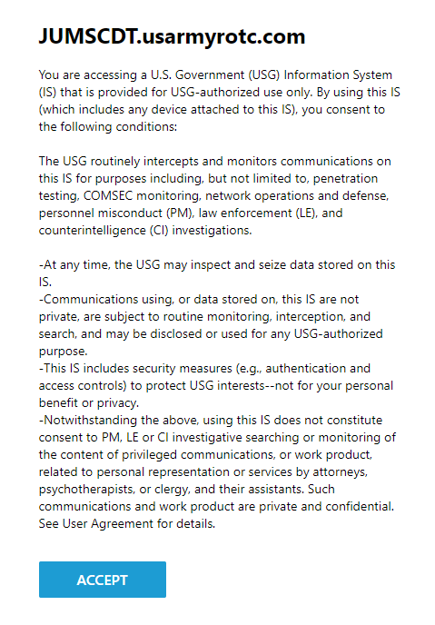
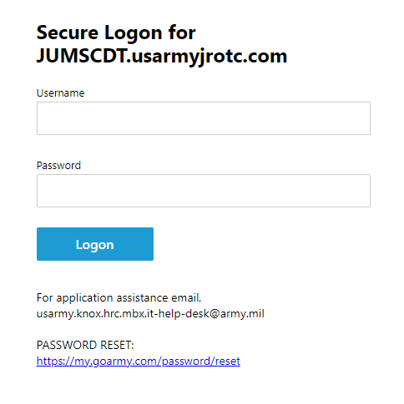
Logging into JUMS as a Cadet (JROTC Unit Management System User Guide pages 17 & 18, 3-9, 3-10, & 3-11)
UNCLASSIFIED
Each Cadet must establish an account with My.GoArmy.com using a personal email address before an Instructor can create a Cadet login in JUMS. If a Cadet receives the error message their account is locked, the Cadet should stop trying to login. Locked accounts will unlock after 90 minutes.
To log in, on the JUMS homepage select YES to be directed to jumscdt.usarmyjrotc.com/my.policy.
Read the policy statement then select ACCEPT.
In the Secure Logon for JUMSCDT.usarmyjrotc.com section enter your Username and Password.
Select Logon to be directed to JUMS homepage.
Cadet Logins
Click here to learn about creating Cadet Logins
Cadet JUMS Account
Click here to learn about creating Cadet JUMS Accounts
Recover a Forgotten Cadet Password
Click here to recover a forgotten Cadet password.

Slide 12
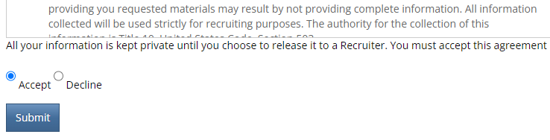
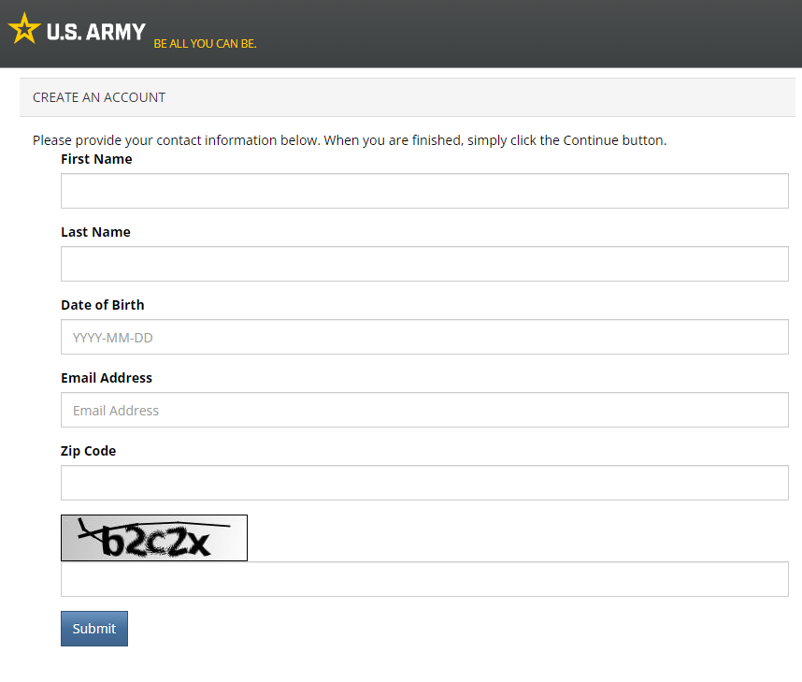
Create Cadet Logins (JROTC Unit Management System User Guide page 92, Appendix D)
Create Cadet S1, S3, and S4 Logins
Before an Instructor can create a Cadet login in JUMS the Cadet must establish an account at My.GoArmy.com using a personal email address.
Step 1.
Click on the link above or copy and paste the URL into your web browser.
Step 2.
Accept the Privacy & Security Notice.
Step 3.
Complete all fields then select Submit.
Step 4.
Receive an Email Confirmation. Follow the instructions in the email
Step 5.
Create the account.
Step 6.
Provide the JROTC Instructor with the e-mail used to sign up.

Slide 13
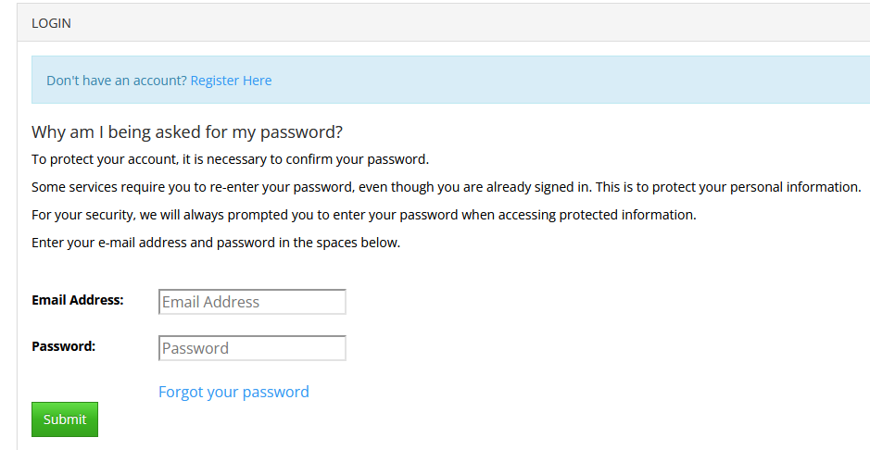
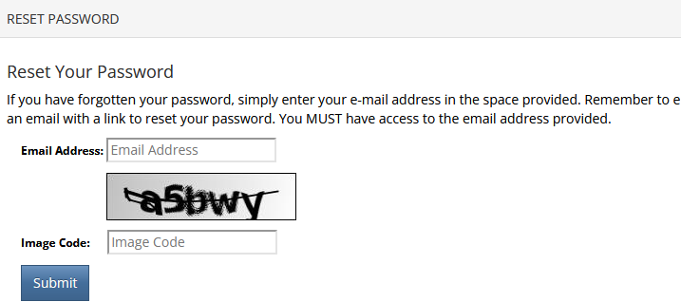
Recover a Forgotten Cadet Password (JROTC Unit Management System User Guide page 18, 3-10)
Recover a Forgotten Cadet S1, S3, or S4 Password
Cadets must follow the on-screen prompts to recover their password on My.GoArmy.com.
Step 1.
Go to Login (goarmy.com).
Step 2.
To recover a forgotten Cadet password from the My.GoArmy Logon page click the link Forgot Your Password.
Step 3.
Enter the Email Address and Image Code in the spaces provided. Remember to enter the same e-mail address that was supplied during registration.
Step 4.
Click Submit.
Step 4.
An e-mail containing the password will be sent to the email address entered.

Slide 14
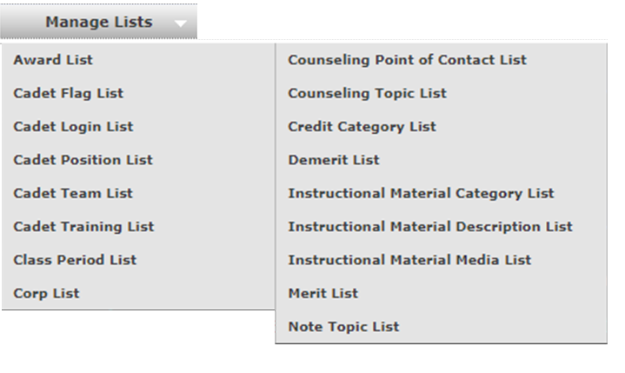

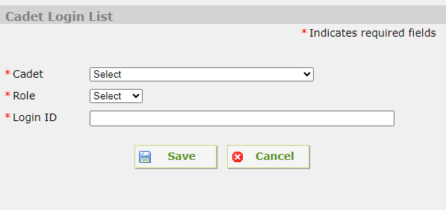
Create a Cadet JUMS Account (JROTC Unit Management System User Guide page 17, 3-9)
Create Cadet S1, S3, and S4 JUMS Account
Once a Cadet has Established a My.GoArmy.com account, the Cadet must provide the Instructor the email address used to establish the account for input into JUMS.
From the top menu bar, select the Manage Lists tab; from the drop-down menu select the Cadet Login List.
On the Cadet Login page, click the Add New button.
In the Cadet Login List panel:
Select the Cadet you want to assign a role in JUMS from the pull-down list.
Enter the Cadet’s role, S1, S3, S4, etc.
Type in the Cadet’s Login ID in the box provided then select Save.
Cadets will use the email account login username and password they established when creating the My.GoArmy.com account when logging into JUMS.
The Login ID entered must be an EXACT match to the email address the Cadet used to establish the My.GoArmy.com account. If the email address is not an EXACT match the Cadet will not be able to login JUMS.
NO OTHER LOGIN ID WILL BE ACCEPTED FOR CREATING A CADET ACCOUNT.

Slide 15
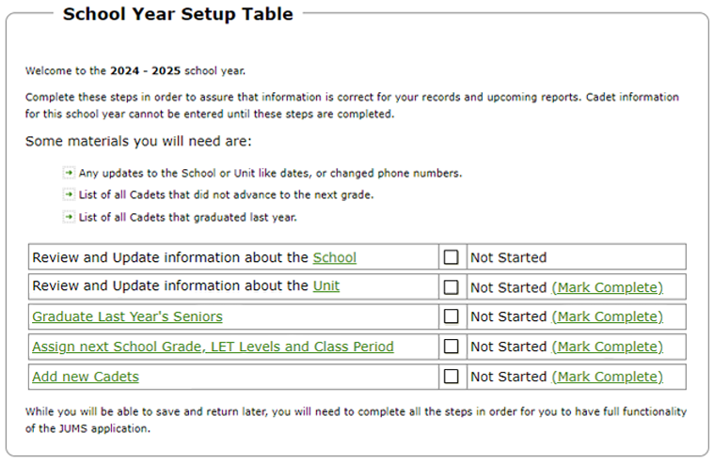
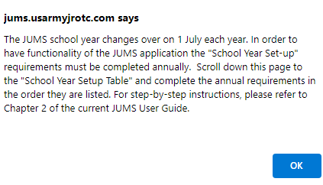
Annual School Year Set-Up (JROTC Unit Management System User Guide page 7, 2-1)
Overview of Annual School Year Set-up Requirements
The JUMS school year is 1 July – 30 June annually. The JUMS school year resets on 1 July each year. The school year set-up MUST be completed each year, after 1 July for the new school year. JUMS Home page will display a pop-up message regarding the change over and the required School Year Set-up wizard. Users will not have full function of the JUMS menus until the school year set-up items are completed.
School Year Set-Up Items
Select a set-up item to explore.

Slide 16
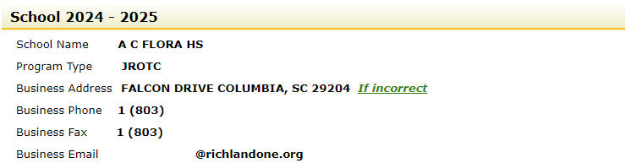
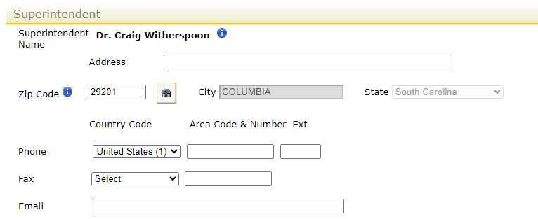
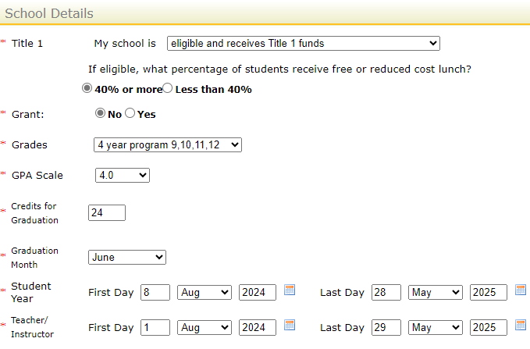
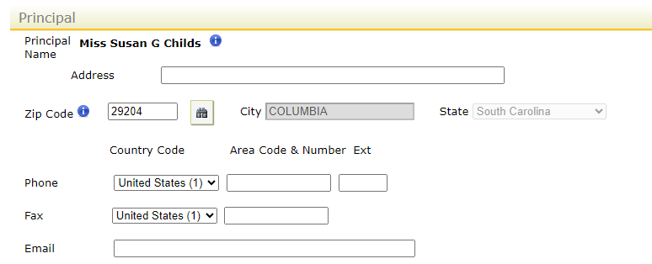
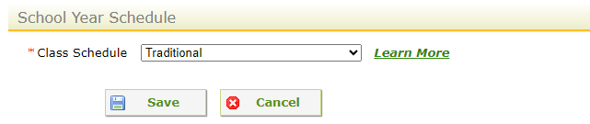
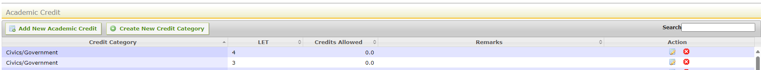
Review and Update School Information (JROTC Unit Management System User Guide pages 8 & 9, 2-2)
The school's name, business address, phone number, Superintendent, Principal names, and other school information reflected in BOLD in JUMS cannot be changed in JUMS. Click the green “If incorrect” to learn more.
Enter data in all fields with an asterisk (*).
The recommended traditional school year for both students and teachers is 1 July as the start date and 30 June for the end date. This will ensure that all unit events during summer months are captured on the unit report.
Block schedule would enter 1 July – 31 Dec for the 1st block/semester and 1 Jan – 30 June for the 2nd block/semester for both students and teacher/instructor. The dates entered here have no bearing on the instructor contract.
Click Save when finished.

Slide 17
How to Update School Information (JROTC Unit Management System User Guide pages 8 & 9, 2-2)
The school's name, business address, phone number, Superintendent, Principal names, and other school information reflected in BOLD in JUMS cannot be changed in JUMS. Official school information is maintained and updated in JCIMS by the Instructor Management Division. The school information in JUMS is auto populated and updated from the information entered in JCIMS.
If the school's name or address is incorrect, DA Form 918B (Amendment to Application for Establishment of Army Reserve Officers' Training Corps Unit) is required to request the correction.
You must complete the form and mail it and 4 copies to your designated representative (either your Brigade or your Director of Army Instructor (DAI)).
To correct Superintendent or Principal's names in JUMS, submit a letter on school letterhead, signed by a school official with the correct information through your brigade JROTC staff, to the USACC, JROTC Directorate, Instructor Management Division. Letters may be emailed to usarmy.knox.usacc.list.hq-jrotc-im@army.mil. Once Instructor Management Division updates the information in JCIMS, JUMS will update automatically.

Slide 18
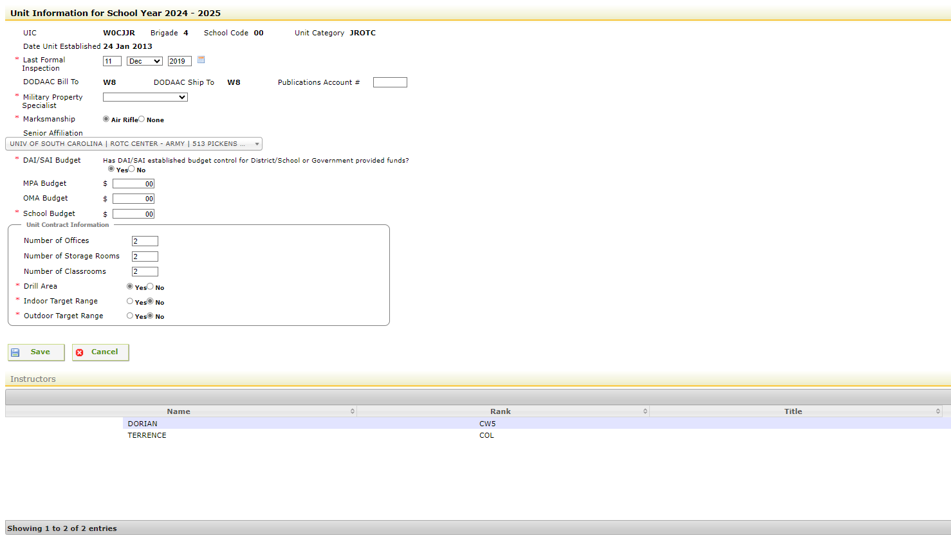
Review and Update Unit Information (JROTC Unit Management System User Guide page 9, 2-3)
After the JUMS school year resets on 1 July each year the Unit information for the school must be updated. Enter data in all fields with an asterisk (*).
The Last Formal Inspection refers to the last JROTC Program for Accreditation (JPA) date.
For Budget Information contact the DAI/SAI or the Brigade.
Unit Contract Information can be found on the JROTC Application/Contract (DA Form 3126) with the school for JROTC programs and the NDCC Application/Contract (DA Form 3126-1) for NDCC programs. The School, Brigade, and JROTC Headquarter have copy of the contract.
Verify the correct Instructors are assigned to the school at the bottom of the page.
Click Save when finished making changes.

Slide 19
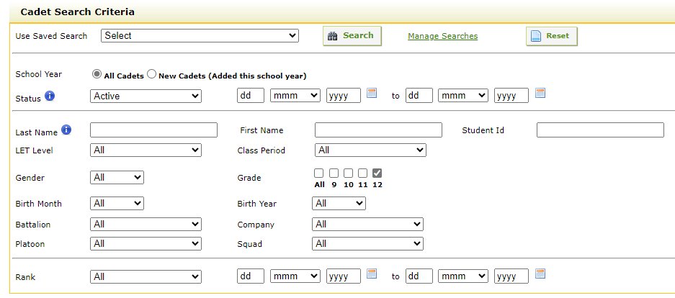
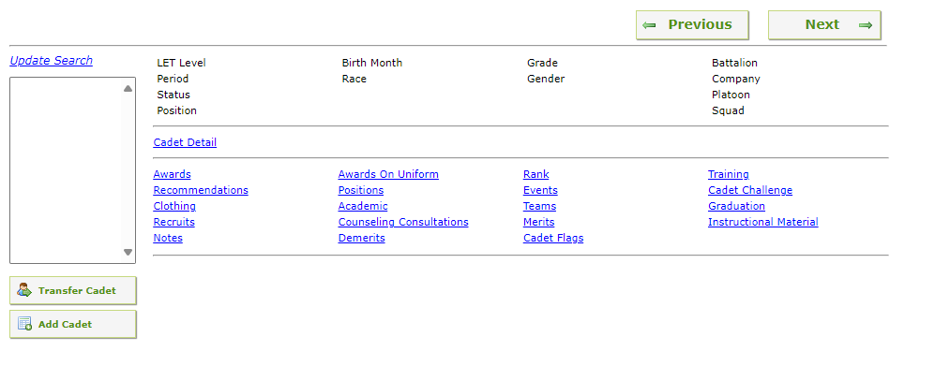
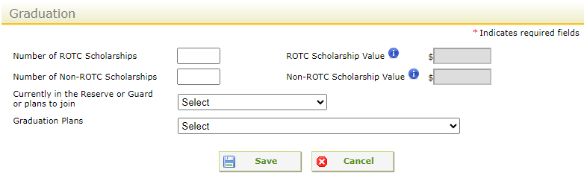
Input Cadet Senior Graduation Plans (JROTC Unit Management System User Guide page 20, 3-14)
From the top menu bar, select Manage Cadets.
From the drop-down menu select Search/Add Cadet.
In the Search Criteria section of the Search/Add Cadet page in the Grade box select 12 from the drop-down menu, next click the Search Button, the 12th grade or senior Cadets will appear in a table at the bottom of the page.
Once, you have verified the selected senior Cadets, click on the Edit Selected in Group button in the lower left corner of the screen. The Cadet Detail Panel will open for the first Cadet selected.
Click on the blue underlined Graduation hyperlink to enter the Cadet’s plans following graduation. The graduation panel will open and display for the first Cadet listed. Enter the graduation scholarship and graduation plans of the Cadet as appropriate.
Once you have completed entering a Cadet’s information click save, after the screen refreshes, if you have selected multiple Cadets for editing click on the Next button to move to the next Cadet record. The screen will refresh to the Graduation panel for the next listed Cadet. Repeat the process until the graduation plans have been input and saved for each senior Cadet.
xxxx
xxxx
xxxx

Slide 20
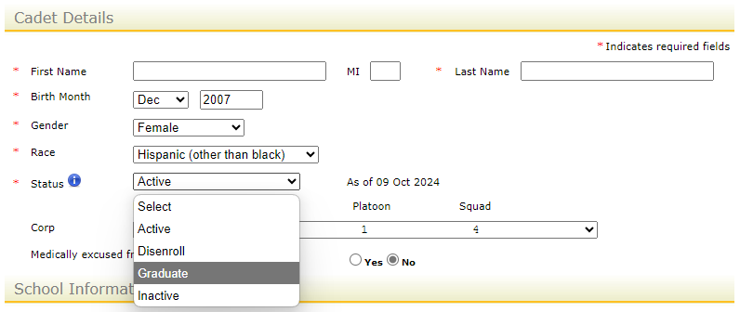
Graduate Last Year’s Seniors (JROTC Unit Management System User Guide pages 9 & 10, 2-4)
After clicking the green Graduate Last Year’s Seniors hyperlink the Cadet Detail page will open with the “Graduation Panel” displayed.
A list of senior Cadets will be displayed in the “Update Search” box, located at the top left of your screen. The name of the first Cadet displayed in the lists record will be open. The name of the Cadet whose record is open will be displayed in bold on the top left of the page.
Under the Graduation Panel, select the Cadet’s graduation plans from the provided drop-down lists and complete all the applicable fields.
Click the Save button at the bottom of the screen.
Once completed, click Cadet Details.
Click the Status drop-down menu and select “Graduate” from the list.
Click the Save button at the bottom of the screen.
Repeat the steps until graduation plans have been entered for all the listed senior Cadets, and their status has been changed to graduate.
xxxx
xxxx
xxxx
To graduate a Cadet all issued items must be returned to inventory and Graduation Plans must be entered in each senior Cadets record.

Slide 21
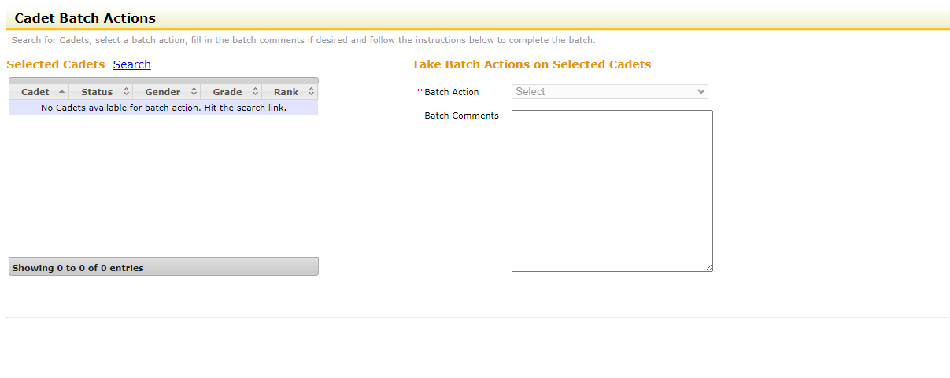
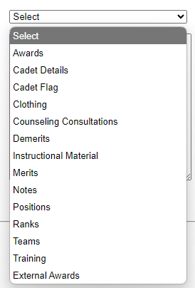
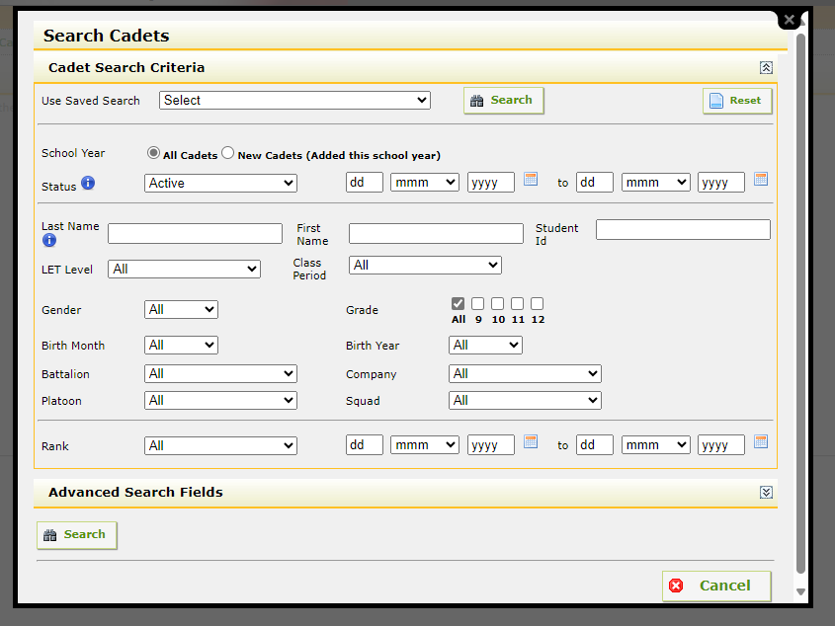
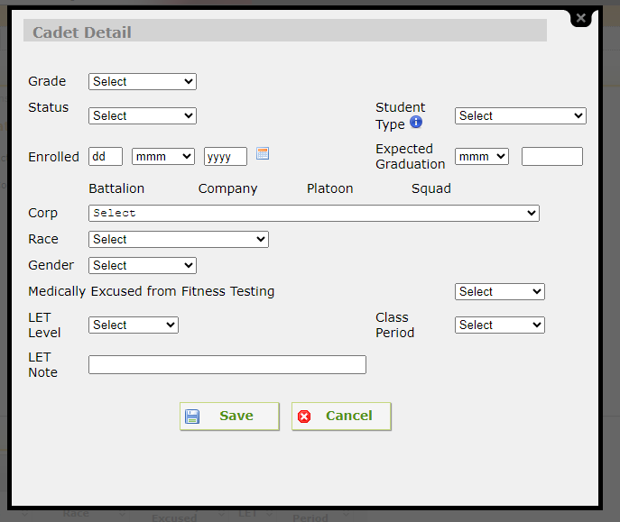
Assign Next School Grade, LET Level, and Class Period (JROTC Unit Management System User Guide pages 10 & 11, 2-5)
These steps are for Cadets in grades 8, 9, 10 and 11.
After clicking the green Assign Next School Grade, Let Level and Class Period hyperlink. The Cadet Batch Actions page will open.
Click the blue Search hyperlink next to Selected Cadets; the Search Cadet Screen will open.
In the Search Cadets screen, check the 11 box from the Grade option, then click the Search Button. Any Cadet you do not want to perform the batch action on may be unselected by clicking on the checkmark in the select column.
Click on Select Cadets button.
Click on the drop-down menu arrow next to Batch Action.
Select Cadet Details from the dropdown list.
Select Change Details and the Cadet Details panel will open.
From the Grade dropdown menu select 12.
Click the Save button.
Repeat steps 3 - 10 to move all Cadets to the appropriate Grade, LET level, and Class Periods.
NOTE: Begin at LET 3 and move the Cadets in each LET level up to the next LET Level.

Slide 22
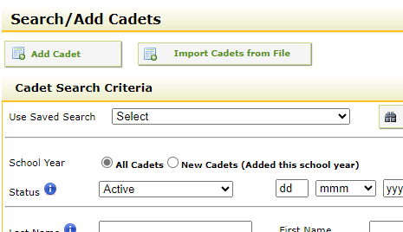
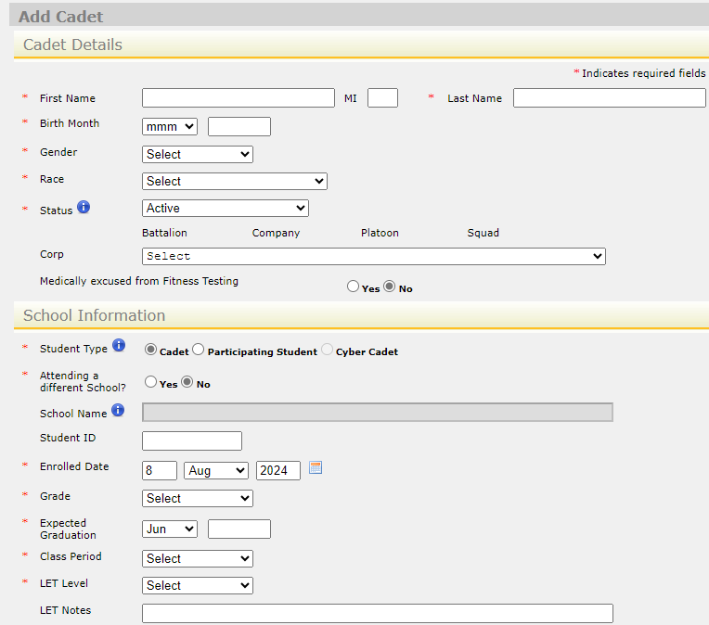
Add New Cadets (JROTC Unit Management System User Guide pages 11 & 12, 3-1)
How to Add a Cadet
After clicking the green Add New Cadets hyperlink. The Search/Add Cadet page will open.
Search/Add Cadet can also be accessed from the top menu bar by selecting Manage Cadets, and then selecting Search/Add Cadet from the drop-down menu.
Click on the Add Cadets button and enter data in all fields with an asterisk (*).
Click the Save button at the bottom of the page. If all information was correctly entered, you will receive a message “Cadet information successfully entered and saved.” Clicking ok will return you to the JUMS homepage.
Medically excused from fitness testing – Enter the Cadet’s fitness testing status by selecting the appropriate radio button. (The radio button is the little ‘dot’ next to the words ‘yes’ and ‘no’)
Student Type – Select the student’s type, Cadet or Participating Student by clicking in the appropriate radio button. Please review CCR 145-2, Chapter 7 Cadet Management for requirements
Note: Only Instructors can add new Cadets into JUMS, JROTC Cadets are NEVER allowed access to add or remove Cadets.
For a more detailed tutorial watch: JUMS: Add a Cadet

Slide 23
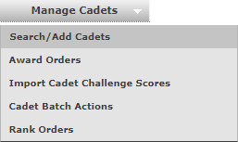

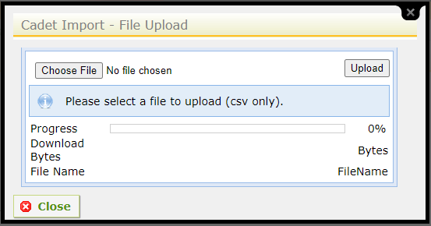
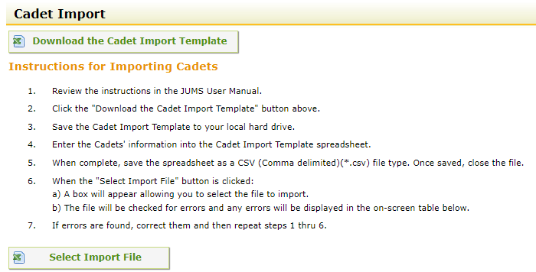
Import New Cadets from a File into JUMS (JROTC Unit Management System User Guide pages 13 & 14, 3-4)
From the top menu bar, select Manage Cadets.
From the drop-down menu select Search/Add Cadet.
Click the Import Cadets from File.
Click the Select Import File.
Select Choose File
Select the location you saved your import file.
Select the CSV file and click on the import file.
Click open.
Click Upload, this will upload your new Cadet’s into JUMS. An on-screen pop-up box will display that will give you the status (upload successful, error, or cancelled). If an error message is displayed, it will provide the information necessary to correct the Cadet Import template so that it will successfully upload. The errors will be displayed by Excel row number and Cadet name on the Cadet Import screen.
Note: If an error message is displayed, none of the Cadets listed on the import file were uploaded into JUMS.
Only Instructors can add new Cadets into JUMS, JROTC Cadets are NEVER allowed access to add or remove Cadets. As new Cadets are imported into JUMS, the rank of Cadet Private E1 will be system appended to each new Cadets record. Rank orders will not be generated for the Cadet Private E1 rank. Students entered as “Participating Students” will not have the Cadet Private E1 rank appended to their records. For a more detailed tutorial watch: JUMS: Batch Action Add Multiple Cadets

Slide 24
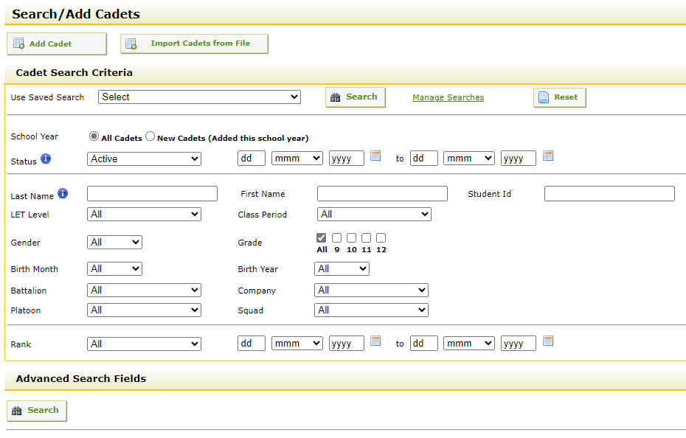
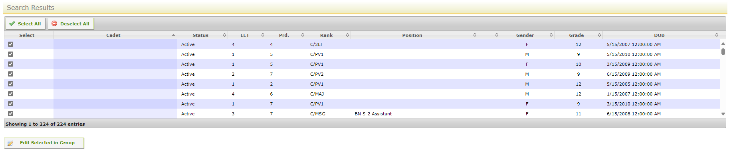
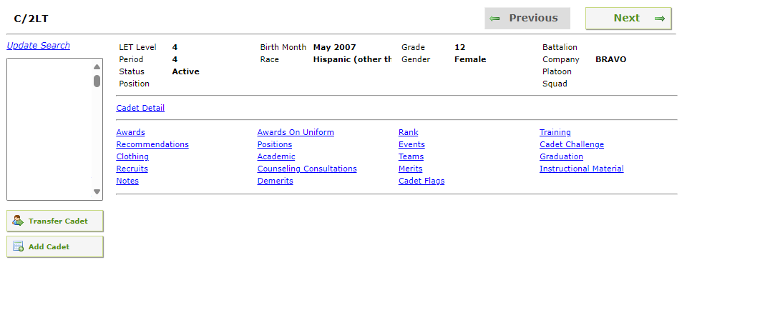
Edit Cadet Data in the Cadet Detail Screen (JROTC Unit Management System User Guide page 15, 3-6)
How to Edit Cadet Details
From the top menu bar, select Manage Cadets.
From the drop-down menu select Search/Add Cadet.
In the Search Criteria section of the Search/Add cadet page you may enter the Cadet’s information such as name, let level, class period etc.. then click the Search Button, the Cadets that match the search criteria will appear at the bottom of the page.
Once, you have selected the Cadet or Cadets you wish to edit, click on the Edit Selected in Group.
Click on any of the category hyperlinks in blue to review, edit, or add new information in the Cadet’s information record. Some of the information is auto populated from other information sources in JUMS and cannot be edited. Once you have completed reviewing or editing a Cadet’s information click save, once the screen refreshes, if you have selected multiple Cadets for reviewing or editing click on the Next button to move to the next Cadet and repeat the process.

Slide 25
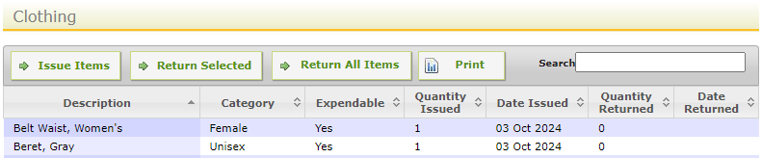
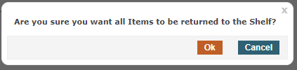
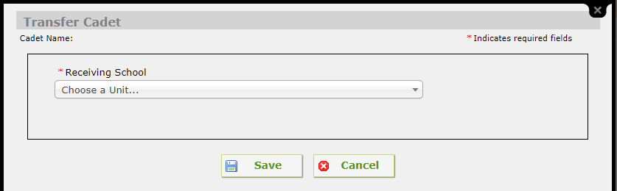
Transfer a Cadet’s Record to Another JROTC Program (JROTC Unit Management System User Guide page 16, 3-7)
From the top menu bar, select Manage Cadets, from the drop-down menu select Search/Add Cadet
When the search screen opens type the last name of the Cadet that you need to transfer to another Army JROTC program. Click “search.”
The selected Cadets, Cadet Detail Screen will open. Verify that all clothing and equipment issued to the Cadet has been returned to your program. This must be done before the Cadet record transfer can be initiated. To check this, click the blue “clothing” hyperlink located on the Cadet Detail screen list. When the clothing screen opens, click “Return All Items.” A message will appear “Are you sure you want all items to be returned to the shelf?” Click “OK.”
The Cadet Detail screen will refresh. On the left side of the screen under the box that displays the selected Cadet’s name, click “Transfer Cadet”
The “Transfer Cadet” screen will open. The Cadet’s name you are transferring will display at the top of the Transfer Cadet screen. From the dropdown menu select the school you are transferring the Cadet records to. Click “save,” you will receive a pop-up message “Cadet Transfer Succeeded,” click “OK.” Close the Cadet Transfer screen.
Cadet record transfers must be initiated by the losing school Instructor. Cadet record transfers are “Accepted” by the gaining school Instructor.

Slide 26
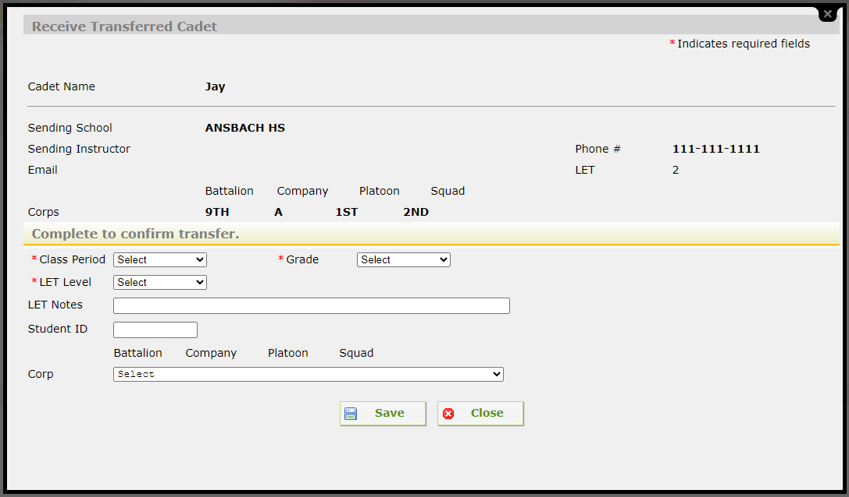
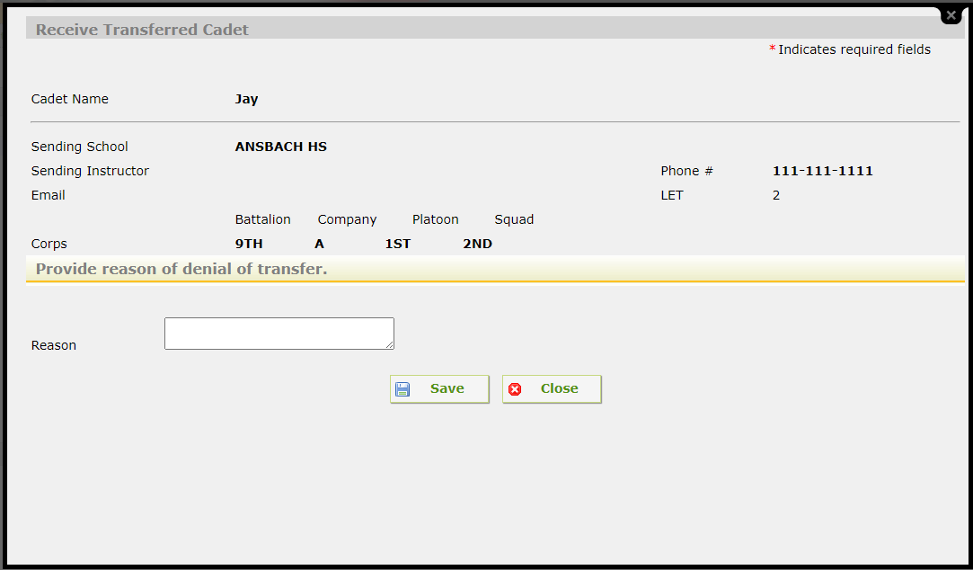
Accept Cadet Transfers from Another JROTC Program (JROTC Unit Management System User Guide pages 16 & 17, 3-8)
When the losing school process a Cadet transfer the gaining school will receive a message on the JUMS Homepage. The message will be listed under “Transfers.” You have 1 pending Cadet transfer, followed by a green hyperlink “Click here to process.”
In the action column, you may accept, decline, or view details of the Cadet Transfer.
To accept transfer of the Cadet’s record, click the accept hyperlink in the action column. The Receive Transferred Cadet screen will open. The screen displays the Cadet’s name, sending school, sending instructor, email, and a section “Complete to confirm transfer.” From the dropdown menus select the Cadet’s class period, grade, LET Level, enter optional information in LET Notes, student ID and Corp assignment. After all information is entered, click “save.” Close the menu, the Cadet detail screen will refresh and show the transfer has been accepted.
To decline transfer of the Cadet’s record, click the decline hyperlink in the action column. The Decline Transferred Cadet screen will open. The screen displays the Cadet’s name, sending school, sending instructor, email, and a reason text box. Type the reason the Cadet transfer was declined (Example, wrong school), and click save. After all information is entered, click “save.” Close the menu, the Cadet detail screen will refresh and show the transfer has been declined.
Cadet record transfers must be Initiated by the losing school Instructor. Cadet record transfers are “Accepted” by the gaining school Instructor.

Slide 27
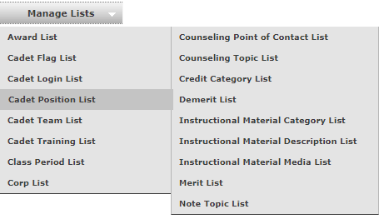
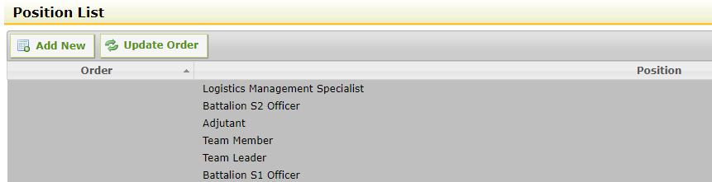
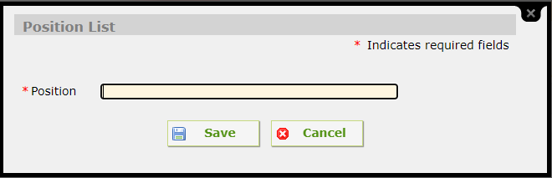
Create Cadet Positions (JROTC Unit Management System User Guide pages 18 & 19, 3-12)
Cadets assigned to any position or role in JUMS are system removed from the role or position and the Cadet’s access to JUMS is system removed when the Cadet is placed in an inactive status, graduates or is disenrolled.
From the top menu bar, select the Manage Lists tab; from the drop-down menu select the Cadet Position List.
This will open the Position List panel.
In the Position List panel there are preset positions listed. To create a new Cadet position that is not listed for your unit, click the Add New button.
The Position List input panel will open.
Type the name of the position you want to create in the position text input box.
Click the Save button.
The Position List input panel will close; the newly created position will appear in the Position List.
Note: The system will not allow a user to create a position that already exists for the unit. When a user attempts to create a duplicate position, the error message will read “This list items already exists in the system. Please add a different list item.”

Slide 28
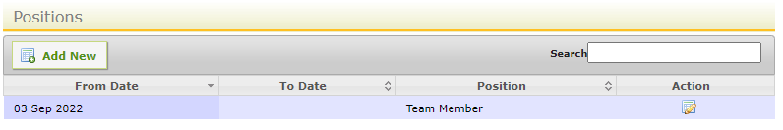
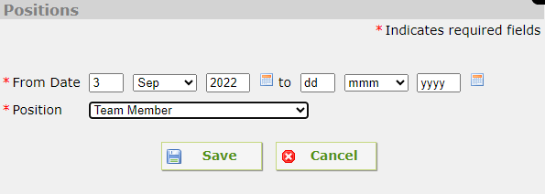
Assign, Change or Remove Cadet Positions (JROTC Unit Management System User Guide page 19, 3-13)
From the top menu bar, select the Manage Cadets tab; from the drop-down menu select the Search / Add Cadets.
In the Cadet Search Criteria panel type the last name of the Cadet you want to assign or remove from a position. Click the Search button.
Click the blue Positions link. The Positions panel will open.
To assign the selected Cadet to a new position, click the Add New button. The Positions selection panel will open. Click the Position drop-down selection arrow and select the position that you want to assign to the Cadet. Click the Save button. The Positions Panel will now display the Cadet’s assigned position.
If you want to change the Cadet’s current position to another position, click the Edit icon. Click the Position drop-down selection arrow and select the position that you want to assign to the Cadet. Click the Save button. The Positions Panel will now display the Cadet’s new assigned position. This removes the Cadet from the previously assigned position and inputs the “To Date” into the Cadets record.
To remove a Cadet from a currently assigned position click the Edit icon, once the Positions screen opens, click the “to” calendar icon on the right side, and select the date you want the Cadet removed from the position. Once you have selected the date, click the Save button. This will remove the Cadet from the position they were assigned.
Cadets assigned to any position or role in JUMS are system removed from the role or position and the Cadet’s access to JUMS is system removed when the Cadet is placed in an inactive status, graduates or is disenrolled.

Slide 29
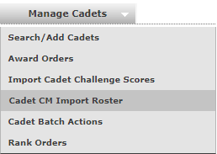
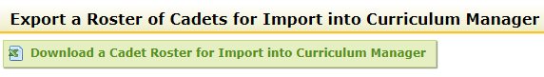


Download a Cadet Roster for Import into Curriculum Manager (JROTC Unit Management System User Guide pages 20 & 21, 3-15)
From the top menu bar, select Manage Cadets, from the drop-down menu select Cadet CM Import Roster.
Click the Download a Cadet Roster for Import into Curriculum Manager button, located at the top of the page. The search Cadets screen will open.
Enter the appropriate search criteria for the Cadets you want to download to the Curriculum Manager Import Template. Once you have verified the Cadets selected, scroll to the bottom of the Search Results, and click “Select Cadets” button.
A new window opens with “What do you want to do with the Cadet CM Import Template 243.xlsx? Click Save as, another menu will open with the file name displayed, select the location you want to save the file to and click 21 save. The file will save in the location selected as a Microsoft Excel Worksheet (*xlsx).
The import file has now been successfully saved to the designated location on your computer. The Cadet CM Import Template downloads with the following information already completed for all active Cadets: Cadet first name, last name, MI, student ID, LET level and class period.
Do not make any formatting adjustments to the downloaded file. The information downloads in the exact format required to import the information into CM.

Slide 30


Promote an Individual Cadet (JROTC Unit Management System User Guide pages 21 & 22, 4-1)
From the top menu bar, select Manage Cadets, from the drop-down menu select Search/Add Cadet.
Search for a Cadet by last name and click Search.
Select the rank link.
Click the Add New button to open the rank information panel.
All the fields marked with a red asterisk (*) are required fields.
Input the earned and effective dates of the Cadet’s new rank.
Select the Cadet’s new rank from the pull-down list under Rank.
Once all the information is input, click Save.
The Cadet’s new rank and dates of rank are now listed; to view the promotion order click the printer icon under action and select the report type you would like to view.
More promotion information can be found at the links below.
Promote a Single Cadet
Promote Cadets of Different Ranks up One Rank
Promote Cadets of the Same Rank to a New Rank
Note: The printer icon does not work on most school networks to print information from JUMS. Information must be exported to an Excel, PDF, or Word document and saved to another location on your computer to print.

Slide 31



Rescind a Cadet or Group of Cadets Promotion (JROTC Unit Management System User Guide page 24, 4-3)
From the top menu bar, select Manage Cadets, from the drop-down menu select Rank Orders.
A Rank Orders page will open that displays all your unit’s promotion orders, by order number and order date.
On the Rank Orders page, Action Column, you can Rescind, print, or delete promotion orders. Use the green arrow in the Action Column to rescind the appropriate promotion orders. This will revert all the Cadets listed on the selected promotion order to their previous rank.
Note: CADET RANK CANNOT BE CORRECTED BY DELETING ORDERS, DELETING THE ORDERS SIMPLY REMOVES THE ORDERS, IT DOES NOT REVERT THE CADETS BACK TO THEIR PREVIOUS RANK. PROMOTION ORDERS SHOULD NEVER BE DELETED.

Slide 32




Demote a Cadet (JROTC Unit Management System User Guide page 25, 4-4)
From the top menu bar, select Manage Cadets, from the drop-down menu select Cadet Batch Actions link.
On the Cadet Batch Actions page, click on the Search link.
When the search window opens, type the last name of the Cadet you want to demote in the last name box, Click the bottom Search button.
The Cadet you entered will appear in the search result window, verify the correct Cadet has been displayed, and click the Select Cadets button at the bottom of the page.
You are now back on the Cadet Batch Actions page; from the Batch Action drop-down list, select Ranks. The Cadet Batch Ranks window will open.
Verify the Cadet’s name and click the Demote button. The rank panel window will open. In the promotion/demotion levels box, enter the number of ranks you are reducing the Cadet. Complete the remainder of the rank panel items marked with a red asterisk. Click the Save button.
The Batch Ranks Panel will reopen; verify the Cadet’s new rank.
Note: A demotion cannot be deleted from a Cadets record except by rescinding the demotion order. If the demotion order is rescinded, the Cadet will revert to the rank they held prior to the demotion, effective the date the demotion order is rescinded.

Slide 33
Cadet Awards (JROTC Unit Management System User Guide pages 26 & 27, 5-1)
The frequency and type of awards that Cadets may earn are established in CC Regulation 145-2. Most Cadet awards are earned on an annual school year basis, please review the criteria for each award in CC Regulation 145-2. Instructors may not authorize or issue Cadets awards for wear on the Cadet uniform that have not been approved and authorized by the Department of the Army Heraldry. Instructors must ensure that all Cadet awards are processed, and award orders generated in JUMS for Cadets in the school year they are earned.
Many of the Cadet N series awards were designated as “annual” awards by the Department of the Army when they were approved. Cadets are eligible to receive annual awards once per school year. Once a Cadet receives an annual award, the system will not allow the same Cadet to receive the same annual award a second time during the same school year. Block schedule schools are authorized to give annual awards in both blocks. If a Cadet is selected for a second award designated as an annual award, JUMS will return a message “This is an annual award. NAME of CADET has already received this award for the current school year.” Click “OK.” This will return you to the Awards screen, click “Cancel.”
Examples of awards that Cadets earn individually and should not be Batch processed include the Academic Excellence Ribbon, Perfect Attendance Ribbon, Student Government Ribbon, Varsity Athletic Ribbon, Physical Fitness Ribbon, Personal Appearance Ribbon, Good Conduct Ribbon, Recruiting Ribbon, Excellent Staff Performance Ribbon, and the Directors of Army Instruction/Senior Army Instructor Leadership Ribbon.
Examples of awards that a group of Cadets earn based on participation in scheduled unit co-curricular events include the Color/Honor Guard Ribbon, Parade Ribbon, Service-Learning Ribbon, JCLC Participation Ribbon, Color Guard - White Cord, Raider Challenge/Orienteering Activity – Black Cord, and the Color Guard ARC Pin.
Cadet Challenge awards will AUTOMATICALLY be calculated as Cadet challenge scores are entered into JUMS and award orders generated and posted for the Cadets that earn an award based on their final score. Award orders for the N-2-2, Physical Fitness Ribbon will be automatically generated by JUMS for all Cadets who achieved a score of 85% or higher per all five events. Award orders for N-2-3, JROTC Athletic Ribbon will be automatically generated by JUMS for all Cadets who achieved a score of 50% or higher per all five events. Both the N-2-2 and N-2-3 ribbons are annual awards. For traditional schedule schools, JUMS will not generate or allow a second award for either of these ribbons to be generated and published for any Cadet regardless of how many Cadet Challenge scores are entered in the Cadets record in any school year. For block schedule schools, beginning in February 2017, JUMS will generate these orders a second time for Cadets enrolled in the 2nd block of the school year who complete and meet the Cadet Challenge award criteria.

