Slide 1
USAREC Overview/Army Benefits
MG Johnny Davis
Commander
Since 01 OCT 2022
CSM Shade Munday
Command Sergeant Major
Since 10 MAR 2023

Slide 2
Purpose
The purpose of this training is to give a brief understanding of Army benefits. Along with the basic knowledge on the operations within USAREC.

Slide 3











Recruiting Stakeholders
Supports US Army Recruiting Command
US Army Recruiting Command Supports
Key Stakeholders
Secretary of the Army
Chief of Staff of the Army
Sergeant Major of the Army
Assistant Secretary of the Army for Manpower & Reserve Affairs
Army G1 (Personnel)
Directorate of Manpower and Personnel Management
Human Resources Command
The Surgeon General
Training & Doctrine Command
Commanding General
Deputy Commanding
General/Chief of Staff
Army Enterprise Marketing Office
Senior Responsible Official
for all Army Accessions
US Army Special Operations Command
Direct Support
Corps of Engineers
Office of the Chief of Army Reserve
Combined Arms
Center
US Army Recruiting
Command
US Army Cadet Command
US Army Center
For Initial Military Training
Military Entrance Processing Command
Army Chief of Chaplains
Interdependent Army Accessions Enterprise
Notes:
Who does USAREC impact?

Slide 4


Enlisted & AMEDD Recruiting BN Boundaries
5 Enlisted Recruiting Brigades
1 Medical Recruiting Brigade
1 Marketing & Engagement Brigade
1 Recruiting & Retention College
Medical Bde
Enlisted Personnel
BDEs 5
BNs 38
COs 236
Stations 1,328
RRF 9,578
RA RRF 8,209
AR RRF 1,369
AMEDD Personnel
BDEs 1
BNs 6
COs 16
Stations 98
RRF 592
RA RRF 293
AR RRF 299
Chaplain Personnel
COs 1
Stations 1
RRF 22
RA RRF 11
AR RRF 11
MEB Personnel
BDEs 1
BNs 6
COs 20
Stations 98
RRF 126
RA RRF 126
9A
9B
9C
9D
9E
9O
1ST MR Bn (Ft Meade, MD)
2nd MR Bn (Redstone, AL)
3rd MR Bn (Ft Knox, KY)
5th MR Bn (Ft Sam Houston, TX)
6th MR Bn (Las Vegas, NV)
SORB MR Bn (Ft Bragg, NC)
1ST MRB BN
9A1
9A2
9A3
9A4
MDW
Boston
NCY
Pittsburgh
9E
9C
9A
2ND MRB BN
9B1
9B2
9B3
Atlanta
Nashville
Orlando
3RD MRB BN
9D
9C1
9C2
9C3
Minneapolis
Chicago
Columbus
5TH MRB BN
9D1
9D2
9D3
San Antonio
Kansas City
Houston
9B
OCONUS
Alaska | Japan
Hawaii | American Samoa
Puerto Rico | South Korea
Virgin Islands | Guam
Germany
6TH MRB BN
9E1
9E2
9E3
Denver
Los Angeles
Seattle
Recruiting & Retention College
79 Instructors
62 Support Staff
Pre-Command Course
Company Commander/1SG Course
Army Recruiter Course
Healthcare Recruiter Course
Station Commander Course
Guidance Counselor Course
Recruiting Operations Officer Course
Master Trainer Course
Career Counselor Course
Transition NCO Course
79R/79S Senior Leader Course (SLC)
1st Bde
2nd Bde
3rd Bde
5th Bde
6th Bde
5A
5C
5D
5H
5I
5J
5K
5N
Chicago
Cleveland
Columbus
Indianapolis
Great Lakes
Milwaukee
Minneapolis
Nashville
4C
4D
4E
4G
4J
4K
4P
Dallas
Denver
Houston
Kansas City
Oklahoma City
San Antonio
Phoenix
6F
6H
6I
6J
6K
6L
6N
Los Angeles
Portland
NorCal
Salt Lake City
Southern Cal
Seattle
CentCal
Marketing & Engagement Bde
19 Assets
48 Recruiters
13 Support Staff
1A
1B
1D
1E
1G
1K
1N
1O
Albany
Baltimore
New England
Harrisburg
New York City
Mid-Atlantic
Syracuse
Richmond
3A
3D
3E
3G
3H
3J
3N
3T
Atlanta
Columbia
Jacksonville
Miami
Montgomery
Raleigh
Tampa
Baton Rouge
7A
7A3
7B
7C
Mission Support Bn (Ft Knox, KY)
Outreach Company (Ft Knox, KY)
Parachute Team (Ft Bragg, NC)
Marksmanship Unit (Ft Benning, GA)
Notes:
General display of the geographically dispersed AO that is USAREC.

Slide 5




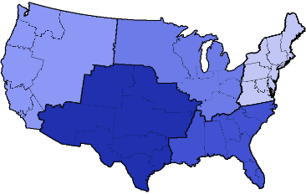






How USAREC Works
50% of appts are made in the first week
Average 2.6 Days appt to interview
Walk in
Face to Face
College OPS
RA: 751K
AR: 182K
Appointments
Scheduled
Email/Social Media/Text
RA: 563K
AR: 136K
Appointments
Conducted
25M Contacts
3.6M Leads
RA: 207K
AR: 50K Test
Make Appt w/ Prospect
Army Interview
ASVAB
Test
Telephonic
37.3 Leads to a contract
Mail outs
RA:118K
AR: 25K
Pass Test
ASVAB
Test Pass
Army Reserve Referrals
Military Entrance
Processing Command
HS List / College List / ASVAB
School Events
Virtual Campaigns
RA: 88K
AR: 15K Contracts
Physical
Packet
Build / 2807 & SF86 / background check / medical pre-screen
Military Entrance Processing Station
Conduct
FY22
Entry
Pool
Mental
14.6K
Report to Troop Program Unit (TPU) of Assignment
(30 Days of Contracting)
RA: 98K
AR: 20K
Agree to Process
Low
Basic Combat Training / One Station Unit Training
Advanced Individual Training (AIT)
Return to TPU
Moderate
Significant
Losses
+/- 1.2K
High
65.5K Access
Basic Combat Training / One Station Unit Training
Ship to First Unit of Assignment
Losses
+/- 4.4K
Advanced Individual Training (AIT)
First Unit Of Assignment
Notes:
How someone would process through the USAREC pipeline.

Slide 6

Benefits overview
Snapshot of benefits
• Sign-up bonus
• Earn a salary while learning a skill
• High-quality medical and dental coverage
• Free or discounted meals and housing
• Earn college credits
• Specialized job training
• Thrift Savings Plan — the military version of a 401(k)
• Retire young with a pension
• VA loan guarantees to assist with home buying
• 30 days-vacation with pay per year
• Paid parental leave
• SLRP
Notes:
Basic Army benefits to discuss.

Slide 7
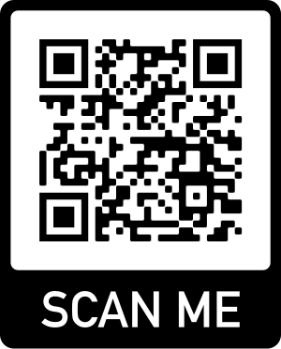
Pocket Recruiting Guide
The purpose of the Pocket Recruiter Guide is to outline Army programs and incentives in a quick reference and easily searchable format. It serves primarily as a ready reference for recruiters and other members of the US Army Recruiting Command.
Notes:
Information contained in this guide is subject to change and should not be construed as a guarantee of the availability of these programs at a given time. Recruiters and authorized members of Recruiting Command must verify and validate enlistment eligibility, availability, and qualifications for specific enlistment options during Army enlistment processing. Users should find the Pocket Recruiter Guide a useful aid to help build and maintain a high-quality Army

Slide 8

Army Career Navigator
Notes:
Army career navigator app. What it can be used for and its benefits.

Slide 9
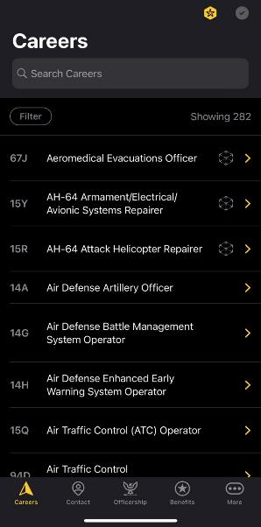
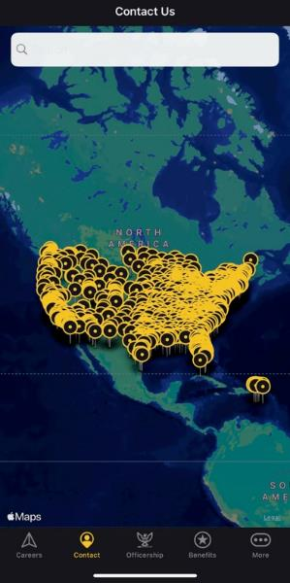
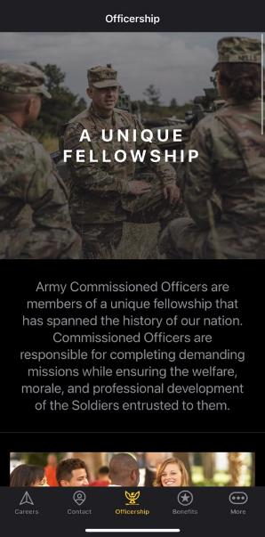
Army Career Navigator
Notes:
Snapshots of the five tabs available on the app.

Slide 10
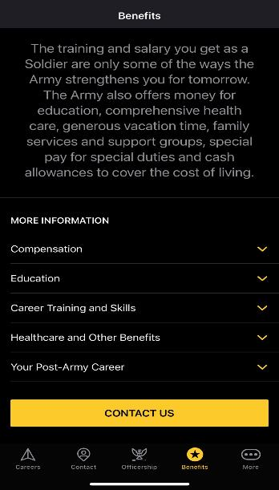
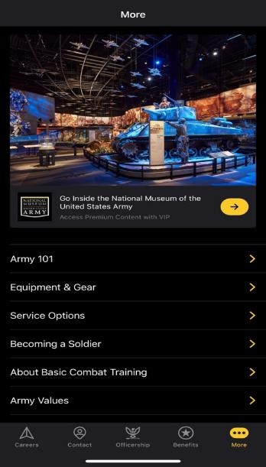
Army Career Navigator
Notes:
Snapshots continued.

Slide 11



Additional Resources
Notes:
Mission Support BN, ASVAB Career Explorer Program, HRAP

Slide 12
Enlistment Incentives/Programs
Quick Ship Bonus
a. QS is authorized FY23 tier 1 I-IIIA: $5,000/I-IIIB $2,500 for a 36 month
or more TOS (Associated Option 273/293).
b. QS is authorized FY23 tier 1 I-IIIA: $10,000/I-IIIB $5,000 for a 48 month
or more TOS (Associated Option 274/294). QS can be combined with LRP.
c. QS is authorized FY23 tier 1 I-IIIA: $20,000/I-IIIB $7,500 for a 60 month
or more TOS (Associated Option 275/295). QS can be combined with LRP.
d. QS is authorized FY23 tier 1 I-IIIA: $40,000/I-IIIB $10,000 for a 72 month
or more TOS (Associated Option 276/296). QS can be combined with LRP.
e. QS MOSs will be determined by REQUEST.
Currently a high school senior or equivalent that has a projected high school completion date within FY23 and with a RECSTA within 02 January 2023 through 31 July 2023.
Senior Seasonal Bonus
MIN INCENTIVE
MOS TOS OPTION LEVEL 3 YR 4 YR 5 YR 6 YR
---------------------------------------------------------------------------
11X1 3 EB/CS 2 10000 20000 26750 40000
4 LRP NA LRP LRP LRP
3 SSB 2500 7500 15000 20000
---------------------------------------------------------------------------
12C1 3 EB/CS 2 10000 20000 26750 40000
5 LRP NA NA LRP LRP
3 SSB 2500 7500 15000 20000
Notes:
QS is 1 to 30 days

Slide 13
Enlistment Incentives/Programs
The Future Soldier Preparatory Course
FSPC/09M is RA and AR (STP only) NPS applicants who have scored 21-30 AFQT on the ASVAB (CATIV). The CATIV applicants will have the opportunity to attend an improvement course at Fort Jackson. At the completion of the course the Soldiers will be administered the Armed Forces Classification Test (AFCT(in-service ASVAB)). Soldiers are required to score a 31 AFQT or above on the AFCT.
Applicants enlisting in the FSPC/09M must meet the following criteria.
a. Have 3 valid ASVAB attempts listed in ERM (School ASVAB scores must be
visible in the "Test Scores" tab in ERM)
b. Applicant must have a valid high school letter with expected graduation date
c. Score 21-30 AFQT on the ASVAB
d. Enlist for 09M (Delayed Trainee)
e. Cannot enlist under ARMS (dual participation not authorized)

Slide 14

OPTION 1 ENLISTMENT PROCESS
Reference UM 21-047
1: Applicant selects U.S. Army Option 1 at time of enlistment
2: Soldier successfully graduates BCT+AIT+Airborne
3: Soldier Completes Special Operations Aviation Enlisted Combat Skills Course,“Green Platoon” (Fort Campbell, KY):
-27 Training Days
-Physical Fitness Assessments
-Land Navigation Training
-Combatives Level 1 Training and Certification with Close Quarters Combat Training
- Combat Lifesavers Course and Certification
-Advanced Weapons Training (Students will shoot thousands of rounds with M4 and M18 pistol)
4: Soldier is assigned to one of three 160th SOAR locations:
-Hunter Army Airfield, GA
-JBLM, WA
-Fort Campbell, KY
UNLEASH YOUR SUPERPOWERS
CUI
AND CRUSH IT!

Slide 15
Education
POST 9/11 GI BILL
The Post 9/11 GI Bill is an education benefit program for individuals who served on active duty on or after September 11, 2001.
Eligible individuals are entitled up to 36 months of benefits and based on a sliding scale that is linked to the length of qualifying active-duty service on or after September 11, 2001.
MONTGOMERY GI BILL ACTIVE DUTY
Must have completed at least two years of active duty.
All Soldiers participating in the program contribute $1,200 their first year ($100 per month).
Soldiers completing an enlistment of less than three years receive a total benefit of $59,904 for college ($1,664 per month*).
Soldiers completing an enlistment of three or more years receive a total benefit of $73,800 for college ($2,050 per month*). ​
Notes:
The Post 9/11 GI Bill is an education benefit program for individuals who served on active duty on or after September 11, 2001. Eligible individuals are entitled up to 36 months of benefits and based on a sliding scale that is linked to the length of qualifying active duty service on or after September 11, 2001. All Soldiers are eligible for benefits contingent upon qualifying active duty service. • What does the program pay for eligible individuals? • Tuition & fees — paid directly to the school — not to exceed the maximum in-state undergraduate or graduate tuition, and fees at a public institution of higher learning. • Monthly Housing Allowance (MHA) — paid to the student — equal to the Basic Allowance for Housing (BAH) for an E-5 with dependents. Your MHA is based on ZIP code of your school. Distance learning program housing stipends are payable at MHA Rate $825.00. Individuals on active duty (and the spouses of individuals on active duty) or those who are attending college half-time or less, will not receive the housing stipend. The stipend is prorated for those individuals in more than half-time to full-time attendance. 42 • Annual book stipend — paid to the student — prorated by percentage of the benefit and course load up to $1,000. • A one-time rural benefit payment of $500. BAH rates by ZIP code: https://www.defensetravel.dod.mil/site/bahCalc.cfm • Visit the VA website for the most current rates and information. https://www.va.gov/education/about-gi-billbenefits/post-9-11/
The MGIB payment information below was effective October 1, 2019. Visit the VA website, https://www.va.gov/education/about-gi-bill-benefits/montgomery-active-duty/ for the most current rates and information. • Must have a high school diploma or equivalency certificate prior to expiration of initial term of service. • Must be non-prior service or only have Initial Active Duty for Training (IADT) and entered active duty for the first time after June 30, 1985. • Must have completed at least two years of active duty. • All Soldiers participating in the program contribute $1,200 their first year ($100 per month). • Soldiers completing an enlistment of less than three years receive a total benefit of $59,904 for college ($1,664 per month*). • Soldiers completing an enlistment of three or more years receive a total benefit of $73,800 for college ($2,050 per month*).
To qualify, you must meet the following requirements: • Have a six-year obligation to serve in the Selected Reserve signed after June 30, 1985. If you are an officer, you must have agreed to serve six years in addition to your original obligation. For some types of training it is necessary to have a six-year commitment that begins after Sept. 30, 1990. • Complete your initial active duty for training (IADT). • Meet the requirement to receive a high school diploma or equivalency certificate before completing IADT. You may not use 12 hours toward a college degree to meet this requirement. • Remain in good standing while serving in an active Selected Reserve unit. You will also retain MGIB-SR eligibility if you were discharged from Selected Reserve service due to a disability that was not caused by misconduct. Your eligibility period may be extended if you are ordered to active duty. • They may be entitled to receive up to 36 months of education benefits. • Full-time Institutional training monthly payment $397.00. • Apprenticeship and On-the-Job training $297.75.00 first six months. • Correspondence and Flight – Entitlement charged at the rate of one month for each $397.00 paid.
A kicker is an enlistment or reenlistment education incentive that certain Selected Reserve members can use to increase the amount of money they receive when using their Montgomery GI Bill-Selected Reserve (MGIBSR) to go to school. Comes in $100, $200, and $350 increments. Refer to latest Army Reserve (AR) Enlistment Incentives Message.

Slide 16
Education (Cont)
MONTGOMERY GI SELECTED RESERVE
Have a six-year obligation to serve in the Selected Reserve signed after June 30, 1985
May be entitled to receive up to 36 months of education benefits
MONTGOMERY GI BILL – SELECTED RESERVE PLUS KICKER
​
A kicker is an enlistment or reenlistment education incentive that certain Selected Reserve members can use to increase the amount of money they receive when using their Montgomery GI Bill-Selected Reserve (MGIBSR) to go to school.
Comes in $100, $200, and $350 increments
Notes:
Additional education benefits.

Slide 17
Education (Cont)
LOAN REPAYMENT PROGRAM (LRP)
To qualify for the LRP, applicants must be Non-Prior Service (NPS) and enlist for a minimum five years.
The maximum reimbursable loan amount is $65,000.
CONCURRENT ADMISSIONS PROGRAM (CONAP)
ConAP is a partnership between USAREC and over 1,900 participating colleges to mutually advance the goals of lifelong learning and postsecondary education for Future Soldiers.
TUITION ASSISTANCE (TA)
Soldiers may use TA to earn one or more degrees through the master’s level for a combined total of up to 130 SH at the undergraduate level (associate and bachelor’s), 39 SH for a master’s degree, and 21 SH for an academic certificate/diploma (undergraduate or graduate level).​
Notes:
To qualify for the LRP, applicants must be NPS, tier 1, TSC I-IIIA and enlist for a minimum five years. Applicants cannot renegotiate their contract into the LRP window since the DEP-In date will take precedence. Applicants may receive either an EB/CS or LRP but not both. Applicants may choose both the LRP and QS/SB 43 however, the LRP cannot be combined with any other monetary incentive. All applicants must have incurred student loan debt prior to enlisting into the Future Soldier Training Program and otherwise meet the criteria below. LRP applicants must decline MGIB enrollment on DD 2366 at the Reception Battalions while in processing at DFAS. The maximum reimbursable loan amount is $65,000. More information on qualifying loans can be found in the current USAREC RA Incentive message.
ConAP is a partnership between USAREC and over 1,900 participating colleges to mutually advance the goals of lifelong learning and postsecondary education for Future Soldiers. On January 1, 2014, USAREC assumed ConAP management and now serves as a liaison between recruiters, ConAP colleges, Army education centers, and the higher education community. ConAP goals are to increase enlistment of college-capable active duty and Reserve Soldiers; increase the number of Army Soldiers, veterans, and Reserve Soldiers enrolled in college; and increase the use of Army education benefits.
This policy applies to the RA, and members of the ARNG and AR serving in the Selected Reserve.
• Effective Date. The effective date is 5 August 2018 for this directive.
• Tiered Eligibility. Depending on their current level of post-secondary education, Soldiers may be eligible for
up to two tiers of TA:
• Tier 1: Soldiers who have not attained a bachelor’s degree and wish to pursue an undergraduate
certificate/diploma, or associate or bachelor’s degree; or who have previously attained a bachelor’s degree
without the use of TA and who wish to pursue a graduate certificate/diploma or master’s degree.
• Tier 2: Soldiers who previously used TA for any portion of their undergraduate degree, have attained a
bachelor’s degree, and wish to pursue a graduate certificate/diploma or master’s degree.
• Soldiers establish tier 1 TA eligibility as follows:
• Enlisted Soldiers who have graduated Advanced Individual Training.
• Warrant officers who have graduated Warrant Officer Basic Course.
• Officers who have graduated Basic Officer Leaders Course.
• Soldiers establish tier 2 TA eligibility for pursuit of a master’s degree (when any portion of their
undergraduate degree was funded with TA) as follows:
• Enlisted Soldiers who have successfully completed Advanced Leaders Course.
• Warrant officers who have graduated Warrant Officer Advanced Course.
• Officers who have graduated Captain Career Course or equivalent.
• Baseline Eligibility Requirements. Regardless of which TA tier they are eligible for, all Soldiers must meet
the following eligibility requirements to receive TA benefits:
• Soldiers must not be under suspension of favorable personnel actions in accordance with AR 600-8-2.
• Soldiers must not be a contracted Reserve Officers Training Corps (ROTC) scholarship cadet or Green-toGold ROTC program cadet.
• Soldiers must have sufficient time in service remaining to complete all courses for which the Soldier is
requesting TA.
• Soldiers must resolve any ARMYIgnitED-imposed account holds, including, but not limited to, unsuccessful,
incomplete, or missing class grades; minimum grade point average; incorrect civilian education level;
missing/unapproved degree plan; expired or missing statement of understanding; and semester hour (SH) and
annual and lifetime TA limits.
• Soldiers must not be attending school under the provisions of AR 621-1 (such as fully funded schooling or
degree completion or cooperative degree programs) during the period the Soldier is requesting TA.
44
• Soldiers in Active Guard and Reserve (AGR) status, pursuant to titles 10 or 32, and ARNG and AR Soldiers
in an active drilling status must have a designation of satisfactory participant.
• Tuition Assistance Program Authorizations. If Soldiers meet the eligibility requirements in paragraphs 5
through 8, they may participate in the TA program subject to the following:
• Soldiers may take up to 16 SH each fiscal year at the rate of up to $250 a SH each year.
• Soldiers may use TA to pursue postsecondary education at the following levels: certificate/diploma,
associate, bachelor’s, and master’s.
• Soldiers may only use TA to pursue one degree/certificate at a time.
• Soldiers may not use TA for courses leading to a lower or lateral postsecondary diploma/degree than they
already possess, regardless of funding source used, except for special programs identified in AR 621-5 with
approval of an Army Education Counselor.
• Soldiers may use TA to earn one or more degrees through the master’s level for a combined total of up to 130
SH at the undergraduate level (associate and bachelor’s), 39 SH for a master’s degree, and 21 SH for an
academic certificate/diploma (undergraduate or graduate level).
• TA is not authorized for doctor’s degrees as defined by the U.S. Department of Education. Examples include,
but are not limited to, Doctor of Jurisprudence or Juris Doctor (J.D.), Doctor of Medicine (M.D), Doctor of
Pharmacy (Pharm.D), and Doctor of Philosophy (Ph.D.).
• TA is not authorized for courses available in Army e-Learning unless the class is required as part of the
official degree plan.
• TA is not authorized for institutional challenge examinations/credibly-examination, credit awarded based
solely on an assessment of prior learning and/or experience, portfolio evaluation, or review of military or
civilian transcript(s).
• This policy change does not affect existing authorized uses of TA not explicitly prohibited by this directive.
• TA covers tuition only. TA will not pay for fees institutions levy, unless authorized by DoD Instruction
1322.25.
• TA is not authorized for any course for which a Soldier receives reimbursement in whole or in part from any
other Federal source, including veterans’ education benefits and Service-funded programs (ROTC
scholarship, education-related incentive or bonus, and advanced civil schooling) when the TA payment would
constitute a duplication of benefits. Federal student aid loans, grants, and work-study programs are not
considered a duplication of benefits.
• The Deputy Chief of Staff, G-1 is the proponent for this policy and will incorporate the provisions of this
directive into the next update of AR 621-5. The Deputy Chief of Staff, G-1 will publish implementing
guidance and annual updates to the TA program’s policies and procedures. Direct any questions about the
policy to U.S. Army Human Resources Command, Army Continuing Education Division at:
usarmy.knox.hrc.mbx.tagd-aces@mail.m

Slide 18
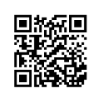
Education (Cont)
Minuteman Scholarship
The U.S. Army Reserve Minuteman Scholarship was introduced in 2015 to enhance the Army Reserve’s ability to recruit highly qualified cadets every year. All qualified applicants for ROTC scholarships may apply for consideration for the 4-year Minuteman Scholarship.
The Minuteman Scholarship covers full tuition and fees (uncapped) at any college or university served by an Army Reserve Officer’s Training Corps (ROTC) program, or can be used toward room and board, capped at $10,000 per year.
Scholarship recipients also receive a monthly Cadet stipend ($420-Fresh, $420-Soph, $420-Junior and $420-Senior), and a yearly book allowance of $1,200. In addition, Minuteman Scholarship recipients participate in the Simultaneous Membership Program, which gives them experience with an Army Reserve unit while earning SGT/E-5 Cadet pay for their service.
After graduation and commissioning, Minuteman Scholarship recipients are guaranteed placement in the Army Reserve.
To get started, high school seniors should contact the Professor of Military Science or Recruiting Operations Officer at the Army ROTC program that serves their college or university. There are 275 host programs that cover nearly 3,000 schools across the United States.
https://www.usar.army.mil/MinutemanCampaign/
Notes:
Qualifications
Be a US citizen
Have a valid MEPS physical
Currently in the USAR
Complete SF86 to obtain secret security clearance
Pass a valid ACFT
Be in compliance with AR 600-9 HT/WT standards
Pass MSC CDR interview process (if applicable)
Pass PMS interview process (PMS should be involved early in the process)
Proof of acceptance into participating University of attendance
Proof of academic major
GPA of 2.5 or Higher
Proof of SAT/ACT scores (min 920 SAT or 19 ACT)
Must have an approved academic major and be a current drilling USAR member.
They must, at a minimum, be accepted into a participating institution.
Be able to commission before reaching the age of 31

Slide 19
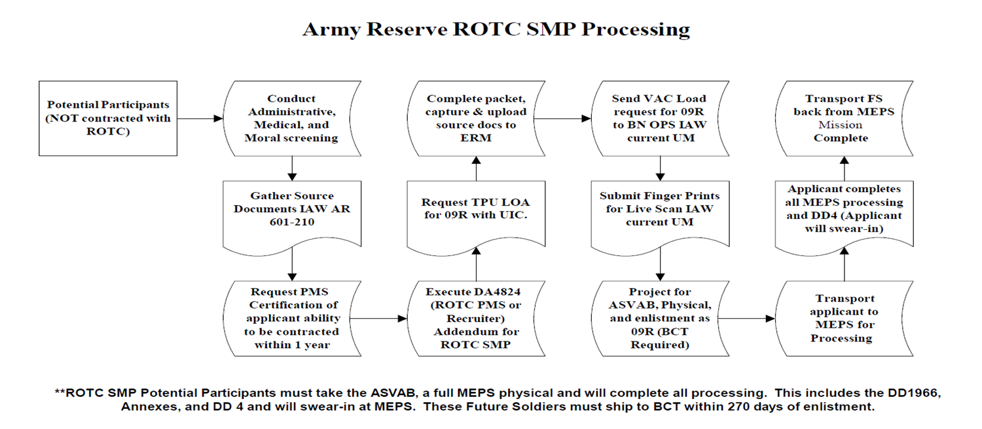
Education (Cont)
Simultaneous Membership Program (SMP)
SMP allows non-scholarships MSL II, III, IV cadets. GRFD and Dedicated Reserve and Guard scholarships cadets to simultaneously participate as members of an AR or ARNG unit. SMP provides the future officer with leadership and AR unit experience . Benefits may include MGIB benefits, federal and state tuition assistance. SMP is optional for non-scholarship MSL II, III, and IV cadets, but required for RFD scholarship cadets and non-scholarship Guaranteed Reserve Forces Duty contract cadets.
Notes:
SMP cadets are non-deployable
Documents required:
Professor Of Military Science (PMS) Certification (Memorandum) that the potential participant has the ability to be contracted.
TPU Letter of Acceptance (LOA).
BN Operations must forward LOA and Vacancy Load Request Form to AR ROC NCO for 09R position to be manually loaded into the system.
Applicant must take ASVAB Test (if no valid test exists) and full MEPS physical.
Applicant must score an AFQT of 31 or higher. (UM 13-045)
DD 4
DA Form 4824 executed by ROTC Department PMS or Recruiter
USAREC 601-210, p101
-All applicants must have an ASVAB score of record to enlist.

Slide 20
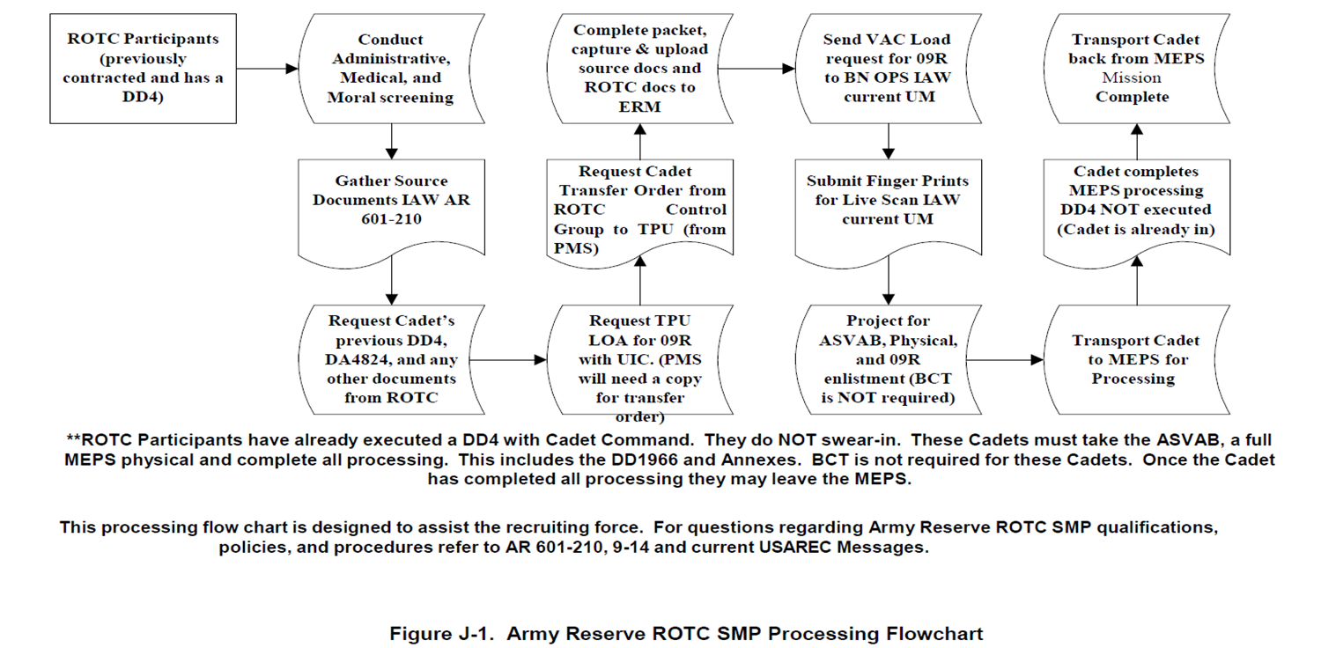
Education (Cont)
Simultaneous Membership Program (SMP) cont…

Slide 21
Army Benefits
President
Dean of Students
LEAVE (30 DAYS A YEAR)
A Soldier earns 2 ½ days per month for a total of 30 days a year.
HEALTH AND DENTAL CARE
Soldiers and family members are entitled to service members group insurance automatically covered by a comprehensive HMO-type military healthcare plan called TRICARE that provides medical and dental care at little or no cost.
PMS
Admissions
BLENDED RETIREMENT SYSTEM
This system, blends the traditional legacy retirement pension, with a defined contribution benefit into a Thrift Savings Plan (TSP)
Advisor/
Counselor
VA Rep
Notes:
A Soldier earns 2 ½ days per month for a total of 30 days a year.
There are three types of non-chargeable leave under the Leave Entitlements under the Military Parental Leave Program. • Maternity convalescent leave is limited to 12 weeks of non-chargeable leave. • Primary caregiver leave is limited to 6 weeks of non-chargeable leave. • Secondary caregiver leave is limited to 21 days of non-chargeable leave. For more explanation of the Army Parental Leave Program refer to Army Directive 2019-05 (Army Parental Leave Program) dated 22 JAN 2019.
One of the key benefits of serving in the Uniformed Services is the retirement plan. The National Defense Authorization Act for Fiscal Year 2016 created a new retirement system for members of the Uniformed Services. This system, called the Blended Retirement System (BRS), blends the traditional legacy retirement pension, also known as a defined benefit, with a defined contribution benefit into a Thrift Savings Plan (TSP). The BRS went into effect on Jan. 1, 2018.
Soldiers and family members are entitled to service members group insurance automatically covered by a comprehensive HMO-type military healthcare plan called TRICARE that provides medical and dental care at little or no cost. TRICARE enrollees receive most health care at Military Treatment Facility, where a primary care manager supervises their care. The Army health-care team is one of the biggest health-care networks in the world, utilizing state-of-the-art technology in world-renowned facilities.

Slide 22
Army Benefits
ARMY MILITARY PARENTAL LEAVE PROGRAM (MPLP)
Birth parents:
Deferred or excused for 365 days after the birth of their child from all continuous duty events that are in excess of 1 normal duty day/shift (e.g., deployment, mobilization, field training, combat training center program rotations, collective training events away from home station, pre-mobilization training, unit training assembly away from home station, TDY, etc.)
Authorized 12 weeks of parental leave in addition to and following maternity convalescent leave during the 1-year period beginning on the date of birth of child.
Non-birth parents/adoption/foster-care/surrogacy:
Authorized 12 weeks of parental leave either taken in whole or taken in increments during the 1-year period beginning on the date of birth of child/date of adoption/date of placement (adoption/long-term foster care)
Should expect to deploy with their units.
Taking leave:
Soldiers may take parental leave in one continuous period or in increments consistent with operational requirements.
Soldiers can take ordinary leave in between increments of or consecutively with parental leave.
Notes:
On 31 January 2023, the Army released ALARACT 007/2023, which provides Soldiers (as defined in key terms) and Families greater flexibility and extended time with dependent children. Per the ALARACT, Soldiers are authorized 12 weeks of parental leave for birth/adoption/long-term foster care placement occurring on or after 27 December 2022.
The following applies to each sub-set of parents.
Soldiers choosing to take parental leave in more than one increment must request proposed leave in blocks of at least 7 days each for a max of 12 increments.
Deferring leave: Operationally deployed Soldiers must normally defer parental leave until completion of deployment. However, unit commanders may approve parental leave if he/she determines it doesn’t impact unit readiness. Soldiers who defer leave because of deployment may be authorized an extension of the 1-year parental leave period.
Extension of leave: Authorized if Soldiers lose unused parental leave (after the 1-year period) because of deployment/military exercise (consecutively more than 90 days), attendance at an in-residence PME course (consecutively more than 90 days), execution of PCS orders with TDY en route to new permanent duty station (consecutively more than 90 days) that would interfere with taking parental leave.
Unused leave: Soldiers forfeit any amount of unused parental leave remaining at the expiration of the 1-year period (unless extension applies); at the time of separation from active service; termination of placement for adoption/long-term foster care.
Stillbirth/miscarriage: Birth parent/spouse not authorized parental leave. DoD Health care provider may recommend convalescent leave.

Slide 23



