Slide 1
Property Accountability G4

Slide 2
Agenda
G4 Organization Structure
JROTC Property Book Office and Structure
Accountability & Responsibility
Inventory Basics
Inventory Schedule
JROTC Post Good Receipts (PGR) and Structure
JROTC Equipment and Uniform Warehouse
Acquisition & Property Accountability Guidance
How to submit a DD Form 250
FLIPLs
POC Listing
Questions

Slide 3
G4 Organization Structure
SGM
(92Z, E9)
DCOS G4
(90A, 06)
Admin NCO
(42A, E5)
Deputy G4
(GS14)
SROTC PBO
JROTC PBO
FAC Br.
LOG Div.
OPS Br.
ACQ Div.
CST Log. Spt. Div.
Prop Acct Tech
(920A, CW3)
Logistics Mgmt
Spec (GS12)
Facility Mgmt Spec
(GS12)
Spvr, Log Mgmt
Spec. (GS13)
Logistics Mgmt
Spec (GS12)
Spvr, Procurement
Analyst (GS13)
Spvr, CST LSD
(90A, 05)
Logistics Mgmt
Spec (GS11)
Facility Mgmt NCO
(92Y, E6)
Sr. Logistics Mgmt
Spec (GS12)
X1 (CTR)
Procurement
Analyst (GS12)
X3
Logistics Mgmt
Spec (GS11)
X2
Logistics Mgmt
Spec (GS11)
X28 (CTR)
X5 (CTR)
Logistics Mgmt
Spec (GS12)
Procurement
Analyst (GS11)
Supply Tech
(GS11)
Logistics Planner
(GS11)
X11 (CTR)
Logistics Mgmt
Spec (GS11)
Procurement
Analyst (GS11)
Supply Tech
(GS07)
Trans Coordinator
(88M, E7)
Supply Tech
(GS07)
Procurement
Analyst (GS (7)
(9) (11)) x 5
Supply NCO (Armor)
(92Y, E6)
Trans Coordinator
(GS09)
Authorized / OH
MIL | 9 / 10
CIV | 22 / 32
CTR | 56
X4 (CTR)
Supply NCO (Armor)
(92Y, E5)
X7 (CTR)
Contract
Support
Term
Not on
TDA
Notes:
1. LSD Div.
--Para/Line 040D/13 The vacant Supply Tech GS07 is being used to fill the Reality Specialist GS11 in FAC.
--Para/Line 040D/05 Logistics Planner GS11 is a dedicated Procurement Specialist for CST in ACQ.
--Para/Line 040D/08 LMS GS11 is being filled on a term basis (return rights).
2. LOG Div. – 040B/03 LMS GS12 is being filled on a term basis (return rights).

Slide 4
JROTC Property Book Office
What we do:
Manage USACC’s Consolidated Property Book – Primary Hand Receipts (PHR)
1,377 JROTC PHRs (geographically dispersed across 1,700 locations)
42 Directors of Army Instruction
28 New JROTC Programs
9 Cyber Programs
Total Value = ~$80M
Types of Property – Automation, Air Rifles, Drill Rifles, Flags, Howitzers, Robotics, 3D Printers
Responsible for timely and accurate performance regarding
Inventories (Annual, Change of Responsible Officer, Command Directed)
Property Adjustments (Receipts/Issues and Lateral Transfers)
Turn-in Directives – Decision Support Tool (DST)
Validates accountability requirements for new purchases/replacements; establishes accountability
Acquisition Contract Requirements
Government Purchase Card (GPC) Requests
Software and Hardware Information Technology Equipment, Products, and Services (ITEPS) Requests
Unaccounted for Contract Items FY20-FY22 ~ 19,000 pieces; Total Value $28M
Supports Junior School of Cadet Command (JSOCC) Logistics Courses and Brigade Annual Workshops
Evaluates and Assesses Trends in the Command Supply Discipline Program
JROTC Program for Accreditation (JPA) Supply Checklist
Oversees the Financial Liability Investigation of Property Loss (FLIPL) Process
Tracks, Advises, and Provides Investigating Officer (IO) Briefs

Slide 5
Property Book Office - Structure
JROTC PBO
Kimberly A. Canela DA Civilian
Program Manager
Nathaniel Morgan Contractor
FLIPL Manager
Mathias Querry Contractor
Senior Supply Tech
Donna Williams DA Civilian
2nd Brigade
Kelly Jones Contractor
3rd Brigade
Lenneris Jones Contractor
5th Brigade
Martin Brost Contractor
6th Brigade
Ricky Allen Contractor
2nd Brigade
Bryan Hackley Contractor
4th Brigade
Jennifer Coates Contractor
3rd Brigade
Tyrone Smith Contractor
4th Brigade
Cameron Doss Contractor
5th Brigade
Vacant
6th Brigade
Brenda Acevedo
Contractor
7th Brigade
Markevis Clark Contractor
8th Brigade
Taneshia Williams Contractor
7th Brigade
Ronald Brightman Contractor
8th Brigade
Yacxiris Lopez Contractor

Slide 6
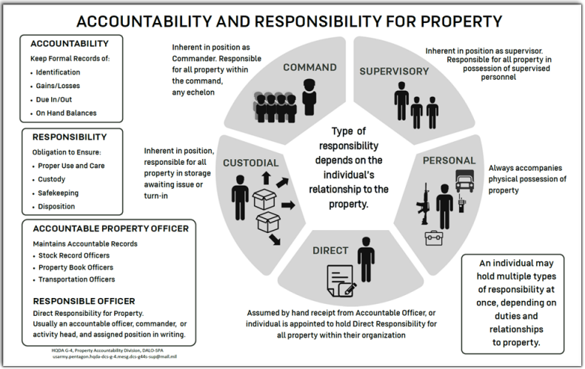
Accountability & Responsibility

Slide 7
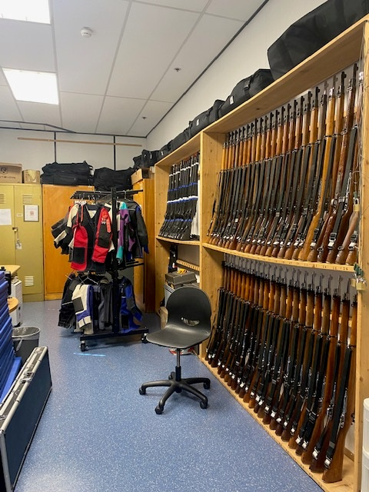
Inventory Basics (1 of 2)
Primary Hand Receipt Holder’s at a JROTC high school will conduct a 100% physical inventory annually – followed by a 6-month review
Intent of the Inventory:
Check each item to ensure it matches the hand receipt
Verify quantities with quantities recorded on hand receipt
Verify serial numbers
Report discrepancies to the Property Book Officer
Document inventory results
Don’t include property purchased with school funds
Ref: Annex A, CCR 145-2, Chapter 4-7
AR 710-2 Paragraph 2-12 and Table 2-2

Slide 8
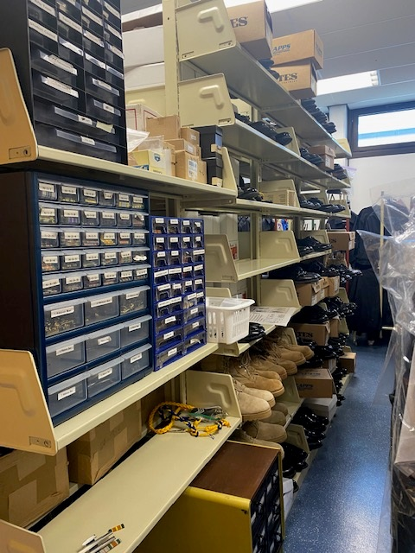
Inventory Basics (2 of 2)
Required documents for Complete Inventory:
Appointment Orders
100% Inventory Memorandum
DA Form 1687 (Delegation of Authority)
A copy of Bond/Insurance
Signed GCSS-Army Primary Hand Receipt
If an incomplete packet is received, program is placed on the delinquent list
Change of Hand Receipt Holder Inventory:
When absent from their duties 30 days or more, the next higher command will ensure an interim is appointed (options below):
Principal or Superintendent may conduct inventory/sign for the property
Brigade may request transfer of property or take ownership for property until another hand receipt holder is appointed
If suspense is not met, program is placed on the delinquent list

Slide 9
JROTC Annual Inventory Schedule
BDE | Inventory Schedule | 6-Month Review | Total Inventories
2ND | NOV | MAY | 118
3RD | NOV | MAY | 79
4TH | OCT | APR | 316
5TH | NOV | MAY | 224
6TH | MAY | NOV | 382
7TH | OCT | APR | 151
8TH | NOV | MAY | 107
 |  |  | 1,377

Slide 10
JROTC Post Goods Receipt Team
What we do:
Manage Military Personnel, Army (MPA) and Operation and Maintenance (OMA) requisitions for JROTC programs through the Global Combat Support System - Army (GCSS-A)
Perform daily maintenance for all JROTC Department of Defense Activity Address Codes (DoDAAC):
Orders not moving in the system
Orders with purchase request numbers
Orders with purchase documents or purchase order numbers
Orders with inbound delivery numbers
Invoices
Post Goods Receipt to the Provisional Storage Location (SLOC) (Hand Receipt)
Consume the equipment located on the Provisional SLOC
Reconciliation sent twice a month to the BDE’s
1st and 15th of each month
DODAAC Coordinator
System used: Army Enterprise System Integration Program (AESIP)
DoDAAC modifications (address changes, dedicated, Routing Identifier Code (RIC) change, Bulk Break Point (BBP))
DoDAAC additions for new programs
GCSS help desk tickets
Structure
Orders not moving in the system
Junior School of Cadet Command (JSOC) Log Course
Maintains open communications with G8, DLA, GCSS, LRC’s, BDEs and Instructors

Slide 11
Post Good Receipts - Structure
JROTC PGR Lead
Audie Proffitt DA Civilian
Program Manager
Nathaniel Morgan Contractor
2nd Brigade
Steven Boykin Contractor
3rd Brigade
Mike Wright Contractor
5th Brigade
Beatrice Whelan Contractor
6th Brigade
Karen Humphrey Contractor
4th Brigade
Cameron Maley Contractor
7th Brigade
Beatrice Whelan Contractor
8th Brigade
Cameron MaleyContractor
PGR Staff

Slide 12
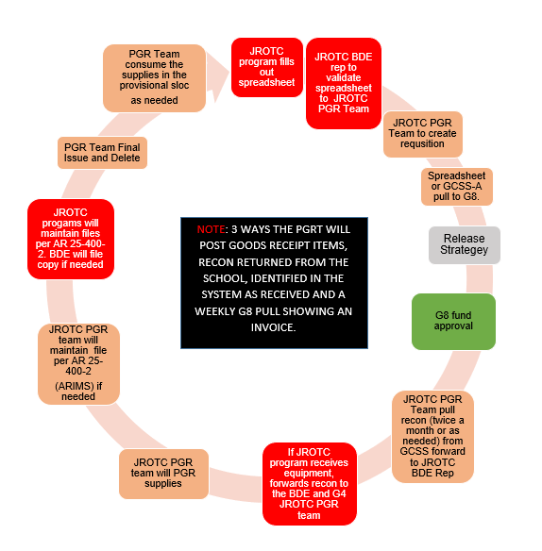
How to Request and Receive Supplies

Slide 13
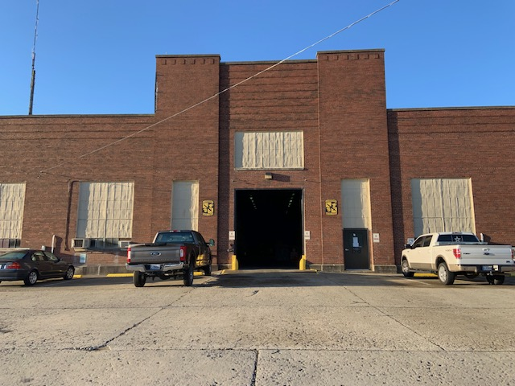
How To Get
Equipment for JROTC Cadets
Who: USACC G4 Warehouse
What: Provides Equipment/uniform items to JROTC Programs
When: As requested by Brigades & JROTC Programs
Where: Warehouse is located at Fort Knox, BLDG# 94
Why: To outfit JROTC Cadet Populations
How: Submit request to G4 via USACC Portal, link:
USACC WAREHOUSE REQUEST SYSTEM (sharepoint-mil.us)
Requirements to draw OCIE from Warehouse
Request submitted via USACC Portal
Primary hand receipt holder appointment memo
Valid DA Form 1687 (Signature Card)
USACC G4 Warehouse Hours of Operation: 0700-1600 Monday-Friday Location: 194 Dixie Street, Building #94, Fort Knox, Kentucky, 40121 (Behind fence line between Barr Library & PX)
Available Items
Gloves Leather work
Cold/Wet Weather Gear
Undershirt / Drawers Cold Weather (Silky, Waffle)
Jacket Cold Weather (Fleece)
Hydration Carriers (No Bladders)
Canteens, Canteen Cups
Pouch, Canteen
Knee / Elbow pads
Mat, Sleeping
Bag, Duffel, Med Rucks / ISO Raider Challenge
Points of Contact
G4 Logistics Division Chief: Woodson Landry
Phone: 502-291-7398
email: woodson.a.landry.civ@army.mil
Warehouse Manager: Jesus Rojo (Jessie)
Phone: 502-624-2316
Email: jesus.l.rojo.civ@army.mil

Slide 14
Acquisition & Property Accountability Guidance (1 of 2)
USACC OPORD 23-01-020:
Discrepancies regarding property accountability within JROTC Programs is a concern of the USACC Commanding General. The USACC CG has directed evaluation of current systems and processes to ensure property accountability throughout USACC
Concept of Operations:
Approved Delivery/Distribution List:
Completed by Requiring Activity (RA)
Signed by JROTC Deputy Director, Brigade XO or DBO
DD Form 250 Template:
Generated by G4 Analyst
Included with shipping and tracking notification (via email)
Distributed to all stakeholders
JROTC PHRH Responsibility:
Inventory items
Complete and sign block 22 of DD Form 250
Submit DD Form 250 to JROTC PBO Group Mailbox
Accomplish receipt process within 7 calendar days

Slide 15
Acquisition & Property Accountability Guidance (2 of 2)
The Delinquent List:
Purpose:
Encourage timely submission of transactions
Enforce Property Accountability
Reporting:
Published every Friday by G4
Captures Incomplete Inventory Packets/DD Form 200 (FLIPL)
Missing DD Form 250s for Unaccounted for Contract Items
Temporarily Suspends:
Requests for clothing (G4 Warehouse and PGR Team)
Requests for services/supplies procured through acquisitions
Suspension is removed once a program reconciles delinquencies

Slide 16
How to Submit DD Form 250 (1 of 2)
Step 1: Complete a physical inventory of items
Step 2: Complete DD Form 250 and sign in block 22
Step 3: Submit DD Form 250 to your JROTC PBO group mailbox
Before submission see formatting instructions below. In the Subject Line of
your email enter the following format:
JROTC Program Name_HS_Type of Equipment
Examples: Ft.Knox HS_Robotics
Ft.Knox HS_Drone Simulation
Ft.Knox HS_Podium Pellets
Ft.Knox HS_Archery
Ft.Knox HS_Orion Scoring System
Ft.Knox HS_Air Rifles
Ft.Knox HS_Drill Rifles
Ft.Knox HS_QT2
Ft.Knox HS_Classroom LCR
Ft.Knox HS_Computer LCR
Ft.Knox HS_Microsoft Surface Pros

Slide 17
How to Submit DD Form 250 (2 of 2)
Step 4: Once Subject Line is formatted, attach DD Form 250 to email and submit to your respective Brigade JROTC PBO group mailbox:
2BDEJROTCPBO@army.mil
3BDEJROTCPBO@army.mil
4BDEJROTCPBO@army.mil
5BDEJROTCPBO@army.mil
6BDEJROTCPBO@army.mil
7BDEJROTCPBO@army.mil
8BDEJROTCPBO@army.mil
Step 5: Once submission is received, the document is validated by the PBO team. If the document is valid, it is posted to accounting records and a copy is provided to you. If it is not valid, the JROTC PHRH will be notified via email of the necessary corrections.

Slide 18
Financial Liability Investigation of Property Loss (FLIPL) – DD Form 200
Initiate FLIPL within 15 days of loss, damage, or destruction to government property:
After 15 days, a letter of lateness is required
Total processing time 75 days days!
Details in Block 9 of the DD Form 200
- Capture as much information as possible
Work Closely with your JROTC PBO Team Chief/Brigade Supply Tech
Refer to Chapter 13, AR 735-5 Property Accountability Policies
Utilize FLIPL’s as a property accountability tool

Slide 19
JROTC PBO - Point of Contacts
JROTC Property Book Officer, kimberly.a.canela.civ@army.mil / 502-624-6333
Program Manager, nathaniel.l.morgan.ctr@army.mil / 502-624-6252
JROTC Senior Supply Tech, donna.l.williams@army.mil / 502-624-7027
6th BDE Team:
Rickie Allen- 502-624-0177
Email: rickie.j.allen.ctr@army.mil
Brenda Acevedo
Email: brenda.i.acevedo.ctr@army.mil
7th BDE Team:
Ronald Brightman – 502-624-7659 Email: ronald.j.brightman.ctr@army.mil Markevis Clark – 502-624-765
Email: markevis.clark.ctr@army.mil
8th BDE Team:
Taneshia Williams – 502-624-4941
Email: taneshia.n.williams2.ctr@army.mil
Yacxiris Lopez – 502-624-4941
Email: yacxiris.e.lopez.ctr@army.mil
2nd BDE Team: Kelly Jones – 502-624-7612 Email: kelly.m.jones91.ctr@army.mil
Bryan Hackley – 502 624-1165
Email: bryan.j.hackley.ctr@army.mil
3rd BDE Team:
Lenneris Jones – 502-624-4255
Email: lenneris.w.jones.ctr@army.mil
Tyrone Smith – 502-624-2821
Email: tyrone.l.smith56.ctr@army.mil
4th BDE Team: Jennifer Coates – 502-624-6262
Email: jennifer.l.coates2.ctr@army.mil
Cameron Doss – 502-624-4075 Email: cameron.j.doss3.ctr@army.mil
5th BDE Team:
Phone: 502-624-7133
Email: Vacant
Martin Brost - 502-624-7471
Email: martin.a.brost.ctr@army.mil

Slide 20
JROTC PGR - Point of Contacts
JROTC PGR Lead, audie.b.proffitt.civ@army.mil / 502-624-0672
Program Manager, nathaniel.l.morgan.ctr@army.mil / 502-624-6252
2nd BDE Team: Steven Boykin – 502-624-0642 Email: steven.r.boykin.ctr@army.mil
3rd BDE Team:
Michael Wright – 502-624-0765
Email: michael.l.wright281.ctr@army.mil
4th BDE Team: Cameron Maley – 502-624-0242
Email: cameron.j.maley.ctr@army.mil
5th BDE Team:
Beatrice Whelan - 502-624-1317
Email: beatrice.m.whelan.ctr@army.mil
6th BDE Team:
Karen Humphrey - 502-624-0572
Email: karen.e.humphrey3.ctr@army.mil
7th BDE Team:
Beatrice Whelan - 502-624-1317
Email: beatrice.m.whelan.ctr@army.mil
8th BDE Team:
Cameron Maley – 502-624-0242
Email: cameron.j.maley.ctr@army.mil

Slide 21

Questions
Property Accountability begins with all of you!

