Slide 1


JSOCC Basic Certification Course Documents
https://www.usarmyjrotc.com/jsocc-basic-course/

Slide 2
Classroom Management
Focusing:
Think about what “Classroom Management” means:
  Preventative
  Supportive
  Corrective

Slide 3
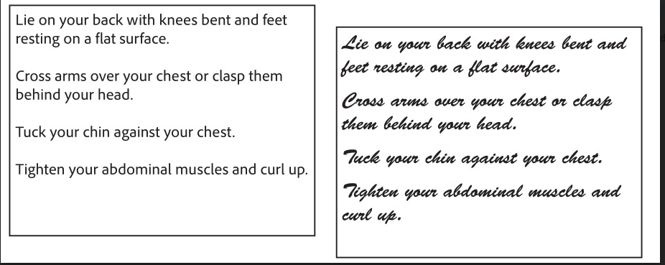
Notes:
This is an example of student perception of difficulty:
– Students will assume the cursive passage is more difficult b/c it is moderately harder to assimilate.
– However, research has shown that the effort needed to read the cursive passage does lead to better student retention.
See the hidden slide that follows this one.

Slide 4
Song, (2009), people were given lists of tasks. The only difference between the two lists was the font used, one of which was easier to read. Participants were asked to rate how easy or difficult they thought the task would be to perform.
Tasks presented in the easier-to-read font were rated by the participants as being easier to perform. The group given the same list in a hard-to-read font rated those tasks as being harder to perform.
This is just one example of a fairly subtle way of influencing a learner’s motivation, and paradoxically, some research suggests that things read in a harder-to-read font may be easier to remember.

Slide 5
Classroom Management
Learning Objectives:
Describe concepts of preventative, supportive, and corrective discipline
Dramatize how poor classroom management can affect learning
Essential Question:
What are your opinions about the following prompt: Classroom Management or Discipline?

Slide 6
Classroom Management
Establish Classroom rules
Establish Classroom expectation
Mission of JROTC
Cadet Creed / Class Motto
Learning Management System (grading, seating chart etc.)
Punishment vs Discipline

Slide 7
Source - Building Classroom Management: Methods and Models, 12Ed
Due Diligence
  Instructors are required by law to keep a ‘reasonable attention’ on their Cadets
    You must follow established school policies and conduct yourself as a ‘reasonable and prudent professional’
Negligence
  Failure to maintain a prudent watch over your Cadets – therefore a failure to comply with the legal obligations
    In the case of a Cadet coming to harm the Instructor and school may be held legally liable

Slide 8


Slide 9
Classroom Management
Learning Objectives:
Describe concepts of preventative, supportive, and corrective discipline
Dramatize how poor classroom management can affect learning
Essential Question:
What are your opinions about the following prompt: Classroom Management or Discipline?

Slide 10
Source - Building Classroom Management: Methods and Models, 12Ed.
Classroom Management
  Instructor’s Role
    Classroom Discipline Versus Classroom Management
      Discussion Starter:
        Classroom Discipline, two tactics:
          Instructors would tell Cadets what to do and what not to do
          Instructors would punish Cadets who failed to comply with those directives
        Classroom Management
          Purpose
          Requirements
          Approaches
          Expectations

Slide 11
Source - Building Classroom Management: Methods and Models, 12Ed
Realities of Classroom Management
  Cadets will misbehave, the frequency and severity can be determined by classroom management styles
  Successful instruction is determined by the promotion of responsible classroom behavior
  Upholding the standard of responsible classroom behavior is the greatest challenge in education
  Cadets who develop responsible behavior will have an advantage going ahead
  Many Cadets NEED to be taught how to behave responsibly

Slide 12
Source - Building Classroom Management: Methods and Models, 12Ed
Main Objectives
  Safe learning environment
  Promote civil and responsible behavior
  Cadet development of self-motivation and self-control

Slide 13
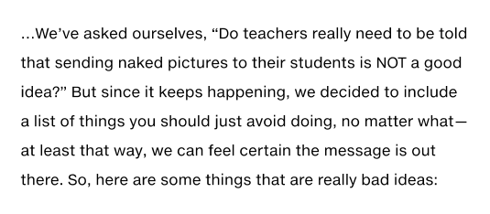
Educator – Don’t Ever Do this List!

Slide 14
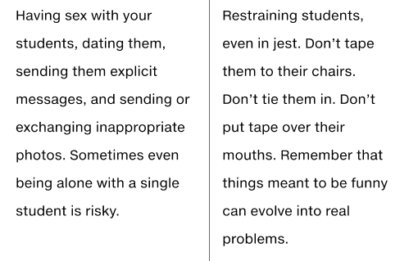

Slide 15
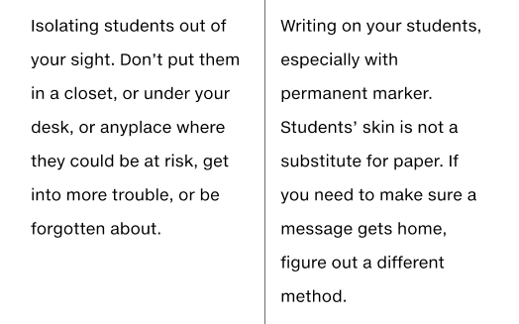

Slide 16
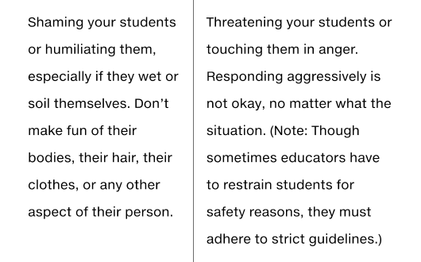

Slide 17
Source - Building Classroom Management: Methods and Models, 12Ed
Cadet Diversity
  Criteria:
    Get to know your learners
    Demonstrate acceptance for Cadets / Cadet Families
    Assist students in developing resilience
    Emphasis knowledge, skills, and values
    Communicate your conviction to their success
    Provide mentoring and guidance
    Establish standards for behavior
    Demonstrate and relate the concept of situational awareness

Slide 18
Source - Building Classroom Management: Methods and Models, 12Ed
Classroom Management: Concepts and Terms
  Procedures
  Behavior
  Appropriate / Acceptable / Responsible Behavior
  Limits
  Misbehavior
  Positive Influence

Slide 19
Classroom Management
Learning Objectives:
Describe concepts of preventative, supportive, and corrective discipline
Dramatize how poor classroom management can affect learning
Essential Question:
What are your opinions about the following prompt: Classroom Management or Discipline?

Slide 20
JSOCC Basic Certification Course Documents
https://www.usarmyjrotc.com/jsocc-basic-course/

