Slide 1
CMv3 Setup
CMv3 Setup Overview
How to Download CMv3 from SMART Cadet
Download the User Guide
Create an account

Slide 2
Curriculum Plan
Create Curriculum Plan (LET 1)
Create Class Period
Assign curriculum plan
Create Cadet
Under Manage Master Roster
Add Cadet to class period

Slide 3
CMv3 SY/Period/Reports
CMv3 Overview Cont.
Create:
Curriculum Plan
Save/Print Report
School Year
Master Roster / JUMS Import
Class / Period

Slide 4
Cmv3 Lesson Customization
Cmv3 Lesson Customization
Refer to Capstone Rubric
Customize Lessons
Add Slides
Add Text
Add Hyperlink
Add Video

Slide 5
CMv3 Assessments
Create Assessment
Refer to Capstone Rubric
Create a 3-question assessment for your capstone

Slide 6

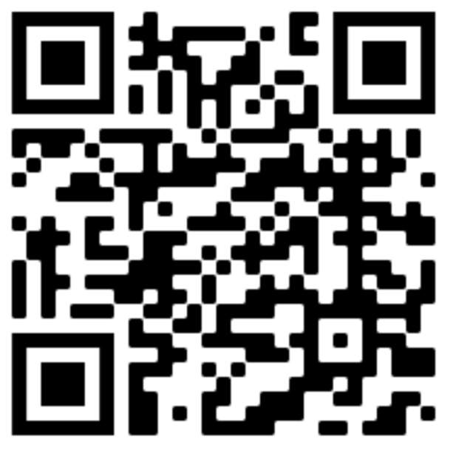
JSOCC Basic Certification Course Documents
https://www.usarmyjrotc.com/jsocc-basic-course/

