Slide 1
Teaching Methods
Learning Objectives:
Demonstrate how traditional instruction and student-centered instruction can be used in conjunction.
Identify your planning/preparation strengths and weaknesses. Give 2 strengths and weaknesses.
Essential Question:
How can traditional instruction and student-centered instruction be used in conjunction?
Notes:
How did you learn?

Slide 2
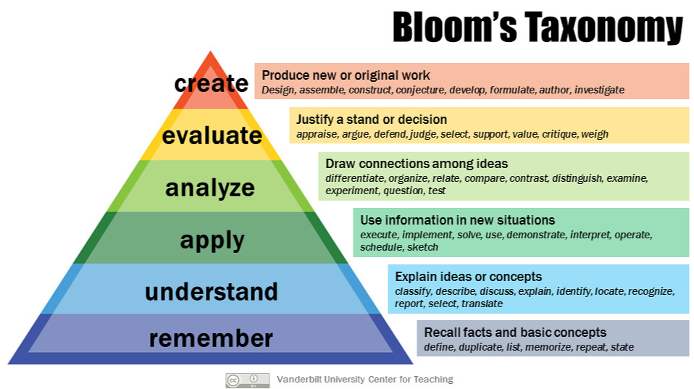

Slide 3
Teaching Methods Table Brief Assignments
Table 1 – Traditional
Table 2 – Student-Centered (Constructivist)
Table 3 – Project-Based Learning (PBL)
Table 4 – Inquiry-Based Learning
Table 5 – Flipped Classroom
Table 6 – Cooperative Learning
Table 7 – Story Design

Slide 4
Teaching Methods Table Briefs
Each Table group is assigned a teaching method
Using the handout provided and additional research and discussion, each table will create a brief - No PowerPoints
Each table will back brief a 5-minute overview of your assigned topic including:
1-2 minutes summary of topic
1-2 minutes pro and cons – your opinions and experiences
1-minute conclusion - recommendations
Notes:
Their conclusion/recommendation for their assigned teaching method

Slide 5
Teaching Methods
Types:
Teacher-Centered
Traditional
Instructor is the center of activity and directs all learning experiences
Instructor explains concepts combining:
Direct Instruction
Questioning Techniques
Whole Class Discussion
Video Example how not too: https://www.youtube.com/watch?v=uhiCFdWeQfA
How to conduct Instructor-Centered learning
Planning/Preparation:
Identify your Strengths and weaknesses
Design (or use/revise questions from CMv3 Curriculum) questions, based on Blooms Taxonomy, that target different levels of understanding
Game plan for the whole class discussion
Video Example how too: https://www.youtube.com/watch?v=Q9aolA-sPZw

Slide 6
Teaching Methods
Types:
Student-Centered / Constructivist Approach
Focus on Cadet – Cadets have a more active role in the learning experiences of the classroom
Changing Cadet role from passive to active
Management - Instructor must create a create and reinforce the standards (Instilling a sense of responsibility, etc.)
Model – Instructors must exhibit / recognize in Cadets the quality of self-motivation
Works well in tandem with Teacher-centered approach laying the groundwork and setting the classroom expectations
The Instructor focus is on:
Student involvement
Helping to Cadets to see the relevance of their learning
Encouraging Cadets to apply what they have learned
Vigilant Facilitator

Slide 7
Teaching Methods
Types:
Project-Based Learning (PBL)
Cadets complete projects – think Service Learning Project – that demand a high-level of Cadet participation
All tasks are supervised by the Instructor
The Instructor may need to provide additional supports to facilitate skill building in Cadets – with the purpose of supporting the overall mission (project)
From PBL Cadets can acquire
Knowledge
Research experience
Critical thinking skills
Evaluate
Analyze
Decision-making
Collaboration opportunities
Skill builder as well as résumé builder
Video Example: Good Teamwork https://www.youtube.com/watch?v=VHGxgfHNjwA

Slide 8
Teaching Methods
Types:
Inquiry-Based (Question driven) Learning
The Instructor poses a ‘compelling’ question and uses it to guide the Cadets through learning experiences that see them develop and refine critical thinking and problem solving skills
Students are free to pursue avenues of thought and research to formulate their answers for the compelling question or questions they were assigned
Active participation is expected of Cadets and Instructors, who facilitate, alike.
The selection of topics is usually chosen by the Instructor but Cadets be given this responsibility over time
Inquiry-Based Learning Example (Planning Document): https://docs.google.com/document/d/1YNZvh202be1w9X96Ol8f8WkPQUgcjjvHtAZvduBrb1w/edit?usp=sharing

Slide 9
Teaching Methods
Types:
Flipped Classroom
FLIP acronym:
Flexible Environment
Learning Culture Shift
Intentional Content
Professional Educator
Homework changes from a review of what was just taught to preparation for the next class meeting
Extremely structured in nature
Cadet can view the learning experience (Lecture, videos, slides, etc.) prior to the class meeting – and then practice what they learned in-class with their peers and under Instructor supervision
From a Bloom’s perspective, a flipped approach has the lower orders of learning take place outside of the classroom, while the higher levels occur during the in-class session
In essence, ‘flipping’ has Cadets perform the simpler tasks outside the class and the more complex ones with assistance readily available
Video Description of Flipped Classroom: https://www.youtube.com/watch?v=iQWvc6qhTds

Slide 10
Teaching Methods
Types:
Cooperative Learning
Group work becomes the norm
Requires high level structuring of learning experiences
Group types:
Groupings base on similarities
Groupings based on differences
Criteria
Deliberate or Random
Performance levels
Student safety (Winning Colors
Instructor must (vigilant) be standing by to intervene to keep the learning process on task
Video description of Cooperative Learning: https://www.youtube.com/watch?v=cnkKHL_dyGE

Slide 11
Teaching Methods – Back Briefs
Instructor groups research and create their briefings
Use the materials provided and/or additional research to create a briefing based in their assigned topic(s).
Teacher-Centered
Student-Centered / Constructivist Approach
Project-Based Learning (PBL)
Inquiry-Based (Question driven) Learning
Flipped Classroom
Cooperative Learning
Instructors teams will back brief their class for approximately 10 minutes per group

Slide 12
Teaching Methods
Learning Objectives:
Demonstrate how traditional instruction and student-centered instruction can be used in conjunction.
Identify your planning/preparation strengths and weaknesses. Give 2 strengths and weaknesses.
Essential Question:
How can traditional instruction and student-centered instruction be used in conjunction?

