Slide 1

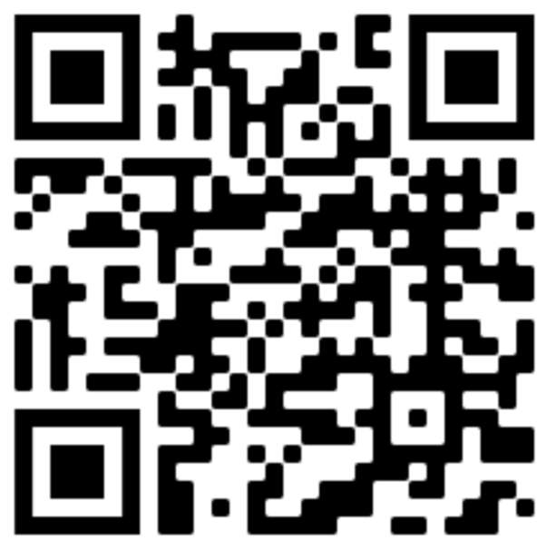
JSOCC Basic Certification Course Documents
https://www.usarmyjrotc.com/jsocc-basic-course/

Slide 2
E.I. and Conover Online
DO NOW Activity
Place your phones on vibrate
Log in to Your Conover Account
http://ajrotc.conovercompany.com/

Slide 3
E.I. and Conover Online
Learning Objectives:
Familiarize you with Conover Online and Will Interactive programs to facilitate Cadets’ emotional intelligence and social interactions in their class, school, and community in order for them to become better citizens.
Essential Question:
How can you use the program(s) to help Cadets develop a deeper understanding of how their emotions and decisions impact both them and those around them through a classroom lesson?

Slide 4
DO NOW: Login to your Conover Account
To sign up for an account:
https://www.conovercompany.com/support/jrotc-instructor-signup/
WILL Interactive: https://access.willinteractive.com/jrotc-lifeskills

Slide 5
Assign 1 per Table: Define and explain how would a Cadet achieve that within a Year (Novice, Intermediate, Advanced)
Self-Esteem – JSOCC Facilitator
Interpersonal Assertion – 1
Interpersonal Awareness – 1
Empathy – 2
Drive Strength/Motivation – 2
Decision Making – 3
Time Management – 3
Leadership – 4
Commitment Ethic – 4
Stress Management – 5
Physical Wellness – 5
Interpersonal Aggression – 6
Interpersonal Deference – 6
Notes:
Sign into Conover.
Define these key terms using the PSM manual. Describe how a Cadet may meet that definition within a LET Year.

Slide 6
Inside Out - Official Trailer #2 (2015)
  Discussion of clip
    What characteristics did you see in the clip?
Learning Activity

Slide 7
GoGoMo Energizer
Emotional Intelligence

Slide 8
Assign 1 per Instructor: Define and explain how would a Cadet meet that intent while in the Program.
Self-Esteem- LTC Parker
Interpersonal Assertion- CSM Stickler
Interpersonal Awareness- 1SG Ruiz
Empathy- MAJ Small
Drive Strength/Motivation- SFC Ortega
Decision Making- MAJ Oliver
Time Management- CSM Bailey
Leadership- LTC Webb
Commitment Ethic- SFC Starke
Stress Management- SFC Paniagua
Physical Wellness- LTC Pendell
Interpersonal Aggression- LTC McGee
Interpersonal Deference- SFC Fontenot
Change Orientation- ____________

Slide 9
E.I. and Conover Online
Learning Objectives:
Familiarize you with Conover Online and Will Interactive programs to facilitate Cadets’ emotional intelligence and social interactions in their class, school, and community in order for them to become better citizens.
Essential Question:
How can you use the program(s) to help Cadets develop a deeper understanding of how their emotions and decisions impact both them and those around them through a classroom lesson?

Slide 10
Energizer: How many (Instructors) have given the Winning Colors Lesson?
  What is the purpose of the Lesson? Pull open CDT Notebook (LET 1) and turn to pages 23-24.

Slide 11
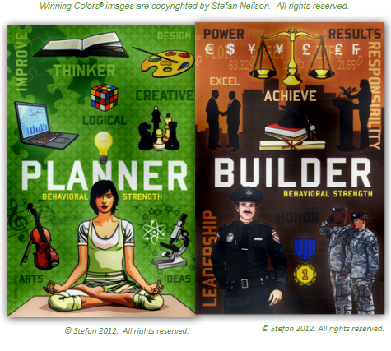
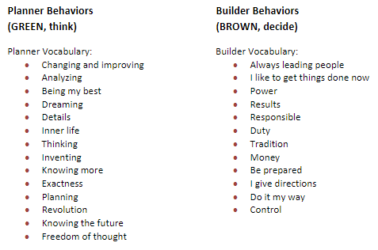

Slide 12
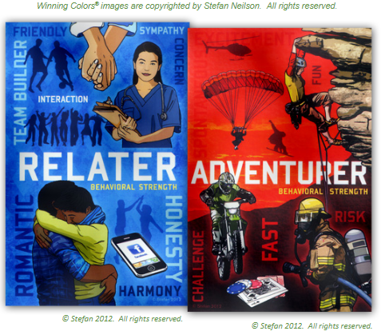
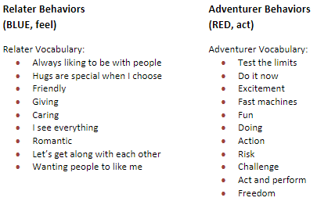

Slide 13
Take an index card and write down (Cold Call)
  What words describe you?
  What is your Winning Color?

Slide 14
What is Emotional Intelligence? (Scan, Cold Call)
Daniel Goldman’s five characteristics:
-Self-Awareness – Discussion
-Self-Regulation – Discussion
-Motivation – “ “
-Empathy – “ “
-Social Skills – “ “
https://access.willinteractive.com/jrotc-lifeskills

Slide 15
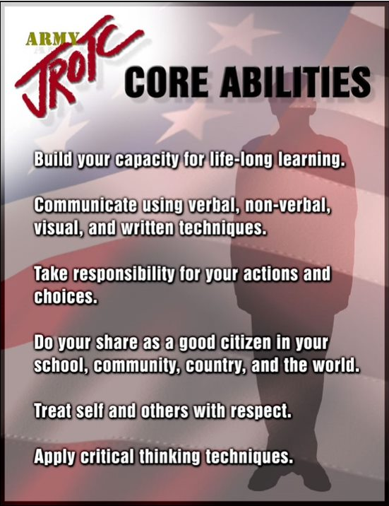
Why is this important to our Mission?
  What Core ability does this correlate to?
-Take responsibility for your actions and choices
-Treat self and others with respect

Slide 16
Conover Online
“I do”
Notes:
Orient to the page

Slide 17
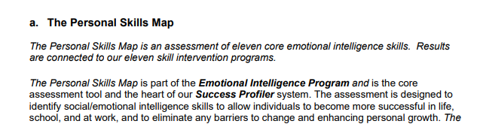
Personal Skill Map

Slide 18
Tool provided for you to develop Cadet’s Social and Emotional awareness is Conover Online.
Pull out exercise sheets
Facilitator – Demonstrate where to find:
  How to enroll a single Cadet, Batch import a roster, and create an account
  How to assign / print PSM
  How to assign / print Winning Colors
  Locate Skill Enhancements and be prepared to explain what each means.
  Review the JROTC Life Skills video. Provide feedback on how you can integrate this into your SEL program
  Instructors Back Brief their assigned EI topics
Notes:
(Why is this important? Who has given this before?)

Slide 19
JSOCC Basic Certification Course Documents
https://www.usarmyjrotc.com/jsocc-basic-course/

