Slide 1
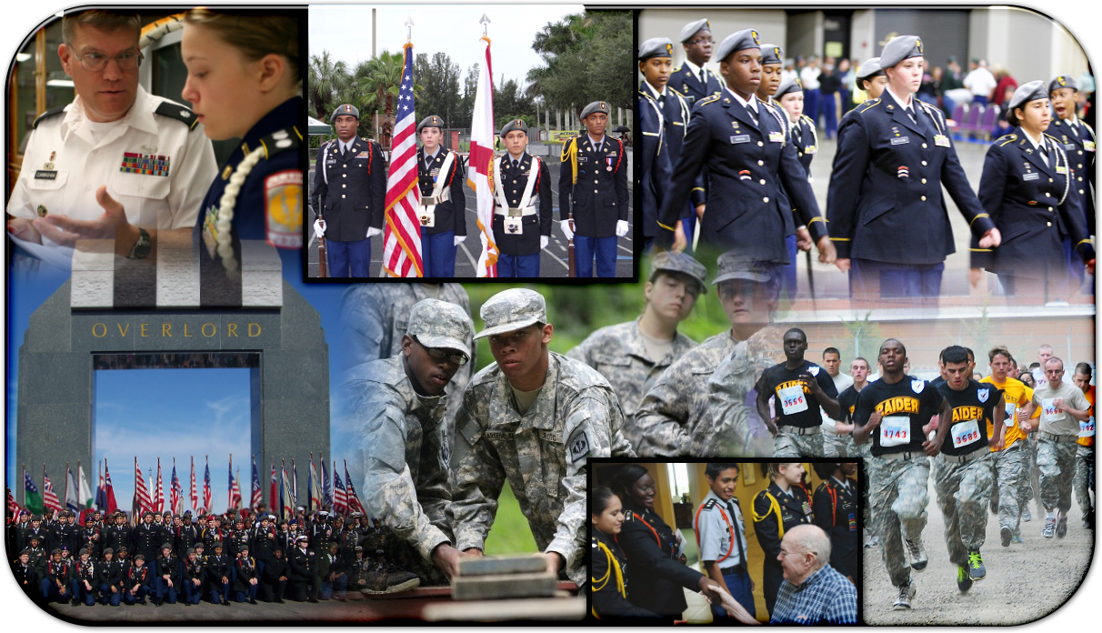

Instructor Training Course Basic Certification
Phase II
“Motivating Young People to be Better Citizens”
Notes:
First level (Arial 26)
Second level (Arial 24)
Third level (Arial 20)
Fourth level (Arial 18)
Formatting
Slide is set to automatically format. Use this slide as your starting point.
Do not go below fourth level bullet
Paragraph spacing is set at “before 6pt”
Use the designated bullet style for each level
Paragraphs are formatted with hanging indents
Additional layouts available under “Slides” “Layout” or “New Slide” in the tool bar

Slide 2
JSOCC
COL Kenneth Jones – Director
Leon McMullen – Deputy Director
Dr. Joseph Cross – Chief Education
Jim Wood – Chief Training and Operations
Tina Proctor– Chief Instructor Management
Adam Palm – Course Facilitator
John Quinene – Course Facilitator
Vena Newton – Curriculum Management System
Jessy Winkelman – JUMS Facilitator

Slide 3
JSOCC
Mission
To provide JROTC DAIs/SAIs/AIs and DoD Civilian Personnel with the knowledge, skills and techniques to execute JROTC Programs to develop and improve their classroom management, emotional intelligence, and teaching methods.

Slide 4
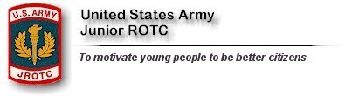
Training Goal
To provide quality training that allows Instructors to model and practice strategies and techniques in a simulated classroom environment

Slide 5
Certification
JSOCC training is intended to provide DAIs/SAIs/AIs and Civilian Personnel with improved skills to execute JROTC through a 5-Step training process:
JSOCC Distance Learning (Pearson MyLab 1x)
Annual Ethics online Training
Instructor Training Course (Basic PHI/II and Advanced Re-Cert)
Annual Training Workshops
Annual Train-the-Trainer

Slide 6

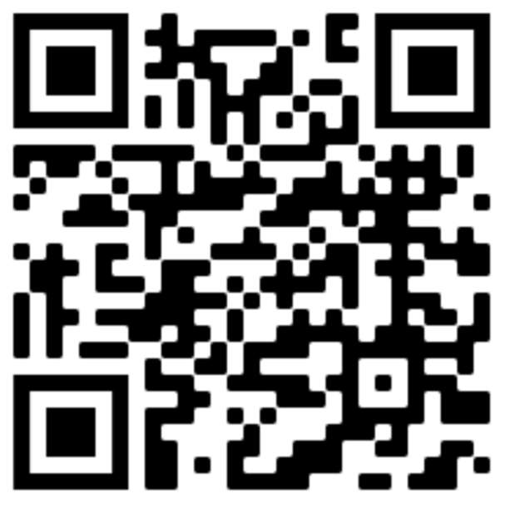
JSOCC Course Documents

