Slide 1
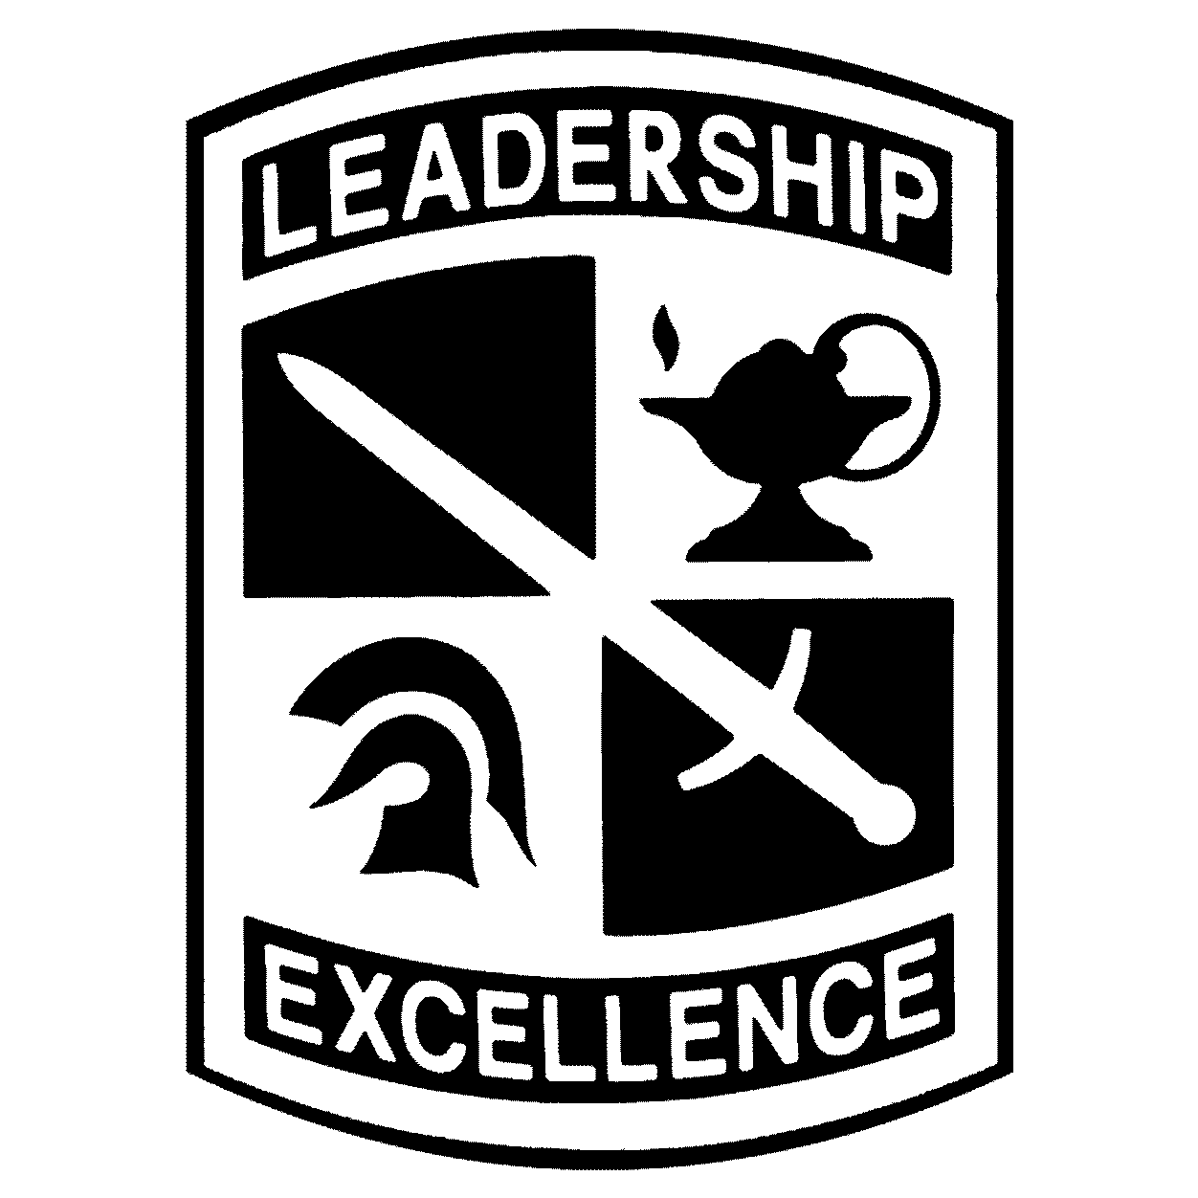
Scholarship Application Process
Create App
Pick Schools
Documents
Interview
Selections
Text SCHOLARSHIP to GOARMY
Create your online profile using an email address you can access until you start college.
You can list up to seven different colleges. Picking these will help ROTC cadre know you’re interested in that school.
Upload all required documents. Transcripts, SAT and/or ACT, Resume, and anything else you want us to know.
You will interview with a PMS at a college. Don’t wait until the last minute to schedule. This is one of the key parts of the entire process.
Scholarship announcements are generally released 2-3 weeks after each board. Check the Selection Status tab to see if you’ve earned a scholarship.
1
STATE
2
TECH
3
U
JROTC
Complete Tabs
Activities
PFA
Boards
Army ROTC
The information provided will help us contact and work with you throughout the application process. All tabs are required. Finish them all before the Board.
Take time to think hard about your extracurricular activities in high school. Do your best to ensure what’s on your resume is reflected here.
The PFA or Physical Fitness Assessment is a measure of your overall fitness. One minute of push-ups, crunches, and a one-mile run. Do your best!
There are three boards during the year – OCT, JAN, MAR. Send your most complete and competitive packet to the board.
It’s not over if you don’t earn a scholarship now. About half of scholarships are awarded in college. Talk to your ROO about this option and other ROTC opportunities.

Slide 2
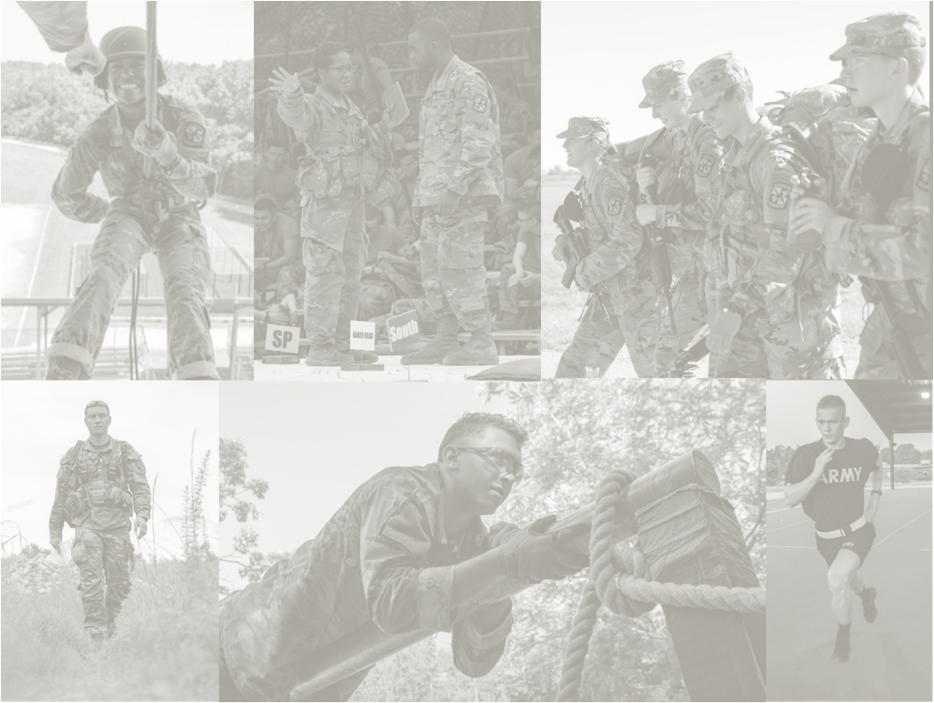
Army ROTC Opportunities
Army ROTC scholarships pay full tuition, a $420 monthly education stipend, and $1200 annually for books and supplies. These benefits will go a long way to helping you worry less about paying for college and focus more time on your studies. Scholarships are available as a high school senior or once you arrive on one of the 800 college campus with ROTC.
As with most jobs, your salary depends on your experience and increases as you advance in rank. An Active Duty 2LT will start around $60k that includes base salary and a food and housing allowance. This will increase as you gain experience where you can earn around $115k after ten years. As a commitment to the well-being of every Soldier, the Army provides high-quality comprehensive health care coverage and life insurance.
Whether you want to go onto Active Duty with worldwide travel and assignment opportunities or commission into the Army National Guard or Army Reserves and stay close to home, Army ROTC can put you onto an unapparelled path to expand your leadership skills and overall competitiveness in the constantly expanding global economy.
Army ROTC Scholarships
& Training
Highly coveted civilian skills
Competitive
Salary &
Benefits
Continuing
Education
Flexible
Service
Options
The training you receive in Army ROTC will hone your leadership skills and help you prepare for one of over 50 career fields and specialties where you will gain unapparelled experience with access to global travel and assignment opportunities. These fields include Infantry, Cyber and Information Technology, Human Resources, Law Enforcement, Aviation, Nursing, Finance, Engineering, Logistics and Transportation Management. Opportunities exist to serve full-time on Active Duty or part-time in the Army Reserve or National Guard.
Training and education are very important in the Army. After completing your Basic Officer Leaders Course, Officers continue to return to the schoolhouse throughout their careers to expand their education and expertise. If you’re interested in continuing your civilian education, the Army not only offers programs to help you earn your Master’s degree while you serve, but also helps pay for tuition costs through tuition assistance programs. The Army also has programs that let you train with industry leaders throughout the country.
Salary benefit is based on 2LT (O-1) pay and allowances at the Fort Bragg, NC locality. The $115k salary is based on MAJ (O-4) at 10+ years at Fort Bragg, NC.

