Slide 1
Free JROTC Courses
Mathematics, Science and research lessons

Slide 2
Free Mathematics courses
Math Planet
Pre Algebra
Algebra 1
Algebra 2
Geometry
SAT
ACT
Math Planet is an online resource where one can study math for free. Take our high school math courses in Pre-algebra, Algebra 1, Algebra 2 and Geometry. We have also prepared practice tests for the SAT and ACT.
The educational material is focused on US high school maths. However, since maths is the same all over the world, we welcome everybody to study math with us, for free.

Slide 3
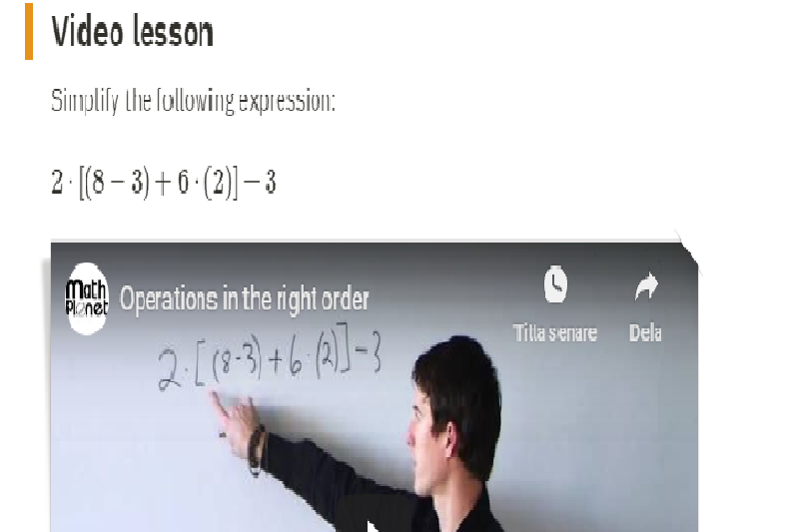
Math Planet
Every lesson includes a video to help work through the problems

Slide 4
Free mathematics courses
Kahn Academy
https://www.khanacademy.org/about
Khan Academy offers practice exercises, instructional videos, and a personalized learning dashboard that empower learners to study at their own pace in and outside of the classroom. We tackle math, science, computing, history, art history, economics, and more, including K-14 and test preparation (SAT, Praxis, LSAT) content. We focus on skill mastery to help learners establish strong foundations, so there's no limit to what they can learn next!

Slide 5
Free mathematics courses
EdX
Take free online math courses from MIT, ASU, and other leading math and science institutions. Get introductions to algebra, geometry, trigonometry, precalculus and calculus or get help with current math coursework and AP exam preparation. Select a course to learn more
https://www.edx.org/course/subject/math

Slide 6
Free Science courses
Kahn Academy
Courses
Math
Math: Get ready courses
Math by grade
Khan Kids, an app (ages 2-7)
Science & engineering
Computing
Arts & humanities
Economics & finance
Test prep
College, careers, & more
ELA beta
https://www.khanacademy.org/science

Slide 7
Free science courses
Life in the Nerddom
Free science curriculum from PreK- Highschool grades
Open and free curriculum for:
Anatomy & Physiology 1, 2
General Chemistry
Introduction to Biology
https://lifeinthenerddom.com/free-science-curriculum-all-grades/

Slide 8
Life in the nerdom: Overview
Anatomy & Physiology 1 & 2
Course Description: You probably have a general understanding of how your body works. But do you fully comprehend how all of the intricate functions and systems of the human body work together to keep you healthy? This course will provide that insight. By approaching the study of the body in an organized way, you will be able to connect what you learn about anatomy and physiology to what you already know about your own body.
General Chemistry 1
Course Description: General Chemistry 1 covers all of the topics typically covered in first semester General Chemistry and includes both formative assessments, with high scaffolding, and end of unit and module quizzes. This course offers highly contextualized, engaging content, designed in a logical flow that transitions smoothly between relatively small amounts of expository text, worked examples, activities, interactives, simulations, and other media.
Introduction to Biology
Course Description: This introductory course defines biology and its relationship to other sciences. We examine the overarching theories of life from biological research and also explore the fundamental concepts and principles of the study of living organisms and their interaction with the environment. We will examine how life is organized into hierarchical levels; how living organisms use and produce energy; how life grows, develops, and reproduces; how life responds to the environment to maintain internal stability; and how life evolves and adapts to the environment.

Slide 9
Free science courses
EdX
https://www.edx.org/high-school
We offer specially designed courses from top high schools, secondary schools and universities to help you prepare for Advanced Placement (AP®) Exams and CLEP® Exams, as well as introductory-level courses to help you get ahead of the game.
Covering subjects ranging from English language and composition to calculus, biology, statistics and computer science, our courses give students around the world the opportunity to access quality courses and materials regardless of financial resources. Teachers can also integrate the course materials to flip the classroom and augment their curriculum.

Slide 10
Edx Science course options
Biology | Biotechnology | Climate Change | Genetics | Health & Wellness | Human Anatomy | Healthcare | Life Sciences | Medicine | Microbiology | Molecular Biology | Neuroscience | Physiology | Astronomy | Chemistry | Earth Sciences | Environmental Science | Geology | Nature | Organic Chemistry | Physics | Quantum Physics | Social Science | Sustainable Development

Slide 11
Free science courses
Coursera
Choose from many options including free courses and university degrees at a breakthrough price. Learn at your own pace, 100% online.
Example courses:
Intro to Chemistry
Writing in the Sciences
Philosophy of Science
https://www.coursera.org/?ranMID=40328&ranEAID=TnL5HPStwNw&ranSiteID=TnL5HPStwNw-t34flA.R65lg9Pove8fe0A&siteID=TnL5HPStwNw-t34flA.R65lg9Pove8fe0A&utm_content=10&utm_medium=partners&utm_source=linkshare&utm_campaign=TnL5HPStwNw

Slide 12
Coursera:
Research for transformation
Understanding Research Methods (Course)
The course will appeal to those of you who require an understanding of research approaches and skills, and importantly an ability to deploy them in your studies or in your professional lives. In particular, this course will aid those of you who have to conduct research as part of your postgraduate studies but do not perhaps have access to research methods courses, or for those of you who feel you would like additional support for self-improvement.
https://www.coursera.org/learn/research-methods
Research courses available to High school students
https://www.coursera.org/courses?query=research

Slide 13
Cousera:
Research for impact
In this course, you will learn more about the Research for Impact approach - a set of principles and practices that will help you to make your research more impactful. Traditionally, the goals and outcomes of research projects were to contribute knowledge and communicate this knowledge through academic publications and journal articles. But If we truly want our research to have an impact, we need to do research differently. Research that influences change in policy, practice, behaviour and attitudes.
Free course offered through Coursera
https://www.coursera.org/learn/research-for-impact

Slide 14
Research for impact:
What you will learn
Understand the key interwoven elements of Research for Impact in the context of development and adaptation research.
Identify the suite of activities involved in Research for Impact
Appraise opportunities in your research plan through an Research for Impact lens and identify challenges applying a Research for Impact approach

Slide 15
DOD Smart Scholarship
https://www.smartscholarship.org/smart

Slide 16
25 Free course websites
https://www.lifehack.org/articles/money/25-killer-sites-for-free-online-education.html

